Slide 1


Proactive Public-Private Partnership for the Reset Ghana Agenda
Joseph Awen Awan

Slide 2
“Effective partnerships are not built on convenience, but on trust, accountability, and innovation.”

Slide 3
“a form of contractual arrangement or concession between a contracting authority and a private party for the provision of public infrastructure or public services traditionally provided by the public sector, as a result of which the private party performs part or all of the infrastructure or service delivery functions of Government, and assumes the defined risks over a significant period of time.”

Slide 4
An arrangement between government and the private sector to finance government projects, services, operations up-front.
Usually a long term contractual arrangement
Investor is paid from revenues generated from the project , tax payers /users

Slide 5

In 2020, Parliament Enacted the Public-Private Partnership Act, 2020 (Act 1039)
POLICY DOCUMENT & ENACTMENT
In 2011, MoFEP Developed the National Policy on PPPs to Provide Consistent Processes; Identification, Appraisal, Selection, Procurement, M&E.
(1). Regulate PPP Arrangements
(2). Establish Regulatory Framework.
(3). Evaluate Value for Money
(4). Manage Financial Commitments.
(5). Promote Indigenous Partnership

Slide 6
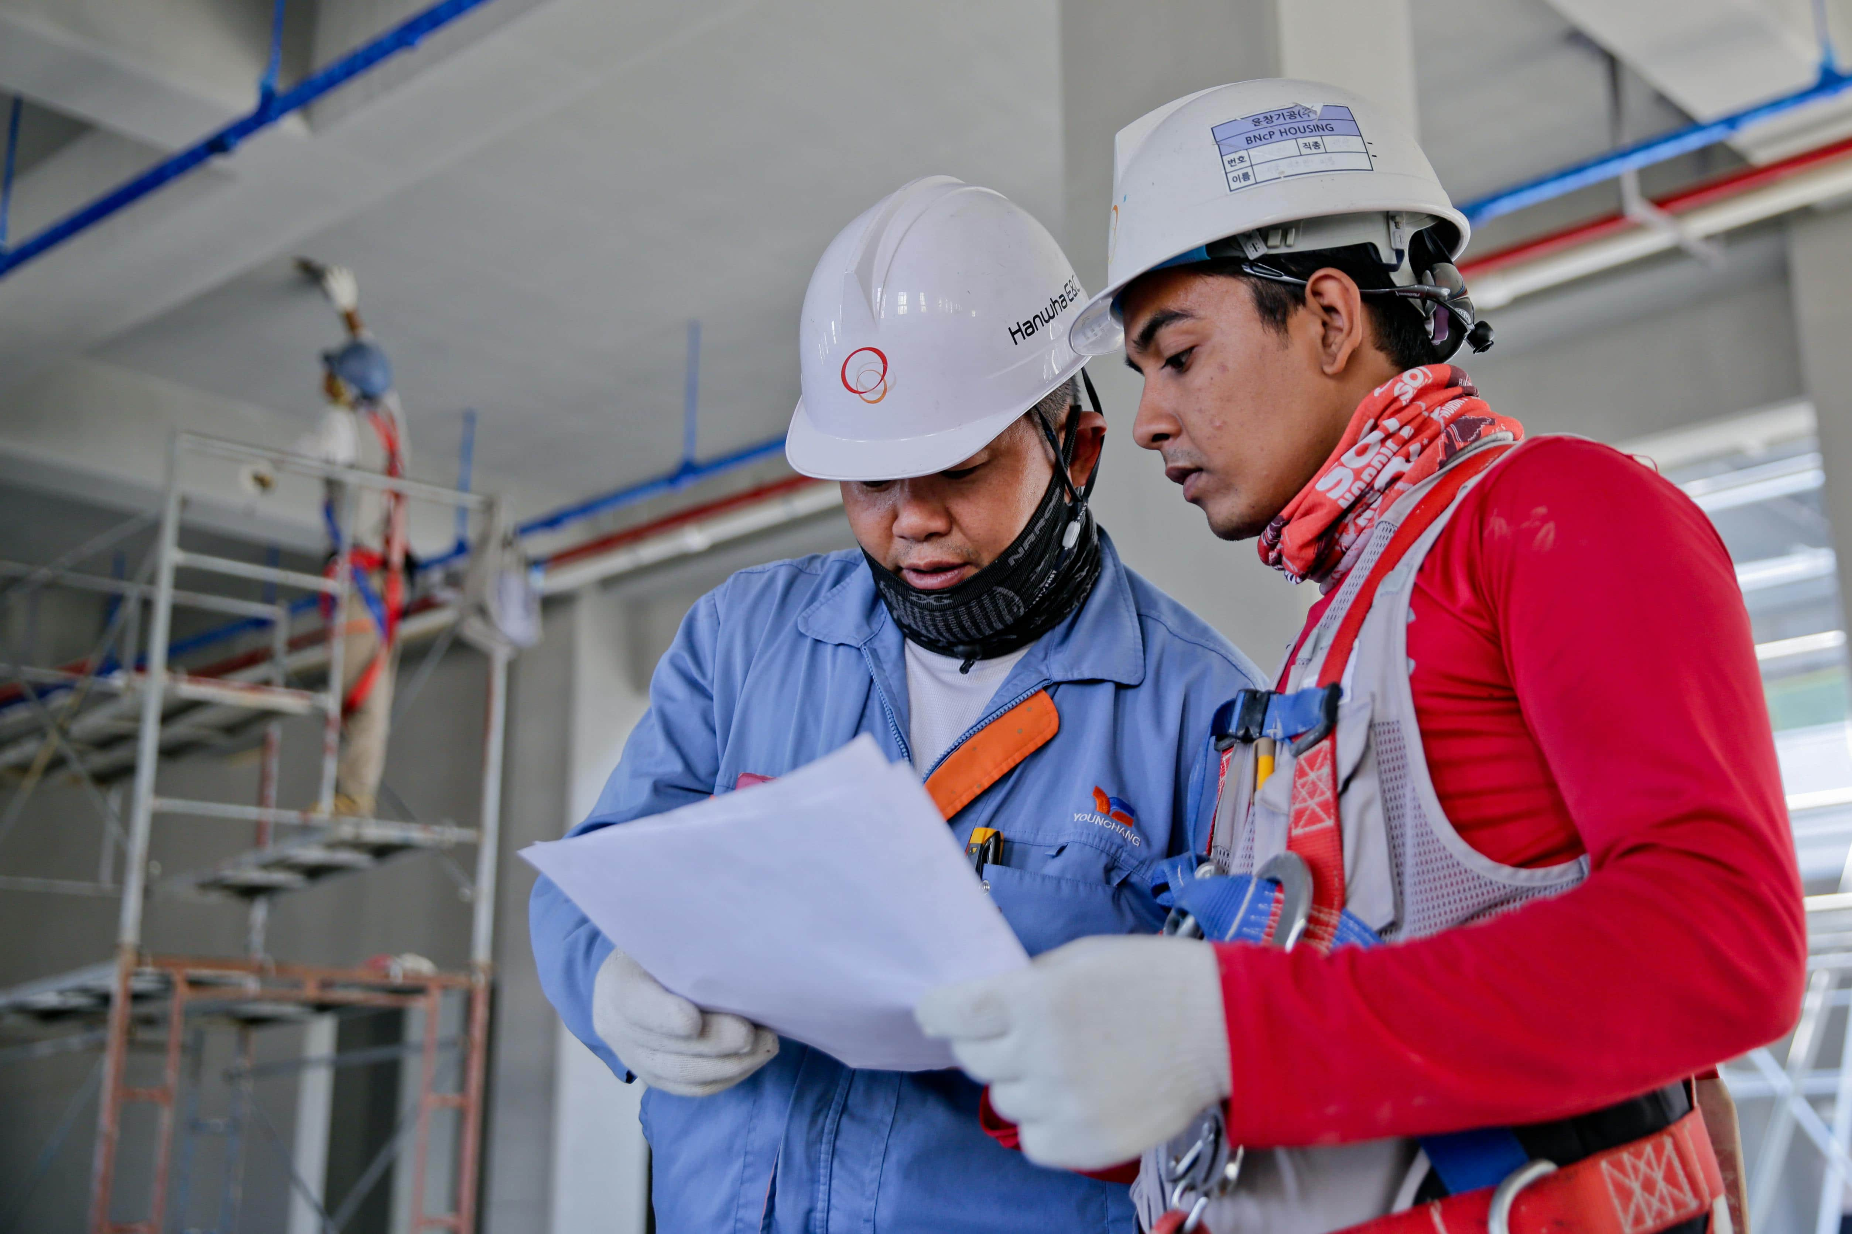
Government's Policy Direction
1.
Create decent jobs through the promotion of public and private partnerships in the Construction and Manufacturing, Agricultural, Forestry and Fisheries.

Slide 7

Government's Policy Direction
2.
Accelerate Inclusive Growth Through The Big Push – US$10 billion investment in infrastructure to create jobs which includes a US$3 billion private-sector led investment in ICT

Slide 8

Government's Policy Direction
3.
Drive Innovation through Science and Technology
Roll out the 5G network and create a strong digital infrastructure to optimize new technologies.

Slide 9

Government's Policy Direction
4.
Strengthen Energy and Resource Resilience
Restore Institutional Trust & Credibility
Revamp Tema Oil Refinery.

Slide 10


Key Projects Under PPPs
27.7Km Accra-Tema Motorway Extension Project
Teshie-Nungua Desalination Project
the National Identification Systems Project,
Takoradi Integrated Container and Multipurpose Terminal,
Tema Terminal 3 Project

Slide 11
Key Projects Under PPPs
Tema LNG Terminal Project
Tema Off-Dock Car Terminal

Slide 12

PPP Possibilities - Energy
Power Purchase Agreements
Renewable Power
LPG Policy Reforms

Slide 13

PPP Possibilities - Transport
Toll Roads
Port Infrastructure
Rail Construction
Transportation by Lake, Sea

Slide 14
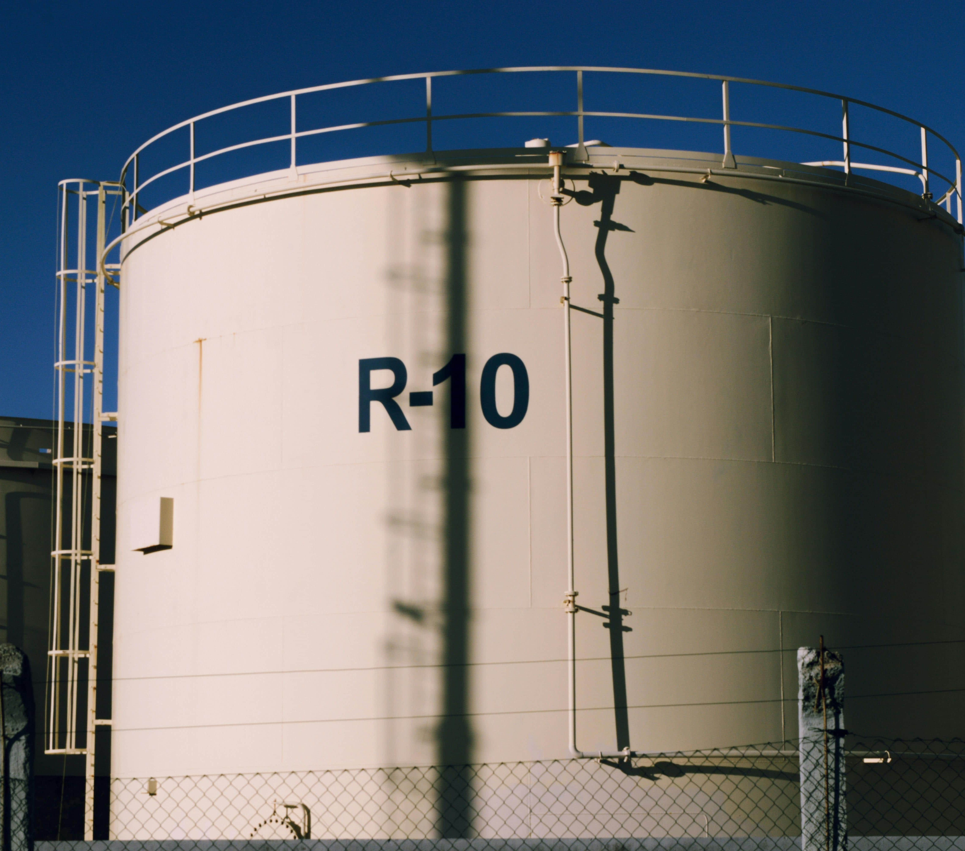
PPP Possibilities– Petroleum Downstream
Private Capital for Refining, Storage, and Distribution.

Slide 15

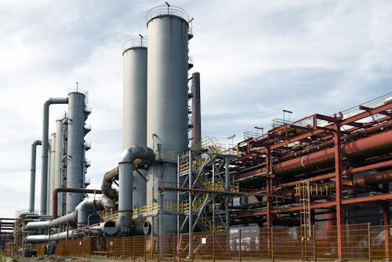


PPP Possibilities – Petroleum Downstream
3 Refineries
10,000,000 m³ Storage Tank
5 Petrochemical Plants
2 Jetties with Multiple Berths

Slide 16

Pre-Investment
The pre-investment phase of the PPP cycle encompasses the identification and selection of projects, developing concept notes or initial business cases, conducting feasibility studies, structuring financial arrangements, and preparing procurement plans and bidding documents.
This phase is crucial for ensuring comprehensive project preparation and assessment to establish project viability and present a strong foundation for successful PPP implementation.

Slide 17

Role of Public Institutions
(Balancing Risk)
Reactive → Private Sector Invited After Problems Emerge
Pillars For Proactive PPPs
Innovation-driven
Fair Risk Sharing Frameworks
Sustainability & Accountability (Aligned with SDGs and the Reset Agenda)

Slide 18

Value For Money
Section 11 of the Public Private Partnership Act, 2020 Provides that:
a contracting authority shall conduct a qualitative and quantitative value for money assessment as part of the feasibility study for the partnership project to guide decision making.

Slide 19
Value For Money
Section 11 of the Public Private Partnership Act, 2020 Provides that:
The contracting authority shall, at each stage of the public private partnership process, conduct assessment to determine value for money and demonstrate that there is greater value for money than the best realistic public sector project designed to achieve similar service outputs

Slide 20
Challenges & Way forward

Slide 21


Challenges
Project Delays
Financial Constraints
Ineffective Project Appraisal
Bureaucratic Delays
Weak Risk Allocation
Lack of Effective M&E to Ensure Project Delivery
Political or Governance Risk

Slide 22

Call to Action (Proactive PPPs)
Identify Infrastructure, Service /Operations Gaps, etc
Invite Proposals for PPPs from Institutions, Private Sector, Think Tanks
Community Engagements

Slide 23
Call to Action (Proactive PPPs)
Incentives to Encourage Private Sector Participation to Guarantee Security
Invite or Engage Interested Parties
Agree on Funding Model

Slide 24
Call to Action (Proactive PPPs)
Involve or Embed Risk Management from Inception to Mitigate Failure or Future Negative Events, Setbacks.
Codesign at Project Inception
Science and Data in Shaping PPS Priorities

Slide 25

Photo Collage

