Slide 1

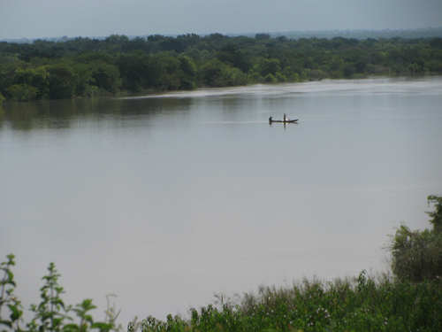
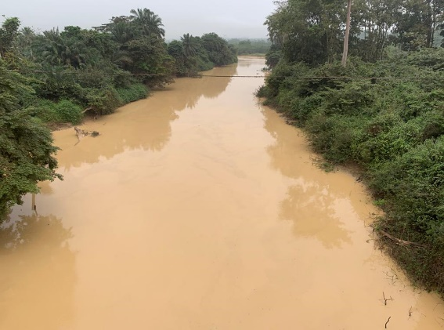

GHANA SCIENCE ASSOCIATION
34TH BIENNIAL CONFERENCE
Topic: SUSTAINANBLE WATER RESOURCES MANAGEMENT
Ing. Dr. Frederick Yaw Logah
CSIR WATER RESAECH INSTITUTE
Dr. Andani Andam Academic Board Chamber, UDS
24th September 2025

Slide 2

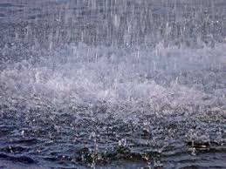
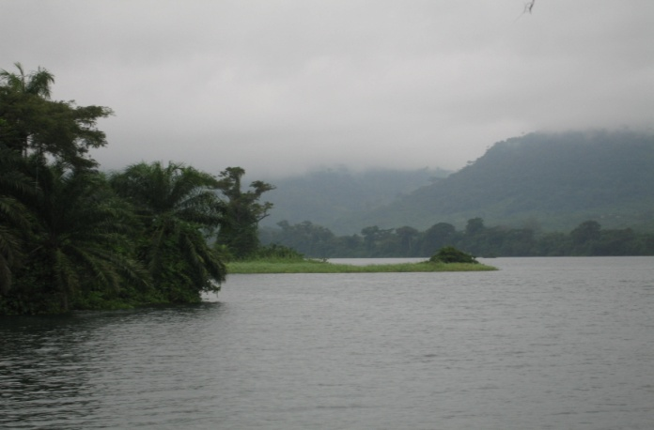
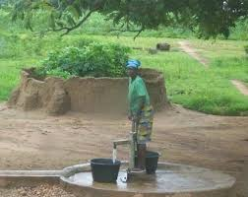
Water sources
Rainfall
Surface water
Groundwater
Notes:
Ghana’s total renewable water resources (surface water + groundwater) is estimated at about 56 Billion Cubic Meters. About half of this volume comes (46%) comes from outside of the country, mainly, Burkina Faso, Ivory Coast and Togo)

Slide 3
Ghana’s Water Profile
Surface water resources: Major river basins in Ghana (HAP, 2006)
GHANA’S RENEWABLE SURFACE WATER RESOURCES AS OF 2015 (SOURCE: FAO/WB DATABASE)
Source of water | Volume
 | (10^9 m³/year)
Surface water produced internally | 29.0
Surface water: total external renewable | 25.9
Total renewable surface water | 54.9
Notes:
Ghana’s total renewable water resources (surface water + groundwater) is estimated at about 56 Billion Cubic Meters. About half of this volume comes (46%) comes from outside of the country, mainly, Burkina Faso, Ivory Coast and Togo)

Slide 4
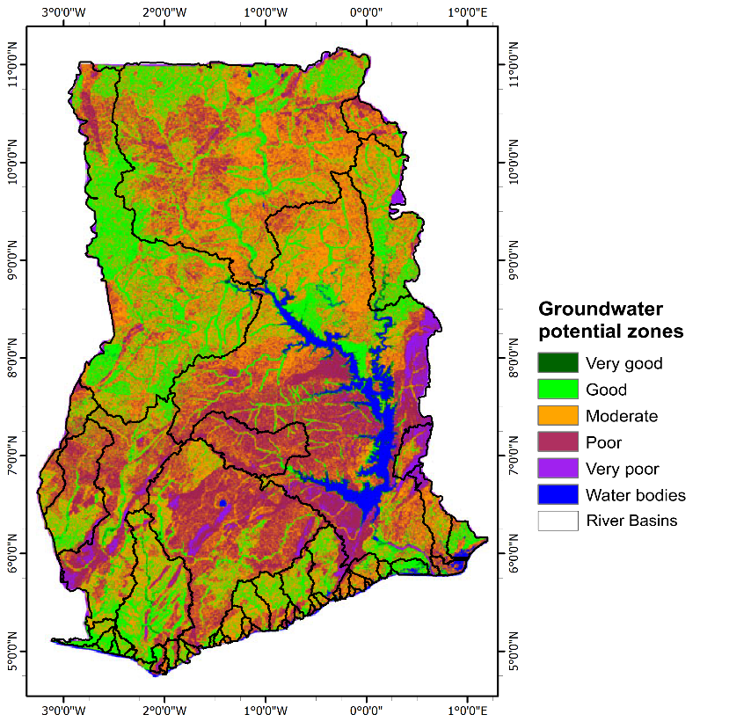
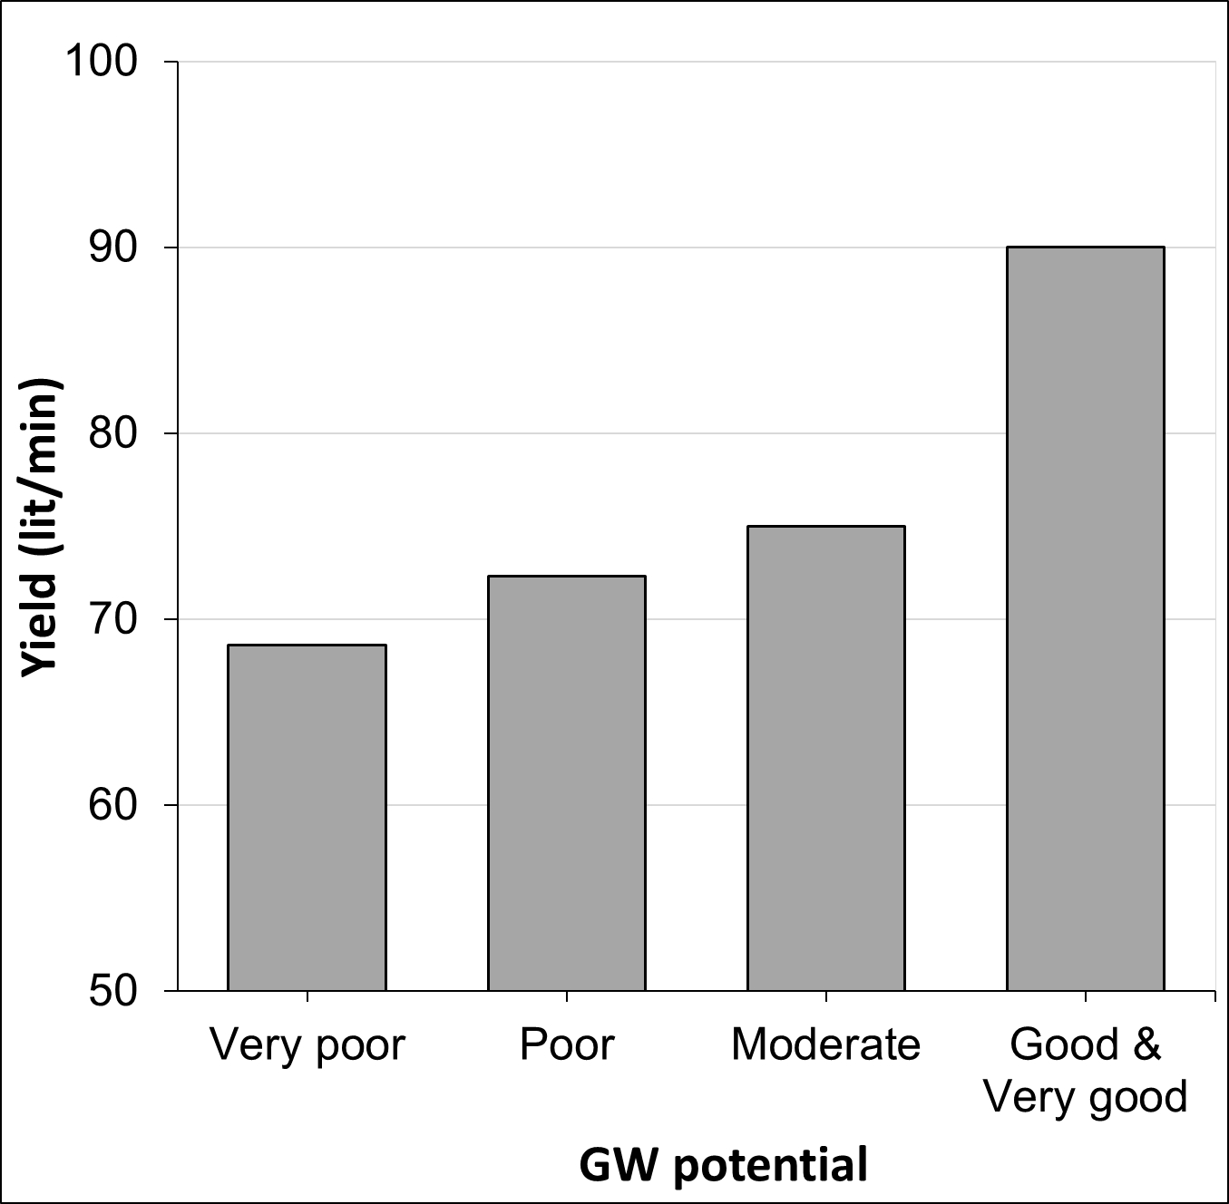
Ghana’s Water Profile
Ghana’s groundwater potential (Gumma & Pavelic, 2012)
GHANA’S RENEWABLE GROUND WATER RESOURCES AS OF 2015 (SOURCE: FAO/WB DATABASE)
Source of water | Volume
 | (10^9 m³/year)
Groundwater produced internally | 26.3
Total renewable groundwater | 26.3
GW Potential | Area coverage (%)
Very good | 2.9
Good | 21.6
Moderate | 45.6
Poor/very poor | 30.0
Notes:
Ghana’s total renewable water resources (surface water + groundwater) is estimated at about 56 Billion Cubic Meters. About half of this volume comes (46%) comes from outside of the country, mainly, Burkina Faso, Ivory Coast and Togo)

Slide 5
Ghana’s Water Profile
Water Availability & Withdrawals
GHANA’S RENEWABLE WATER RESOURCES AS OF 2015 (SOURCE: FAO/WB DATABASE)
Total renewable surface water (10^9 m³/year) | 54.9
Total renewable groundwater (10^9 m³/year) | 26.3
Overlap: surface water and groundwater (10^9 m³/year) | 25.0
Total renewable water resources (10^9 m³/year) | 56.2
GHANA’S WATER WITHDRAWALS AS OF 2020 (SOURCE: MWRWH, 1998)
Withdrawal type | Volume | % total withdrawal
Agricultural water withdrawal (10^9 m³/year) | 4.189 | 82
Domestic/industrial water withdrawal (10^9 m³/year) | 0.937 | 18
Total water withdrawal (10^9 m³/year) | 5.126 | 100
Mean annual streamflow of the Volta River system into the Lower Volta River (LVR): 38.2 billion m³
Less than 1% is utilized in the Lower Volta Basin.
The rest flows into the sea unused
Notes:
Ghana’s total renewable water resources (surface water + groundwater) is estimated at about 56 Billion Cubic Meters. About half of this volume comes (46%) comes from outside of the country, mainly, Burkina Faso, Ivory Coast and Togo)

Slide 6
Sustainable Water Resources Management
Water sustainability is a global issue
Sustainable water management is the focus of most developed countries worldwide to sustain life and ensure everyone’s access to fresh water
Sustainable water management is the process of meeting current water needs without compromising future water needs
That is to say that we want to ensure that everyone has access to clean water today, but not at the expense of future generations to come.

Slide 7
Importance of Sustainable Water Resources Management
Fresh water is essential to life on Earth.
The human body is composed of approximately 70% water, underscoring the necessity for each person to have access to sufficient water for survival.
As we deplete our water supply – of which there are no alternative water resources – we essentially diminish the chances of human and other life surviving.
The water use needs of every individual can be met by effectively managing our water resources.
As society and technology evolve and populations grow, the water demand continues to rise, but it is not equitably distributed.

Slide 8
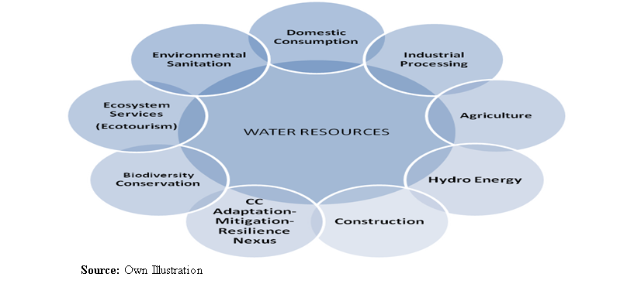
Importance of Sustainable Water Resources Management
Fresh water is vital to life on Earth.
Access to sufficient and quality water for survival.
As society and technology evolve and populations grow, the water demand continues to rise, but it is not equitably distributed.
  SDG 6.4 has a target to “substantially reduce the number of people suffering from water scarcity” by 2030 (UN, 2015).

Slide 9
Water Scarcity/Stress
What is Water Scarcity?
  A concept for quantitatively evaluating water resources availability.
  Water scarcity generally manifest in reduced river runoff, declining groundwater tables, heavily polluted waters, increasing cost of water treatment/supply.
  Water scarcity is natural and man-made.
Notes:
In general, water scarcity is defined as the point at which the aggregate impact of all users impinges on the supply or quality of water under prevailing institutional arrangements to the extent that the demand by all sectors, including the environment, cannot be satisfied fully (UN-Water, 2007).
Water Scarcity is both a natural and human-made phenomenon and can be refereed to as economic scarcity and physical scarcity. Physical scarcity is when there simply is not enough water within a given area while economic scarcity refers to the fact that finding a reliable source of safe water is time consuming and expensive.

Slide 10
Water Scarcity/Stress
  SDG 6.4 has a target to “substantially reduce the number of people suffering from water scarcity” by 2030 (UN, 2015).
  Freshwater scarcity/stress can be evaluated using indices (e.g. water stress index & withdrawal to availability ratio - Brown and Matlock 2011).
  Water stress indices define amount of water required by a person to meet domestic needs (100l/c/d), agricultural, industrial, and energy demands.
Water Stress Index (Damkjaer & Taylor, 2017)
Index (m³/capita/year) | Category/Condition
>1,700 | No stress
1,700 - 1,000 | Water stress
1,000 - 500 | Water scarcity
<500 | Absolute water scarcity
Notes:
In general, water scarcity is defined as the point at which the aggregate impact of all users impinges on the supply or quality of water under prevailing institutional arrangements to the extent that the demand by all sectors, including the environment, cannot be satisfied fully (UN-Water, 2007).
Water Scarcity is both a natural and human-made phenomenon and can be refereed to as economic scarcity and physical scarcity. Physical scarcity is when there simply is not enough water within a given area while economic scarcity refers to the fact that finding a reliable source of safe water is time consuming and expensive.

Slide 11
Sustainable Water Resources Management
In essence, there should be access to adequate water resource for drinking, sanitation, industrial, agricultural/irrigation, and other vital uses essential for sustaining life.
Unfortunately, this isn’t the reality around the globe, with many individuals and communities suffering from water scarcity/stress.

Slide 12
Ghana’s water scarcity profile without galamsey

Slide 13
Water Scarcity Index (WSI)
It is defined in terms of the total water resources that are available to the population of a region
It is measured as the amount of renewable freshwater that is available to meet domestic needs, agricultural, industrial, and energy demands.
Water Stress Index (Damkjaer & Taylor, 2017)
Index (m³/capita/year) | Category/Condition
>1,700 | No stress
1,700 - 1,000 | Water stress
1,000 - 500 | Water scarcity
<500 | Absolute water scarcity
  Water scarcity is natural and man-made.

Slide 14
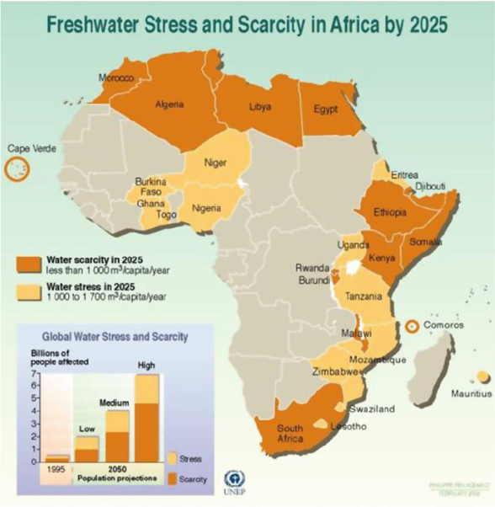
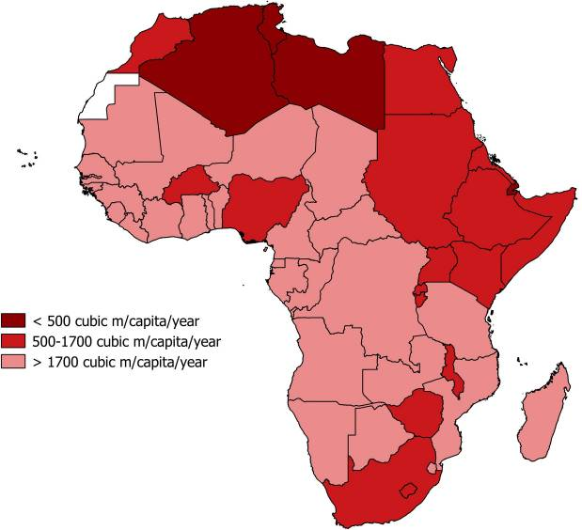
Ghana’s Water Scarcity Profile
Water stress index for Ghana
(calculated with no consideration for environmental stressors)
Ghana’s water stress index (m³/capita/year)
2020 | 1,568
2021 | 1,501
2025 | 1,412
2030 | 1,317
2040 | 1,140
2050 | 1,021
Sources: Author’s estimate (2021); figures were calculated considering environmental flow of 10%
Index (m³/capita/year) | Category/Condition
>1,700 | No stress
1,700 - 1,000 | Water stress
1,000 - 500 | Water scarcity
<500 | Abs. water scarcity
Damkjaer & Taylor (2017)- based on 2014 data from FAO-AQUASTAT
UNEP-Arendal, 2005

Slide 15
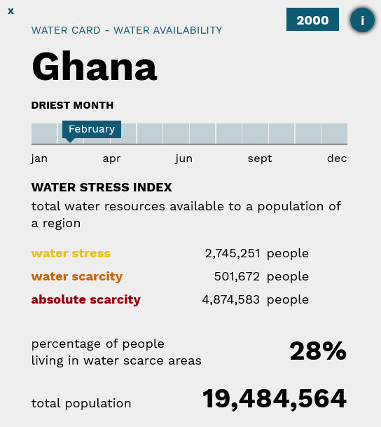
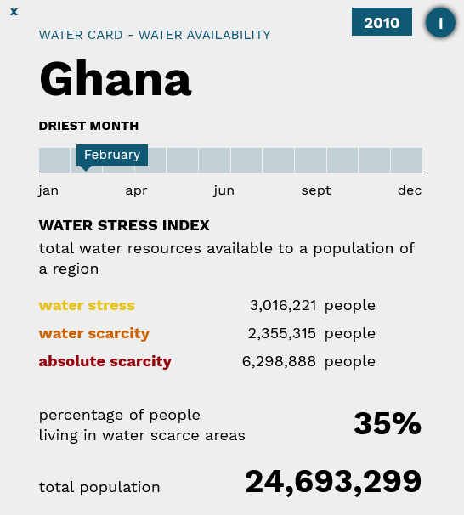
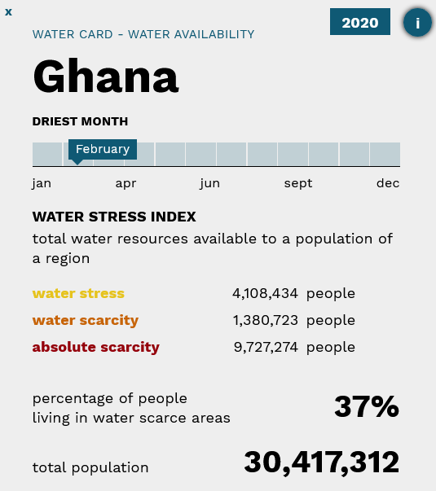
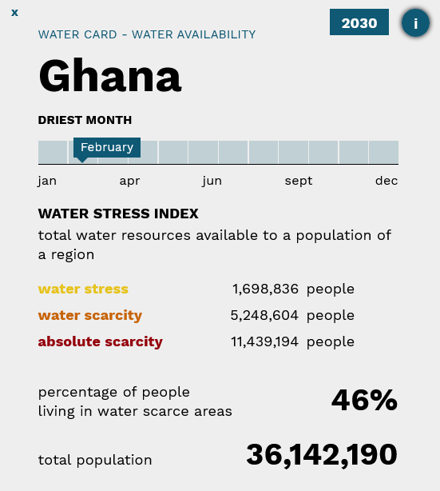
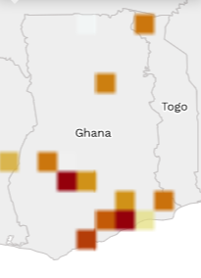
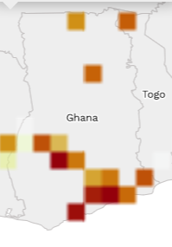
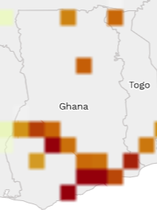
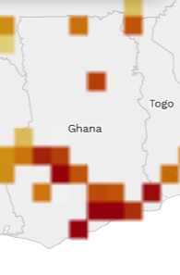

Ghana’s Water Scarcity Profile
Proportion of people living in water stress areas in Ghana
Source: World Data Lab,2021
https://worldwater.io/
2000
2010
2020
2030
Notes:
Ghana will be physically water-stressed by 2025. This will be in addition to the existing economic water scarcity.

Slide 16
Ghana’s Water Scarcity Profile
Water stress conditions in major river basins in Ghana
(index computed without consideration for environmental stressors)
Area | 2020 water availability (m³/per/year) | 2030 water availability (m³/per/year) | 2040 water availability (m³/per/year) | 2050 water availability (m³/per/year)
Ghana | 1,568 | 1,317 | 1,140 | 1,021
Volta Basin | 2,654 | 2,222 | 1,922 | 1,719
Ankobra | 2,115 | 1,761 | 1,517 | 1,354
Pra | 752 | 632 | 546 | 488
Densu | 337 | 286 | 249 | 223
Sources: Author’s estimates (2021); figures were computed considering environmental flow of 10%
Legends
Colour code | Category/Condition | Index (m³/capita/year)
 | No stress | >1,700
 | Water stress | 1,700 - 1,000
 | Water scarcity | 1,000 - 500
 | Absolute water scarcity | <500
Notes:
Ghana will be physically water-stressed by 2025. This will be in addition to the existing economic water scarcity.

Slide 17
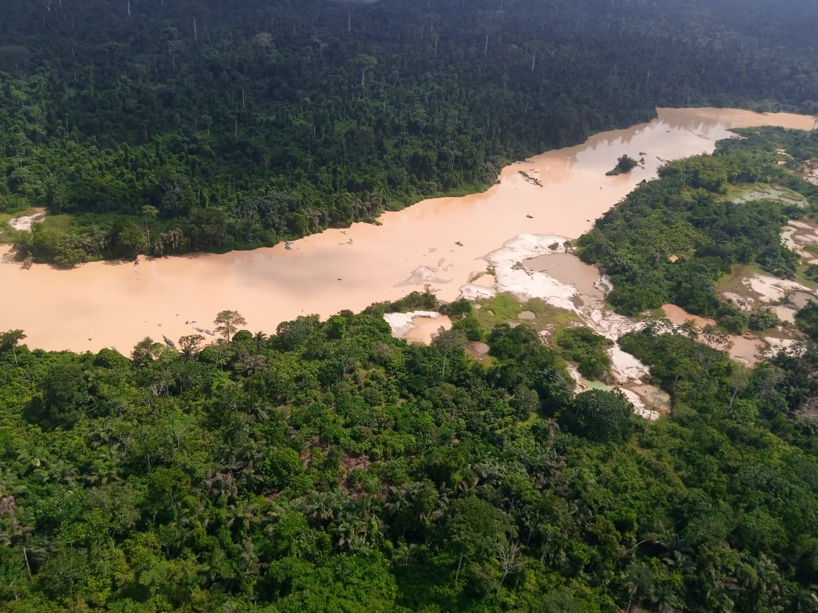
Ghana’s water scarcity profile with galamsey

Slide 18
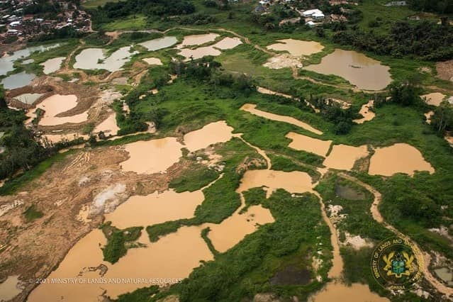
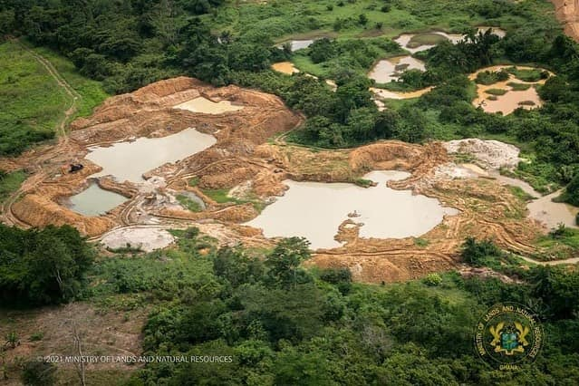
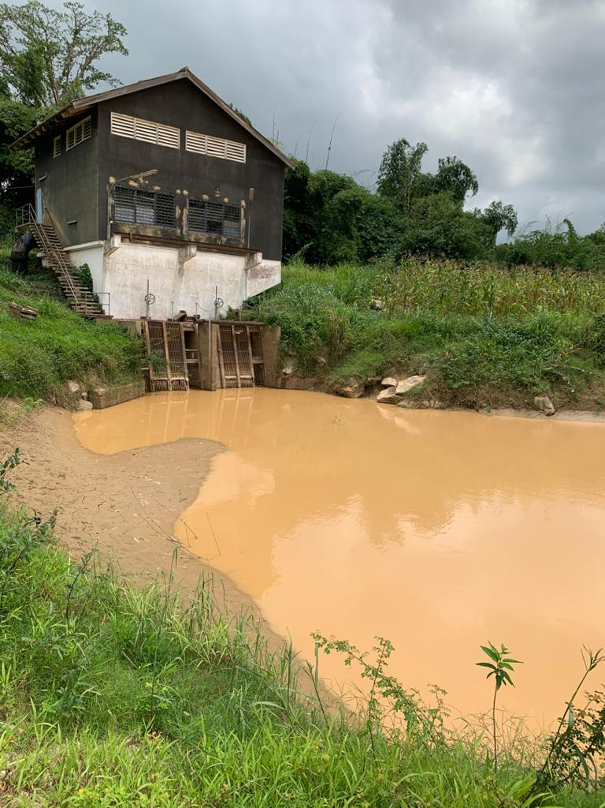
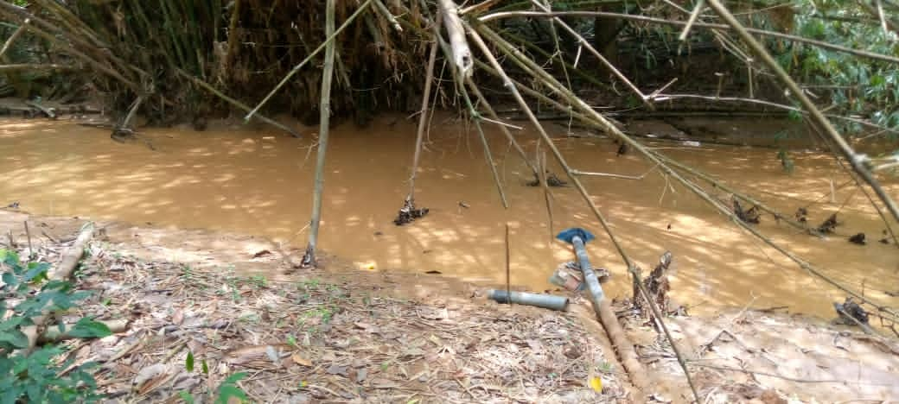
Impacts of Galamsey
Pits become death traps for humans and animals.
increased water surfaces lead to more evaporation, less water yield, and less soil moisture.
Impedes water regulatory functions of the river landscape as forest vegetation is converted to pits and bare land.
High suspended sediments/siltation of rivers, rendering water unfit for any purpose
Siltation of river channels can lead to rivers overflowing their banks and causing or intensifying flood events
Insufficient water for abstraction, treatment, and supply
Heavily silted and polluted water is not suitable/cost-effective for treatment and supply
Ankobra Basin
Pra Basin
Intake point of Bunso GWCL on the Brim River at Bunso
GWCL intake house at Daboase on River Pra

Slide 19
Galamsey and Water Scarcity
Turbidity levels in rivers impacted by galamsey
Basin | Town/Sampling point | 2021 (Unit: NTU)
 |  | Feb | 11-12 May | 24-25 May | 7-8 June
Ankobra | Dominase | 650 | 974 | 528 | 520
 | Prestea | 24,250 | 1,956 | 908 | 846
 | Bonsaso | 560 | 570 | 560 | 230
Pra | Twifo-Praso | 1,157 | 886 | 853 | 848
 | Daboase | 7,500 | 930 | 861 | 907
Birim | Osino | 14,800 | 1,170 | 950 | 564
 | Bunso | 4,700 | 575 | 283 | 942
 | Kyebi | 35 | 13 | 17 | 63
Offin | Odaso | - | 1,854 | 1,079 | 1,122
Tano | Elubo | 850 | 643 | 503 | 256
Acceptable threshold for drinking water is 5 NTU (WRC, 2021; WHO, 2017).
Levels for other uses other than drinking is 80-150 NTU (WRC, 2021).
Pra/Ankobra have far exceeded the threshold for use for any purpose without treatment.
Treatment for drinking now costs more.
Notes:
Ghana will be physically water-stressed by 2025. This will be in addition to the existing economic water scarcity.

Slide 20
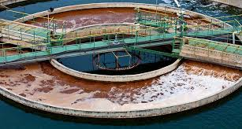

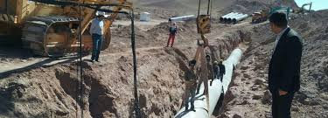
Galamsey and Water Scarcity
Options to provide water in galamsey areas include: (a) Treatment of polluted water; (b) Groundwater; (c) inter-basin water transfer
Population
Basin | 2020 | 2030 | 2040 | 2050
Pra | 6,682,477 | 7,962,254 | 9,202,306 | 10,295,100
Ankobra | 901,747 | 1,082,856 | 1,257,052 | 1,408,259
TOTAL | 7,584,224 | 9,045,110 | 10,459,358 | 11,703,359
Notes:
Ghana will be physically water-stressed by 2025. This will be in addition to the existing economic water scarcity.

Slide 21
Challenges of water scarcity/stress
Water and health are intimately linked. Water scarcity or use of poor quality water, can lead to water borne diseases, which affects the poor disproportionately.
Water scarcity can seriously hinder Ghana’s ability to produce sufficient food to meet the growing demand for food and protein. This may mean spending huge foreign exchange on food imports.
Water scarcity can result in damages to vital ecosystems.
Scarcity of water, caused by high turbidity, can impede the development of Ghana’s mini hydro-power potential and affect electrification/electricity tariff.
Notes:
Water scarcity is also linked closely to the five key areas for action identified by the UN Secretary General on the occasion of the WSSD: water, energy, health, agriculture and
biodiversity. Last, it also has an impact on all the issues identified in the WSSD Johannesburg Plan of Implementation, and, in particular, on: poverty eradication; changing unsustainable consumption and production patterns; and protecting and managing the natural resources base of economic and social development

Slide 22

Sustainable Water Management — What Can Be Done?
The good news:
There are a few solutions that can promote SWM and
minimize water scarcity.
Relevant stakeholders (Research Institutions, Academia, Water users, Policy makers, etc) should be involved in defining mitigation measures for a sustainable solution and ensure a better future.

Slide 23
Objective for Mitigation Efforts
Mitigation for sustainable water resources
The good news is that there are a few solutions that can promote sustainable water management and minimize water scarcity.
The objective of a mitigation strategy
determines the path to pursue. Relevant
stakeholders should be involved in defining
mitigation objectives for a sustainable solution.
Mitigation Objectives (the 4Rs):
  Restoration: action of restoring to the original or pristine state.
  Rehabilitation: action of restoring a thing to a previous condition or status.
  Reclamation: bringing back to a proper/usable state.
  Remediation: clean-up of the contaminated area to safe levels by removing or isolating contaminants.

Slide 24
Mitigation for sustainable water resources
Mitigation Objectives (the 4Rs):
  Restoration:
  Action of restoring to the original or pristine state.
  Rehabilitation:
  Action of restoring it to a previous condition or status.
  Reclamation:
  Bringing it back to a proper/usable state.
  Remediation:
  Clean-up of the contaminated area to safe levels by removing or isolating contaminants.

Slide 25
Mitigation scenarios
Passive action: Closure of galamsey operations & allow habitat to heal itself and regenerate (lower cost, higher environmental & societal risks).
Active Action: Restoration/Reclamation/Rehabilitation efforts (higher cost, lower environmental & societal risks).
Options for active actions
Backfilling, plugging, and sealing.
Surface grading, re-profiling and levelling.
Re-vegetation/tree or spot planting.
Pump and treat waters contaminated with sediment, metals, oil/grease, etc.
Re-instatement of drainage channels.
River channel stabilization.
Phytoremediation exercise for contaminated sites.

Slide 26
Sustainable Water Management
Implementing new or existing water governance policies
The most efficient way to improve sustainable water management is through high levels of government implementing new or existing water governance policies and better water system planning.
Leverage technology for more water
There’s technology that’s not only able to increase our water supply, but is also able to improve access to water security for the increasing populations. Examples
  Desalination, which removes dissolved mineral salts from water to make it safe for human consumption and irrigation.

Slide 27
Summary
  Presently, without considering galamsey and other environmental stressors, Ghana is water stressed and the proportion of people living in water scarcity areas is growing.
  With consideration for galamsey, water in the Pra and Ankobra rivers cannot be used for drinking and other purposes without treatment.
  Groundwater potential in some galamsey affected areas is not good, limiting alternatives to treatment and inter-basin water transfer, both are expensive.
  Future water scarcity in Ghana will grow, driven by population and economic growth but also by pollution from galamsey and other environmental stressors (e.g. climate change).

Slide 28
Conclusion/Way Forward
Although sustainable water management may seem like a large global issue, each one of us has a responsibility to help the cause. You can make a positive impact by adopting a few simple changes to your habits, being mindful of your water consumption, and practicing sustainable use. For example:
  Turn off the faucet while not in use while brushing your teeth or washing dishes.
  Take shorter and more efficient showers.
  Proper waste management
Sustainable Water Management Starts at Home

Slide 29
Way forward
  Relevant stakeholders should be involved in defining mitigation objectives for sustainable solution.
  Government has already taken the first important step to halt small scale mining, to protect water bodies/environment.
  Active actions should follow the halting of small scale mining, to restore/reclaim/rehabilitate affected ecosystems (e.g. rivers, wetlands, forests), to restore availability of good quality water.
  Serious attention should be given to the water sector, to develop the needed infrastructure and systems to address the increasing population living in water scarce areas.
  Enhancement of water productivity (volume of production per unit of water) in all sectors may help slow down growth in water demands.

Slide 30
Thank You

