Slide 1

Science Education and Policy for Accelerated National Development through Problem-Solving Curriculum Prof. Augustine Ocloo Ag. Deputy director-general, Ghana tertiary education commission (GTEC)

Slide 2

Restatement of the topic:
Leveraging Problem-Based Science Education for National Development
Using Problem-Solving Science Curricula to Accelerate National Growth
Science Education Policy for Development: A Problem-Solving Approach

Slide 3

outline
Accelerated National Development
Science Education and Accelerated National Development
Problem-solving curriculum
Science Policy
Science education for national development: the China story
Conclusions and Recommendations

Slide 4
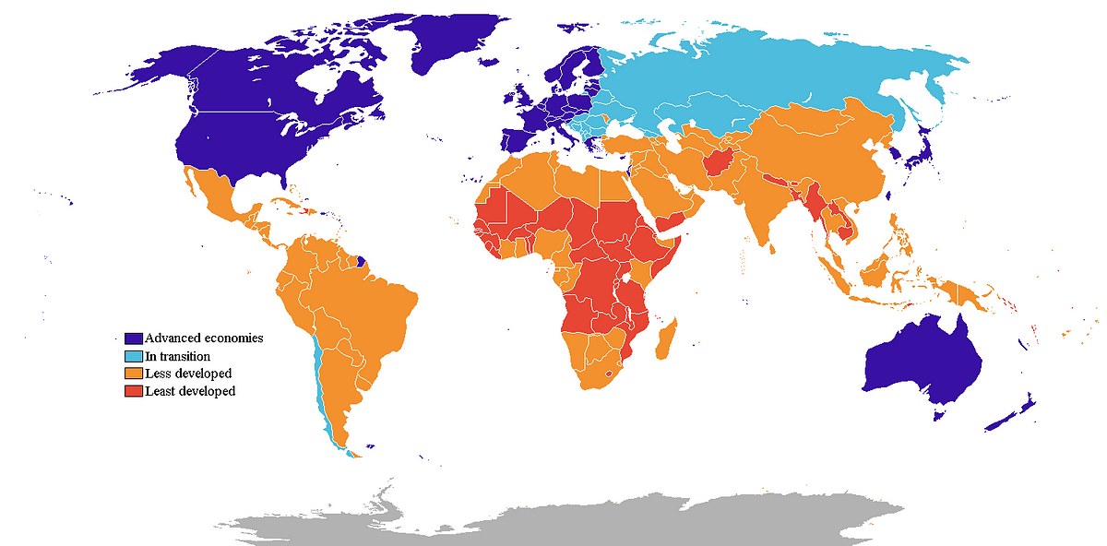
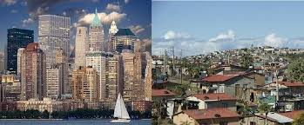
WHAT IS Accelerated National Development?
Rapid improvement of a nation's economic, social, technological, and political systems through strategic and focused efforts.
It involves fast-tracking progress to improve the quality of life for citizens and achieve national goals more quickly than under normal development trajectories.

Slide 5
Key Features of Accelerated National Development
Rapid Economic Growth
Increase in GDP, industrialization, and job creation.
Expansion of infrastructure (roads, power, ICT, etc.).
Human Capital Development
Investment in education, healthcare, and skill acquisition.
Strong emphasis on science, technology, engineering, and mathematics (STEM).
Technological Advancement
Innovation-driven growth.
Adoption of modern tools, digital transformation, and R&D.

Slide 6
Key Features cont’d
Good Governance and Effective Policy
Transparent institutions and accountability.
Strategic national planning and inclusive policies.
Social Inclusion
Reduction in inequality, poverty, and unemployment.
Empowerment women, youth, and marginalized communities.
Sustainability
Development that meets present needs without compromising future generations.
Environmentally responsible policies and practices.

Slide 7

science EDUCATION and accelerated national development

Slide 8

What is EDUCATION?
The process of facilitating learning or the acquisition of knowledge, skills, values, and habits. It plays a vital role in personal and societal development (UNESCO).
Facilitation is making an action or process easy or easier (Oxford Languages Dictionary).
In terms of Education, facilitation is Guiding and Supporting the learning process, encouraging student engagement and collaboration rather than directly instructing.

Slide 9
Facilitators of education
Human Facilitators (Policy makers, Teachers, Mentors, and Tutors).
Technological Facilitators (Learning Management Systems (LMS), Educational Software, and Online Resources).
Environmental Facilitators (Classrooms, Libraries, and Laboratories).
Community Facilitators (Parents, Community Organizations, and Partnerships).
Other Facilitators (Assessment Tools, Curriculum Guides and Professional Development)

Slide 10

WHAT IS SCIENCE?
Science is a systematic enterprise that builds and organizes knowledge in the form of testable explanations and predictions.

Slide 11
Enterprise
A project or undertaking that is especially difficult, complicated, or risky.
A unit of economic organization or activity.
A systematic, purposeful activity.
Readiness to engage in daring or difficult action.
How to carry out a successful enterprise?
Clear Vision & Mission
Research & Validation
Solid Plan
Financial Resources
Legal & Regulatory Framework
Strong Leadership & Team
Effective Strategy
Remaining Focus
Adaptability and Innovation
Risk Management
Technology & Infrastructure
Networking & Partnerships
Execution & Discipline

Slide 12
SCIENCE IS SPECIAL Science is held in high esteem
There is a widely held belief that there is something special about Science. In fact, there is an abundance of evidence that Science is held in high regard. (Advertisements frequently assert that a particular product has been scientifically shown to be whiter, more potent, more sexually appealing, or in some way superior to rival product) (Alan Chambers, 2013)

Slide 13
Some important quotes about science
Jawaharlal Nehru (First Prime Minister of India):
"It is science alone that can solve the problems of hunger and poverty, of insanitation and illiteracy, of superstition and deadening custom and tradition, of vast resources running to waste, of a rich country inhabited by starving people... Who indeed could afford to ignore science today? At every turn we have to seek its aid... The future belongs to science and those who make friends with science.“
Neil deGrasse Tyson (Astrophysicist and Science Communicator):
"When you are scientifically literate, the world looks different to you. It's a particular way of questioning and knowing and reasoning that provides a filter on reality."

Slide 14
UNESCO (United Nations Educational, Scientific and Cultural Organization):
"Without science, no sustainable development; without science education, no science."
World Bank Reports:
"The quality of learning in science and mathematics is a key determinant of future economic productivity and competitiveness in the global knowledge economy.“
Albert Einstein (Theoretical Physicist):
"It is not so very important for a person to learn facts. For that he does not really need a college. He can learn them from books. The value of an education in a liberal arts college is not the learning of many facts but the training of the mind to think something that cannot be learned from textbooks."

Slide 15

WHAT IS Science EDUCATION?
The process of teaching and learning scientific knowledge, skills, and principles.
It plays a vital role in developing critical thinking, problem-solving, and analytical skills.

Slide 16
Importance of Science Education
Fuels Innovation and Economic Growth
Develops Critical Thinking and Problem-Solving Skills
Empowers Informed Citizenship
Supports National Development Goals
Bridges Inequality and Expands Opportunities
Promotes Global Competitiveness
Encourages Environmental Awareness

Slide 17
Builds a skilled, innovative workforce.
Fosters a culture of problem-solving and research.
Drives the technological advancement that powers growth.

Slide 18
Science Education as a Development Infrastructure
Science education is a fundamental pillar of sustainable development, serving as critical infrastructure that drives economic growth, technological innovation, and societal progress.
Unlike traditional infrastructure (roads, bridges, and utilities), science education is a human and intellectual infrastructure that empowers individuals and nations to solve complex challenges, foster innovation, and compete in a knowledge-driven global economy.

Slide 19
Challenges in Building Science Education Infrastructure
Underfunding – Many developing nations prioritize physical infrastructure over education.
Shortage of Qualified Teachers – Poor training and low incentives for STEM educators.
Gender & Social Gaps – Women and rural students often lack access to science education.
Outdated Curricula – Many education systems focus on rote learning rather than practical, research-based skills.

Slide 20

A pROBLEM-SOLVING CURRICULUM

Slide 21

Why a problem-solving curriculum?

Slide 22
Education is not just about storing information; it's about learning how to think, not what to think.
Therefore, an effective educational system should teach learners how to think. Hence the need for a problem-solving curriculum

Slide 23
Several features characterise societies at the beginning of the 21st century, but two of these have prevailing consequences for schooling:
The determining role of knowledge and skills possessed by citizens;
The rapid changes apparent in all areas of life.
The Nature of Problem Solving
USING RESEARCH TO INSPIRE 21ST CENTURY LEARNING
Edited by Ben Csapó and Joachim Funke
Chapter title
The Development and assessment of Problem Solving in 21ST-Century Schools
Students therefore not only have to master more knowledge to be able to live a successful life in these societies, but they also have to master a different type of knowledge which enables them to succeed in a rapidly changing environment.
This means that if schools only prepare their students for current expectations, their knowledge and skills will be outdated by the time they have to use them in their private life and in the world of work.
Hence the need for 21st Century Skills

Slide 24
Creativity
Innovation
Communication
Collaboration
Decision making
Social skills
Cross-cultural skills
Information and Communications Technology (ICT) literacy
Civic literacy
Media literacy
Critical thinking
Learning to learn
PROBLEM SOLVING
21st-Century skills
A family of skills considered the most essential in modern societies

Slide 25
Problem-solving skills
Problem-solving skills refer to a range of abilities that enable individuals to tackle issues systematically, employing a mix of logic, research, and, sometimes, a little creativity. From analyzing data to understanding different perspectives and generating creative solutions, these skills play a vital role in the workplace.
When mastered, they empower employees to face issues with resilience and adapt to new challenges effectively.
https://conflict-resolution-training.com/
Enhanced teamwork and collaboration: Problem-solving encourages collaborative work, promoting better teamwork as individuals come together to address challenges.
Improved decision-making: Critical thinking and analytical skills help people make better choices, enabling them to determine the best solutions for even the most complex issues.
Increased adaptability: Facing and resolving diverse challenges fosters adaptability, preparing employees to handle unexpected issues with poise.
Boosted productivity and efficiency: By identifying root causes and implementing efficient solutions, employees can improve workflow and reduce delays and redundancies.
Strengthened workplace harmony: When conflicts arise, a strong problem-solving framework ensures smoother resolution, fostering a harmonious environment.

Slide 26

WHAT IS A PROBLEM-SOLVING CURRICLUM?

Slide 27
An approach that integrates real-world challenges into the educational framework, preparing students not only with theoretical knowledge but also with practical skills for problem-solving.
It starts with a problem, often local or national in scope, and challenges students to explore, experiment, and engineer solutions. This approach nurtures creativity, resilience, and scientific curiosity.
A problem-solving curriculum is more than project work or practicals. It is a pedagogical philosophy rooted in critical thinking, creativity, and relevance. It asks not “What do we want students to know?” but rather, “What national problems do we want them to solve?”
A problem-solving curriculum empowers learners to apply scientific principles to real-world challenges, often within their own communities

Slide 28
Imagine a curriculum where students in arid regions study climate adaptation through local farming models. Or where urban students apply physics and coding to solve real-time traffic congestion issues. Science becomes not just a subject—it becomes a tool for nation-building.
Imagine a rural school where the science curriculum challenges students to design a low-cost solar dryer for preserving farm produce. They will need to understand thermodynamics, materials science, and environmental sustainability—all embedded in a real-world challenge. That is learning that sticks. That is learning that transforms communities.
A problem-solving curriculum inverts the traditional hierarchy. It begins with contextual challenges—agricultural inefficiencies, energy deficits, public health issues, and environmental degradation and encourages students to approach these issues scientifically. It teaches them not only what to think, but how to think.

Slide 29
IMPLEMENTING PROBLEM-SOLVING CURRICULUM: POLICY REQUIREMENT
Curriculum Reform Policy: National frameworks must mandate curricula that emphasize inquiry-based and interdisciplinary learning.
Assessment Reform: Our assessment systems must evolve to evaluate not just memory, but problem-solving ability, collaborative innovation, and scientific reasoning.
Research-Policy Linkage: Academic research in education must inform policymaking, and vice versa.
Industry and Community Engagement: Policies must encourage partnerships between schools, universities, and industry, enabling students to work on real-life problems with tangible stakes.
Teacher Training and Certification: Policies must invest in teacher education that emphasizes facilitation over lecturing, and problem-based methods.

Slide 30

SCIENCE POLICY
“Public policy concerned with the allocation of resources for the conduct of science, the development of scientific knowledge, and the use of that knowledge in the service of the public."

Slide 31
Importance of Science Policy
Drives national development and economic growth.
Supports technological innovation and competitiveness.
Informs evidence-based decision-making.
Addresses grand challenges (e.g., climate change, health, food security).

Slide 32

Key Stakeholders in Science Policy
Government (Ministries, Parliament)
Academia and Research Institutions
Private Sector & Industry
Civil Society & Media
International Bodies (e.g., UNESCO, OECD)

Slide 33
Science education for national development: the china story
China's science education story is one of significant development and impact on national progress.
Driven by a national strategy to enhance scientific literacy and innovation, China has invested heavily in its science education system.
The country's approach has evolved from focusing on rote learning to incorporating modern learning theories, and it continues to reform its education system to foster creativity and problem-solving skills.

Slide 34
Key Aspects of China's Science Education Development
Government Prioritization:
China has made science education a national priority, implementing policies and strategies to promote scientific literacy across all levels of education and among the general public.
Curriculum Reform:
The national curriculum has been revised to align with modern learning theories, moving beyond rote memorization to emphasize critical thinking and problem-solving.
Infrastructure Development:
The country has invested in infrastructure, including science and technology museums and professional organizations like the Chinese Association of Science Education.
Research Focus:
Research universities have been established and supported to enhance China's research capacity and competitiveness in science and technology.
International Collaboration:
China has actively participated in international assessments like Peogramme for Iinternational Student Assessment (PISA) and Trend in International Mathematics and Science Study (TIMSS).

Slide 35
CONCLUSION AND RECOMMENDATIONS
Science education is not just a subject. It is the backbone of modern development. By treating it as critical infrastructure, nations can ensure long-term prosperity, resilience, and global competitiveness.
Investing in science education today means building the innovators, problem-solvers, and leaders of tomorrow.
Problem-solving skill is a critical 21st century.
Higher Education institutions must fully integrate problem-solving in their curricula.
The Ghana Tertiary Commission must ensure that problem-solving pedagogies are part of the requirements for programme accreditation.
Governments should allocate at least 20% of education budgets to science and technology programs.
Improve salaries and continuous professional development for STEM teachers. Reduce class sizes

Slide 36
Tech companies can fund labs, scholarships, and research initiatives.
Encourage girls and underrepresented groups through mentorship and scholarships.
Shift from theoretical learning to hands-on experimentation and innovation.

Slide 37
Chalmers, A. F. (2013). What is this thing called science?. Hackett Publishing.
Dadzie, K. (1991). Accelerating the Development Process: Challenges for National and International Policies in the 1990s. In Report by the Secretary General of UNCTAD to UNCTAD VIII, United Nations Conference on Trade and Development, United Nations, New York.
McLeish, T. (2014). Faith and wisdom in science. Oxford University Press (UK).

Slide 38
Thank you

