Slide 1
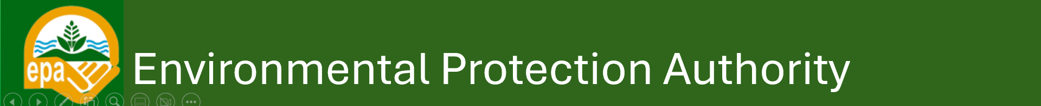
Environmental Conservation for Sustainable Ecosystem Management
Professor Nana Ama Brown Klutse
Chief Executive Officer

Slide 2
Outline of Presentation
Ghana’s unique ecosystems
Threats to Ghana’s ecosystems
Key strategies to conserve ecosystems
Ghana’s Commitments to key international agreements.
Call to Action

Slide 3
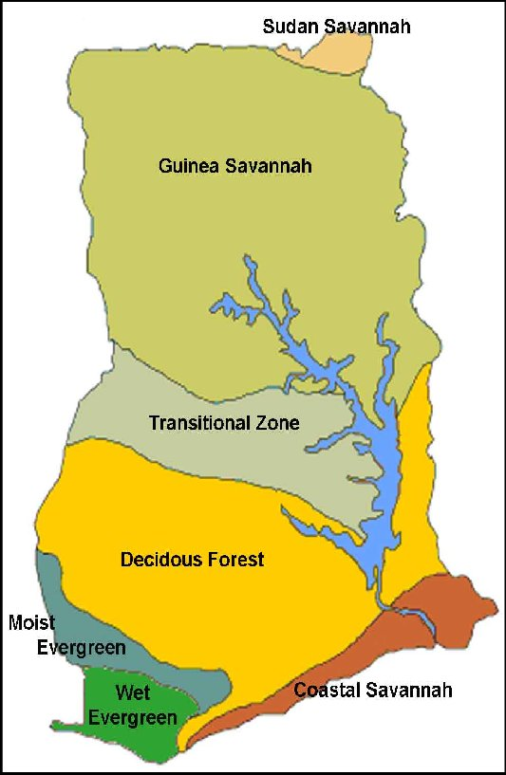
Ghana’s unique ecosystems
Coastal Savannah- mangroves, migratory birds
Guinea Savannah- shea trees , elephants
Sudan savannah- Grasses and livestock
Forest-Savanna Transition Zone – cocoa, yams
Deciduous Forest- mahogany, monkeys
Moist Evergreen Forest- ebony, birds
Wetlands and Riverine Ecosystems- tilapia, manatees
Notes:
Indeed, ecosystem services fall into 4 categories; provisioning, regulatory, cultural and supporting services

Slide 4
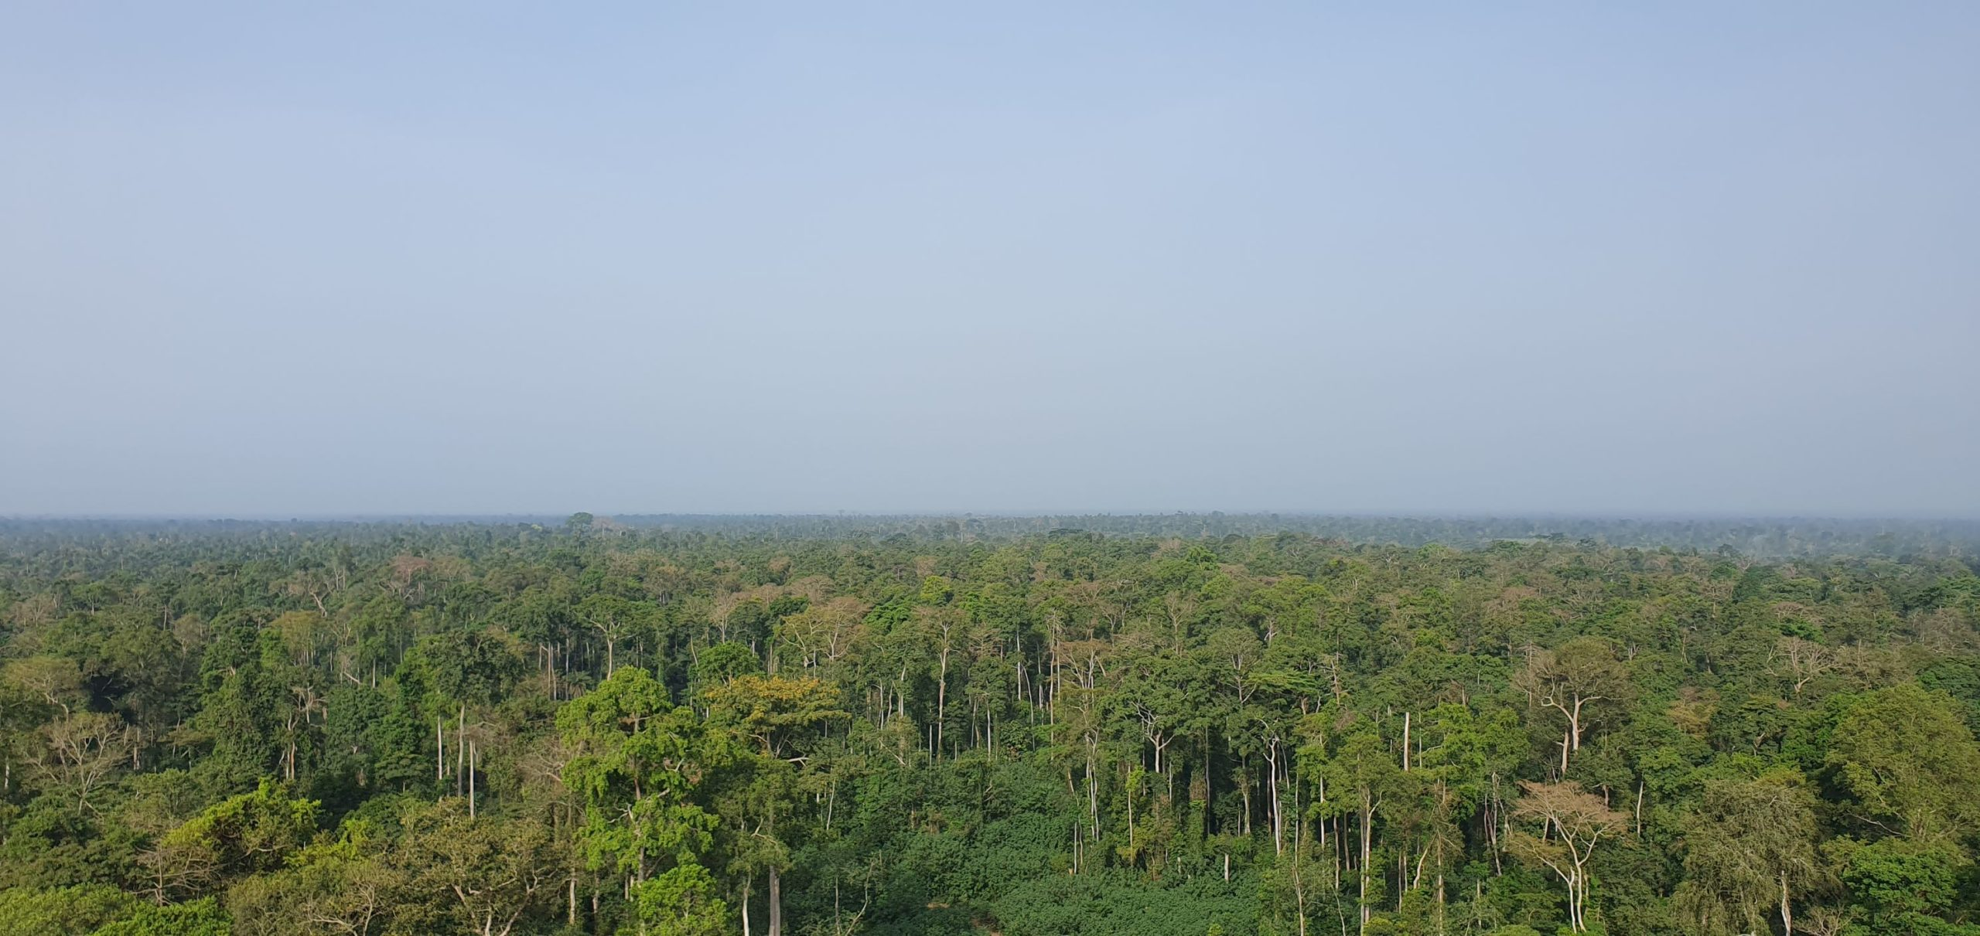
Importance of environmental conservation
Maintains biodiversity and ecosystem services
Supports livelihoods and food security
Enhances climate resilience
Reduces land degradation and deforestation
Fosters sustainability in development planning
Economic stability
Promotes Mental and physical wellbeing

Slide 5
Major Threats to Ecosystems in Ghana
Illegal Small-scale mining/ Galamsey
Deforestation and land degradation
Pollution (air, water, soil)
Overexploitation of resources
Climate change and biodiversity loss
Unsustainable agriculture and urban expansion

Slide 6
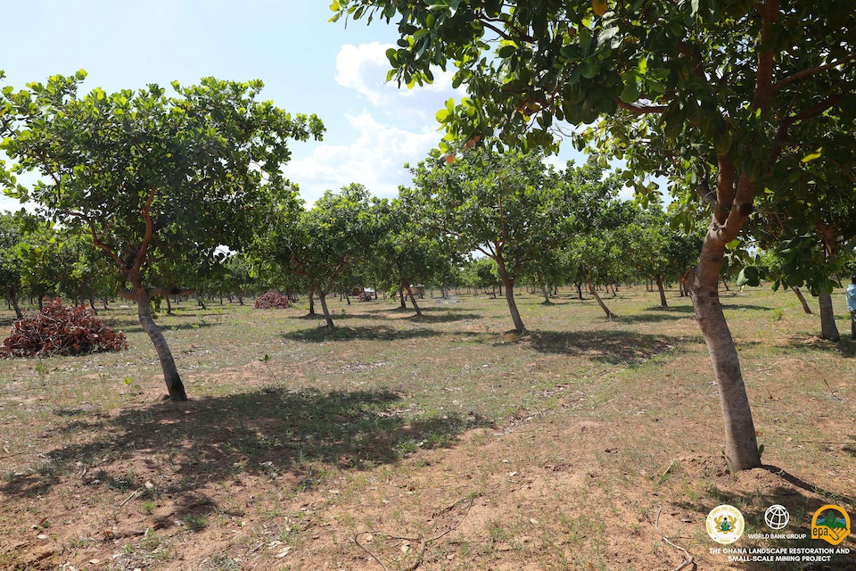
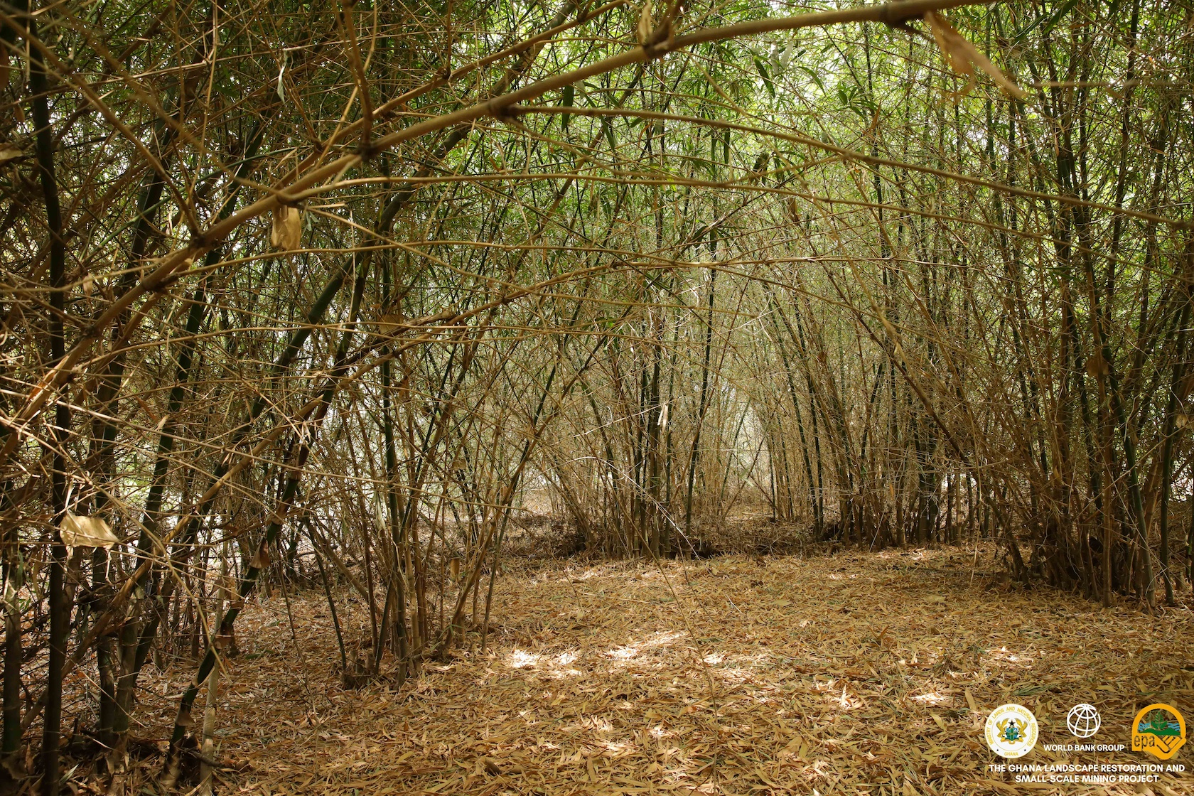
Key Strategies of Environmental Conservation for Sustainable Ecosystem Management in Ghana
Payment for Ecosystem Services (PES)
Financial incentives are offered to landowners or communities to manage land in ways that provide ecological benefits (e.g., carbon storage, clean water).
Wetland And Coastal Ecosystem Protection
This is a critical component of both biodiversity conservation and climate resilience especially in vulnerable areas like, Keta Lagoon, and the Sakumo Ramsar site.
Notes:
Ghana has explored PES in several contexts, though implementation remains limited:
Financial incentives are offered to landowners or communities to manage land in ways that provide ecological benefits (e.g., carbon storage, clean water). PES Program under the then Sustainable Land and Water Management Project: Pays landowners for conserving forests, leading to increases in protection of riverbanks buffer zones

Slide 7
Key Strategies of Environmental Conservation for Sustainable Ecosystem Management in Ghana
Sustainable Agriculture and Agroecology:
Using farming methods that conserve soil, water, and biodiversity while maintaining yields eg. Agroforestry
In Ghana, agroecology is growing rapidly. Farmers in Volta, Oti, and Northern regions are reintroducing local crops, reducing chemical inputs, and embracing circular economy models like composting and waste-to-soil enhancers.
Climate Change Mitigation and Nature-Based Solutions (NbS):
Ghana’s mitigation efforts focus on reducing greenhouse gas emissions while promoting sustainable development. Ghana is a frontrunner in Africa’s REDD+ program, targeting deforestation and forest degradation. Climate-smart agriculture and agroforestry reduce emissions and enhance soil carbon.

Slide 8
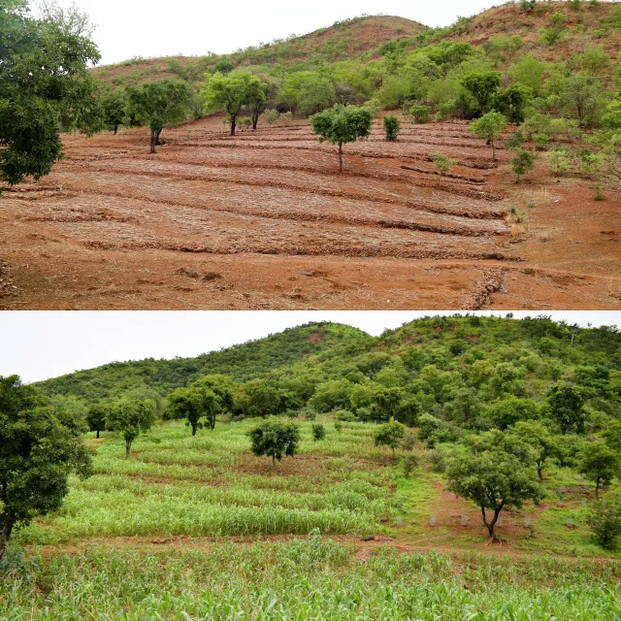
Key Strategies of Environmental Conservation for Sustainable Ecosystem Management in Ghana
  Natural regeneration
  Natural regeneration is quietly transforming degraded landscapes across Ghana especially in northern Ghana. Unlike conventional reforestation, which relies on planting nursery-grown seedlings, natural regeneration taps into the land’s own capacity to heal. Natural Regeneration at Tongo Hills, Talensi District is a standout example of community-led land restoration in the Upper East Region under the Sustainable Land and Water Management Project, this initiative has transformed degraded landscapes into thriving ecosystems without the need for costly tree planting.
  Reforestation and land restoration
  Planting trees in degraded lands and implementation of various sustainable land practices to restore ecosystems, increase carbon sequestration, and prevent soil erosion, improving watershed health, e.g. The Ghana Landscape Restoration Small-Scale Mining Project, the Sustainable Land and Water Management Project.
Then
Now

Slide 9
Key Strategies of Environmental Conservation for Sustainable Ecosystem Management in Ghana
• Protected areas and biodiversity corridors
Ghana has a large system of 21 protected areas which include 7 national parks, 6 Resource Reserves, 2 Wildlife Sanctuaries, 1 Strict Nature Reserve and 5 coastal wetlands.
• Community-based resource management
Local communities are empowered to manage forests, fisheries, and wildlife sustainably, often incorporating traditional knowledge. In Ghana, the dominant model is the CREMA (Community Resource Management Area).

Slide 10
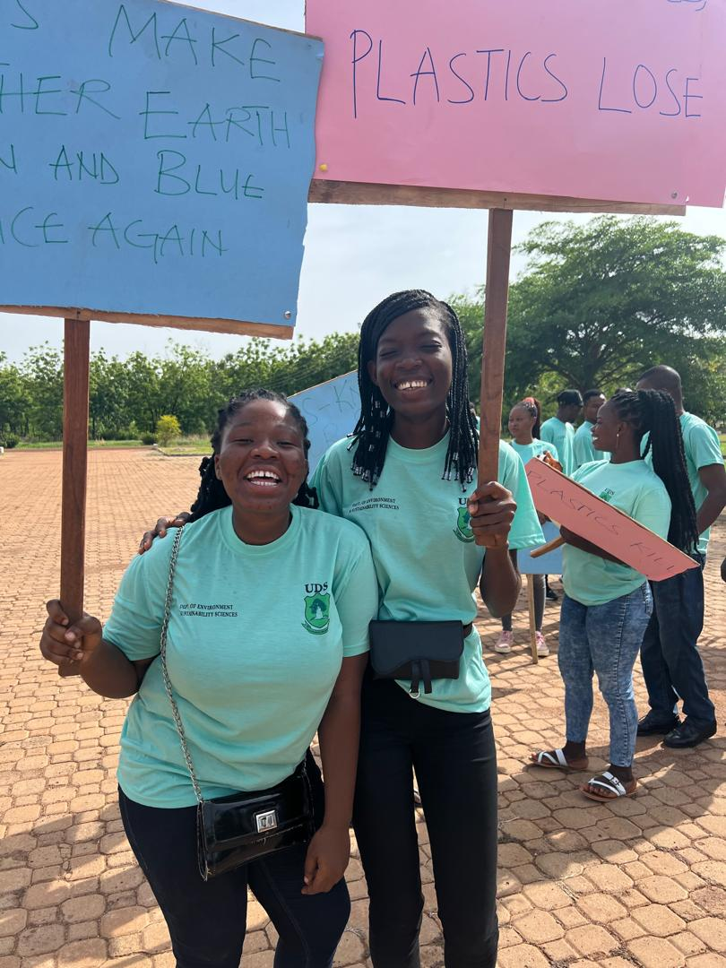
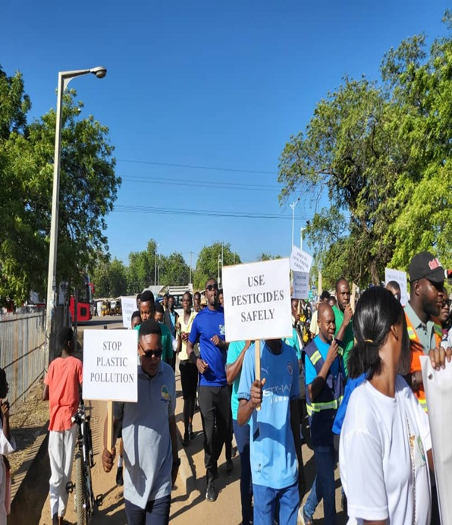
Key Strategies of Environmental Conservation for Sustainable Ecosystem Management in Ghana
Environmental education and awareness:
The Environmental Protection Authority (EPA) leads public awareness campaigns through radio, community workshops, and partnerships with NGOs and other state institutions.

Slide 11
Legal Frameworks for Sustainable Ecosystem Management in Ghana
Legislation | Purpose
EPA Act, 2025 (Act 1124) | Establishes the Environmental Protection Authority (EPA) as the lead regulator.
Environmental Assessment Regulations, 1999 (LI 1652) | Mandates Environmental Impact Assessments (EIAs) for major projects.
Water Resources Commission Act, 1996 (Act 522) | Governs water use and protection.
Forestry and wildlife policy 2012 | Oversees forest and wildlife conservation and management.
Local Governance Act, 2016 (Act 936) | Empowers District Assemblies to enforce environmental bylaws.

Slide 12
Governance and Institutional Architecture
Environmental Protection Authority (EPA):
  Leads policy implementation, EIAs, and compliance monitoring.
Ministry of Environment, Science and Technology (MEST):
  Sets strategic direction and coordinates intersectoral efforts.
National Development Planning Commission (NDPC):
  Integrates environmental goals into development plans.
District Assemblies:
  Play a growing role in local environmental governance, especially through decentralized planning.

Slide 13
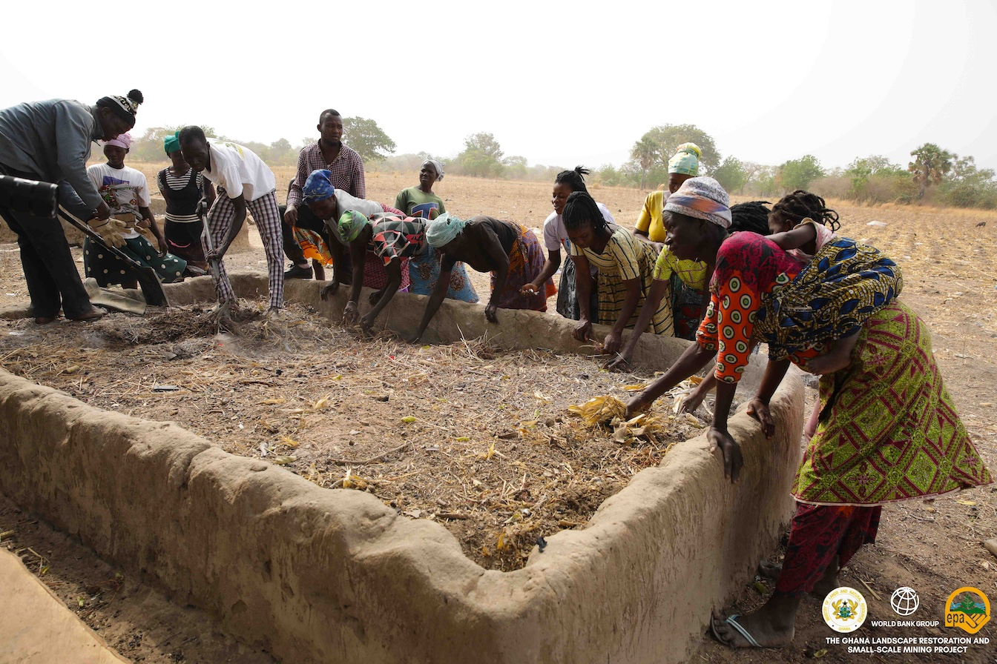
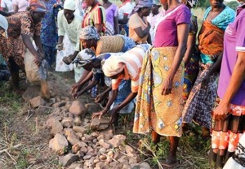
Involvement of Indigenous and Local Communities
Traditional knowledge and values promotes long term stewardship of local resources
Builds Knowledge and reduces conflicts over resource use.
Traditional conservation methods such as sacred groves, stone lining and composting promotes ecosystem and human health

Slide 14
Some Key International Environmental Frameworks and Ghana’s Commitments [1/2]
1. United Nations Framework Convention on Climate Change (UNFCCC)
Submitted its Nationally Determined Contributions (NDCs) for reducing greenhouse gas emissions.
3. Convention on Biological Diversity (CBD),
Developing and implementing the National Biodiversity Strategy and Action Plan (NBSAP).
2. UN Convention to Combat Desertification (UNCCD)
Focus: Sustainable land management and preventing land degradation.
Ghana’s efforts: Implementing reforestation and land restoration programs (e.g. The Ghana Landscape Restoration Small-Scale Mining Project, the Sustainable Land and Water Management Project).
4. Sustainable Development Goals Particularly relevant:
SDG 15 – Life on Land
SDG 14 – Life Below Water
SDG 13 – Climate Action
SDG 5- Gender equality
SDG 2 – Zero Hunger
SDG 1- Poverty reduction

Slide 15
Some Key International Environmental Frameworks and Ghana’s Commitments [2/2]
5. Ramsar Convention on Wetlands
• Ghana has six designated Ramsar Sites, including:, Sakumono Lagoon, Densu Delta, Keta Lagoon
•These are protected under both national law and the Ramsar Convention for their ecological, cultural, and economic importance.
6. African Union & ECOWAS Environmental Frameworks
African Union Agenda 2063: Promotes sustainable natural resource management and climate resilience.
ECOWAS Environmental Policy: Encourages cross-border conservation and sustainable development programs across West Africa.

Slide 16
Why These Frameworks Matter for Ghana
Policy Alignment:
Helps Ghana align national policies with global sustainability goals.
1
Funding Access:
International climate and conservation financing (e.g. Green Climate Fund, GEF).
2
Technical Support:
Provides access to expertise, training, and technology.
3
Accountability & Reporting:
Encourages transparent progress tracking and data sharing.
4

Slide 17
Some Challenges
  • Conflicting land-use priorities
  • Insufficient funding for conservation
  • Weak governance and law enforcement
  • Climate change impacts outpacing efforts.
  Land tenure insecurity hinders long-term investment
  Deforestation pressure from illegal mining

Slide 18
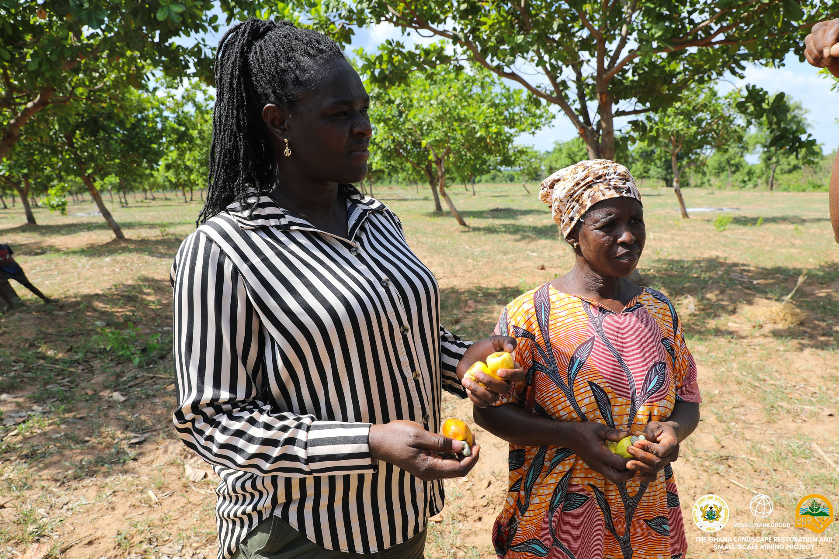
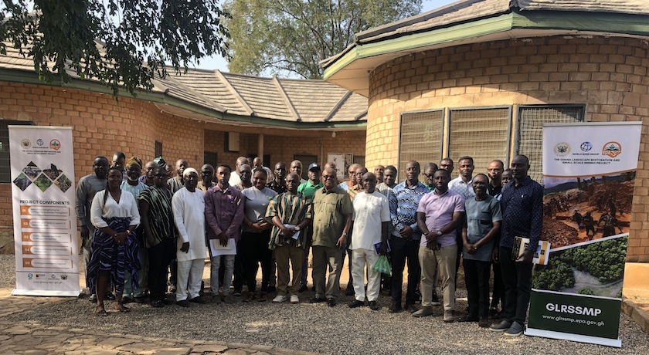
Call to Action
What can governments, communities, and individuals do?
Promote policies that value ecosystem services
Support local conservation initiatives
Law enforcement
Adopt sustainable consumption habits
Invest in nature-based solutions
Join Citizen Science Project
Get Creative

Slide 19

Conclusion
Environmental Conservation and sustainable ecosystems are not optional; they are foundations of life. Protecting them safeguards our health, supports economic and social stability, and ensures the planet remains habitable for future generations. The time to act is now.

Slide 20
Thank you

