Slide 1

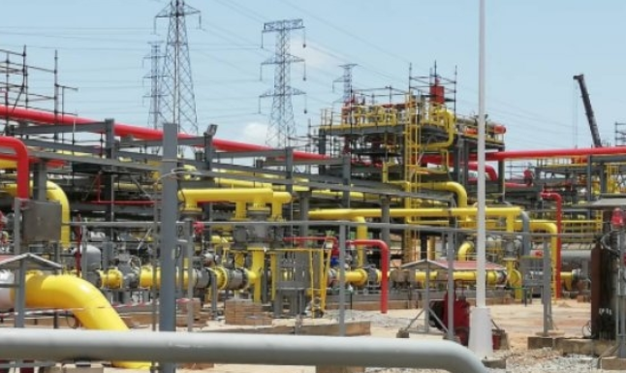

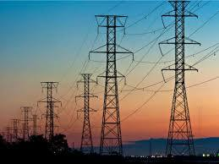
Ghana’s Infrastructural Preparedness for Electric Vehicle
Presented by
Frederick Ken. Appiah
(Dep. Director, Renewable Energy)
10 October, 2024

Slide 2






OUTLINE
Policy Frameworks
eV Market Development and Potential
Regulatory Frameworks for the eV Market
Supporting/Leveraging Structures
Challenges
www.energycom.gov.gh (+233) 302 813756/7
EnergyCommissionGhana

Slide 3
Growth in the Global eV Market
Almost 14 million new electric cars were registered globally in 2023, bringing their total number on the roads to 40 million [Global EV Outlook (GEVO-2023)].
Electric car sales in 2023 were 3.5 million higher than in 2022, a 35% year-on-year increase. This is more than six times higher than in 2018, just 5 years earlier.
In 2023, there were over 250 000 new registrations per week, which is more than the annual total in 2013, ten years earlier.
Electric cars accounted for around 18% of all cars sold in 2023, up from only 2% in 2018.
These trends indicate that growth remains robust as electric car markets mature. Battery electric cars accounted for 70% of the electric car stock in 2023.

Slide 4

ENERGY TRANSITION FRAMEWORK
Net-Zero Targets -2040
• Upscaling of nuclear power in the electricity generation mix.
• Phasing out off-road fossil-fuelled ICEs.
• Phased out fossil liquid fuel for electricity generation.
Net-Zero Targets -2050
• More than 50% of metro urban households use electric stoves.
• More than 90% of household electrical appliances are best in class.
• More than 70% of road vehicles are electricity and hydrogen fuelled.
Net-Zero Targets -2070
• More than 70% of rural households use LPG for cooking.
• All road and rail mobilities are electricity and hydrogen fuelled.
• Net-zero emission in electricity generation in the mid-60s.

Slide 5

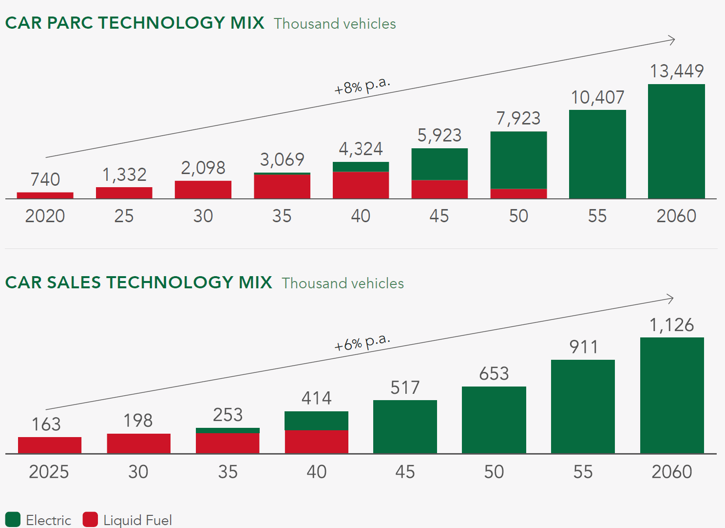
ENERGY TRANSITION INVESTMENT PLAN

Slide 6
NATIONAL EV POLICY
The National Electric Vehicle Policy seeks to effectively contribute to a reduction in greenhouse gas emissions in the transport sector and to actively promote sustainable development.
Implementation Phases
Phase 1: 2024-2026. This is the Preparatory Phase. The key focus will be on addressing the challenges and barriers to EV uptake.
Phase 2: 2027 – 2035. The principal objective of this phase is to ensure a successful takeoff and successful transition to EVs in Ghana. The target is that by the end of this phase EV penetration rate will be 35%.
Phase 3: 2036 – 2045: During this phase, efforts will be made to ensure that, by the year 2045 no new petrol or diesel vehicles would be sold or imported into Ghana.

Slide 7
MARKET POTENTIAL
As of 2022, there were over 3.2 million registered vehicles in Ghana.
Over 100,000 cars are imported into Ghana every year. (www.trade.gov, Dec. 2023)
About 90% of the cars on Ghana’s roads are imported used cars (www.trade.gov, Dec. 2023)
The Environmental Protection Agency of Ghana (EPA) has identified vehicular exhaust emissions from road transport as the single largest contributor, responsible for 48% of the total energy emissions and 17% of the total national emissions.
The national target is to achieve net zero emissions by 2060-2070.
High cost of fuel.

Slide 8
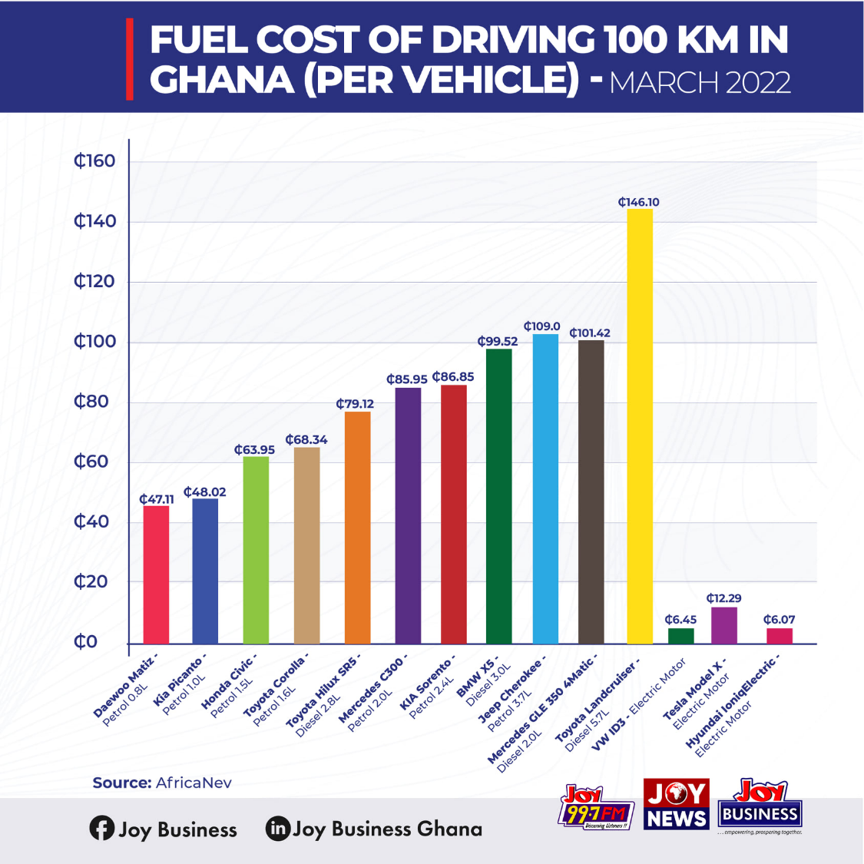


MARKET DEVELOPMENT

Slide 9
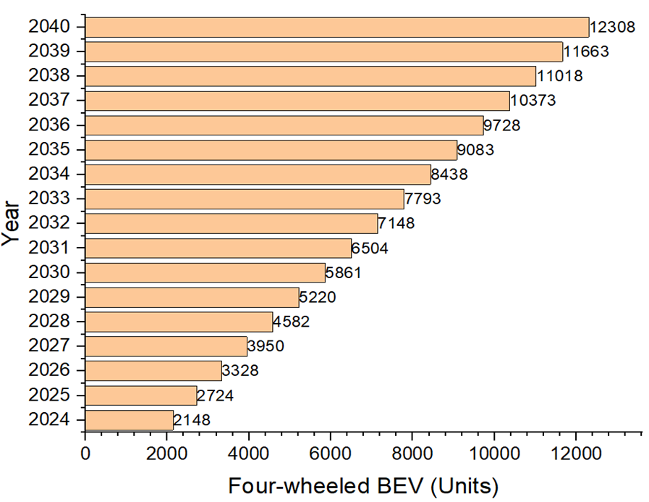
MARKET POTENTIAL
Cumulative forecast of four-wheeled BEV under BAU
According to the DVLA, 1,363 four-wheeled Battery Electric Vehicles (BEVs) were registered at the end of 2022, representing a yearly registration of 194 units
Source: Study by EC, UNDP, MESTI, 2023

Slide 10
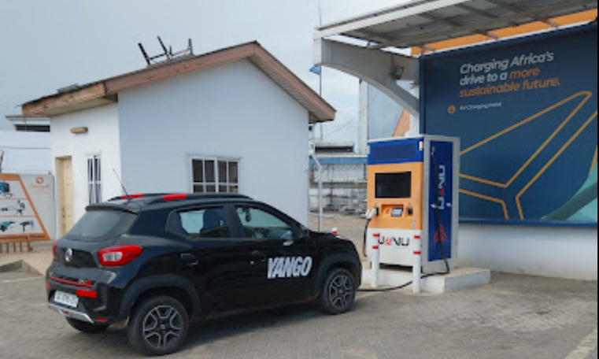
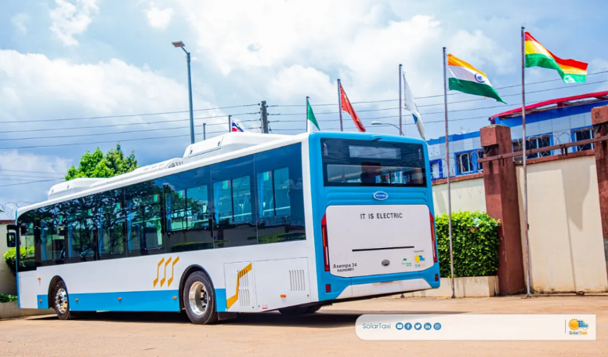
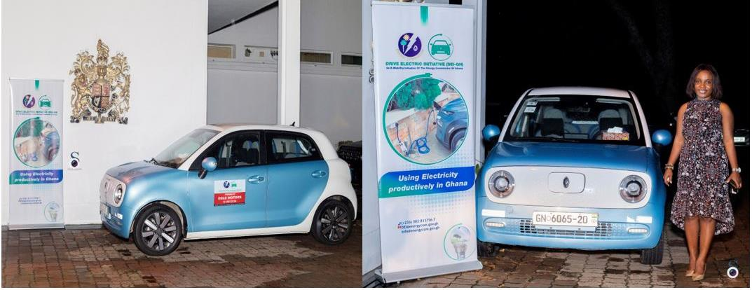
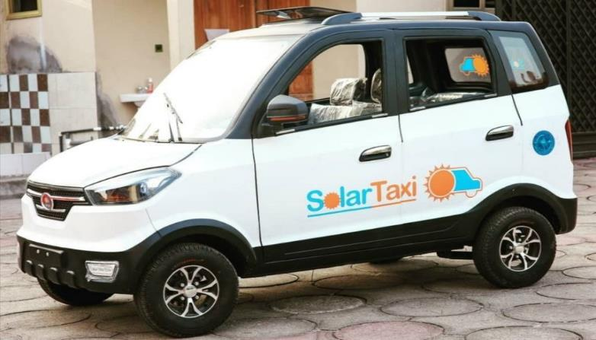
MARKET DEVELOPMENT

Slide 11
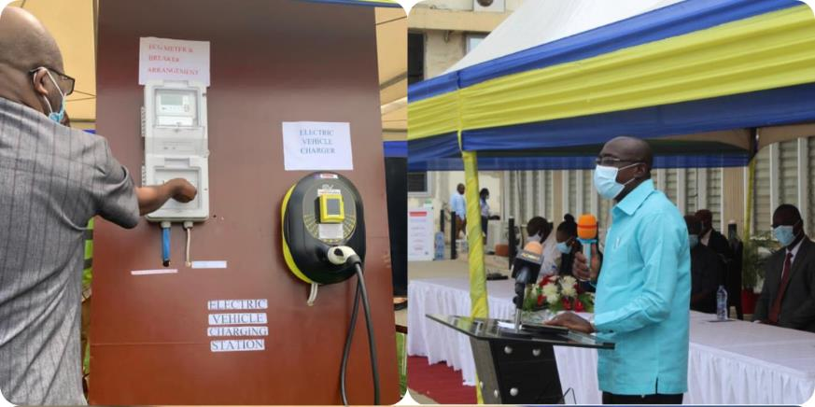
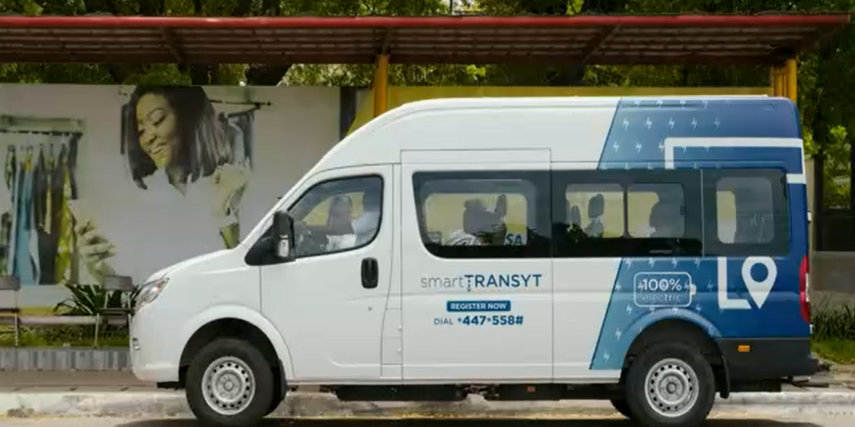
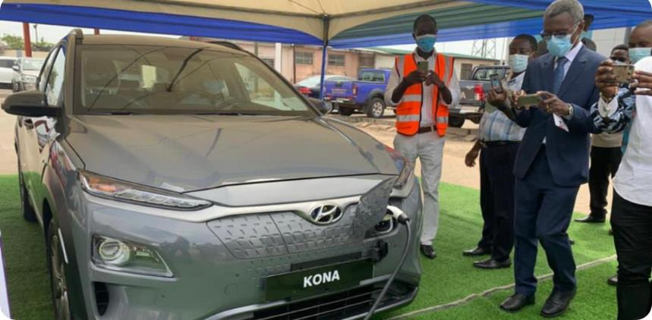
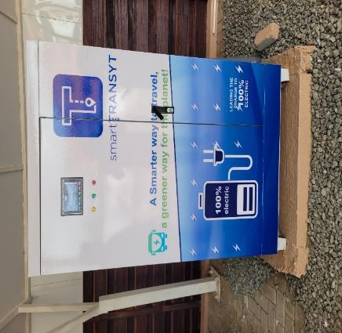
MARKET DEVELOPMENT

Slide 12

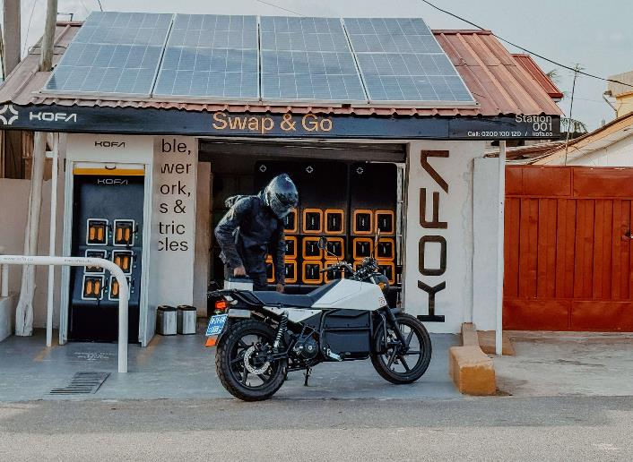


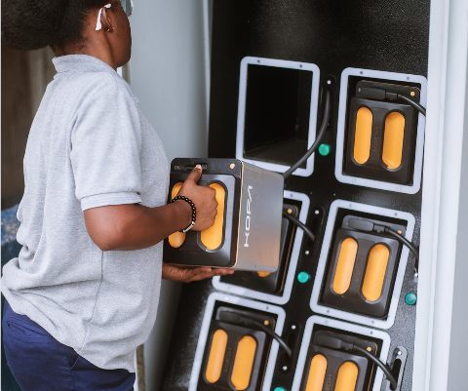

MARKET DEVELOPMENT

Slide 13
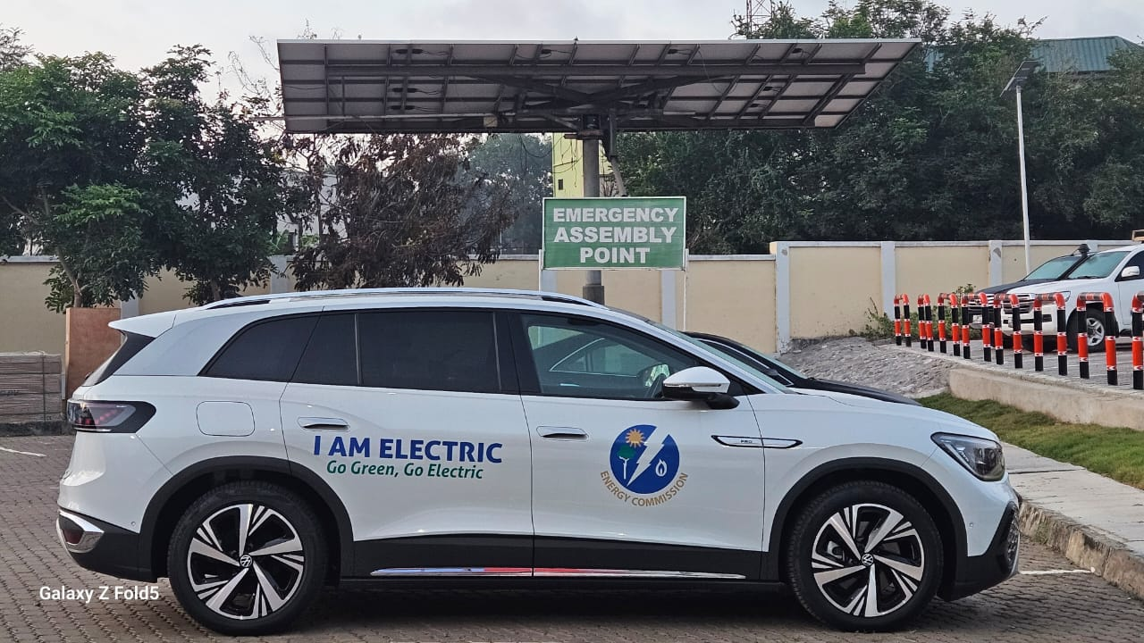
MARKET DEVELOPMENT

Slide 14
THE BIG QUESTION??
  Are there enough infrastructure for these developments and potential growth?
  Phase 1: 2024-2026. This is the Preparatory Phase. The key focus is;
    putting in place the necessary policy and regulatory frameworks
    addressing the challenges and barriers to EV uptake

Slide 15
REGULATORY FRAMEWORK FOR ELECTRIC VEHICLE CHARGING INFRASTRUCTURE

Slide 16
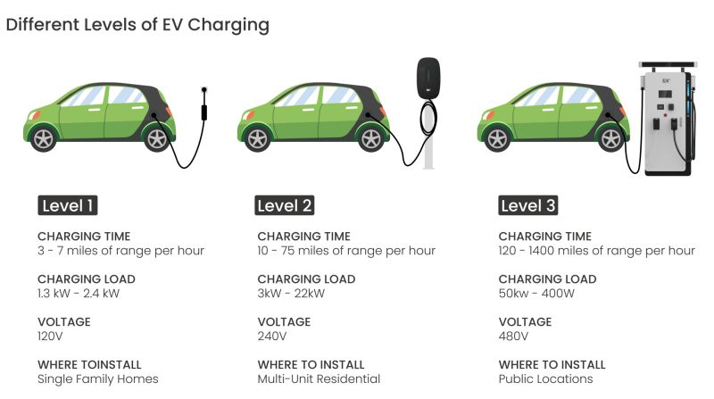
eV CHARGING STATIONS
18-48 hours 3-12 hours 15-50 mins
Residential Residential/Public locations Public locations
Residential Residential/Public locations Public locations

Slide 17
1. eV STANDARDS
  Relevant applicable standards (49) have been developed/adopted as Ghana Standards
# | Standard Number | Title
2 | GS 4501-2019 | Compulsory specification of motor vehicles of category M1
3 | GS 4502-2019 | Compulsory specification of motor vehicles of category N1
4 | GS IEC 61851-1:2023 | Electric vehicle conductive charging system - Part 1: General requirements
5 | GS IEC 61851-21-1:2023 | Electric vehicle conductive charging system - Part 21-1 Electric vehicle on-board charger EMC requirements for conductive connection to AC/DC supply
7 | GS IEC 61851-23:2023 | Electric vehicle conductive charging system - Part 23: DC electric vehicle charging station
8 | GS IEC 61851-24:2023 | Electric vehicle conductive charging system - Part 24: Digital communication between a d.c. EV charging station and an electric vehicle for control of d.c. charging
15 | GS IEC 62196-2:2023 | Plugs, socket-outlets, vehicle connectors and vehicle inlets - Conductive charging of electric vehicles - Part 2: Dimensional compatibility and interchangeability requirements for a.c. pin and contact-tube accessories

Slide 18
1. eV STANDARDS
  Relevant applicable standards (49) have been developed/adopted as Ghana Standards
# | Standard Number | Title
16 | GS IEC 62196-3:2023 | Plugs, socket-outlets, vehicle connectors and vehicle inlets - Conductive charging of electric vehicles - Part 3: Dimensional compatibility and interchangeability requirements for d.c. and a.c./d.c. pin and contact-tube vehicle couplers
18 | GS IEC 62196-6:2023 | Plugs, socket-outlets, vehicle connectors and vehicle inlets - Conductive charging of electric vehicles - Part 6: Dimensional compatibility requirements for DC pin and contact-tube vehicle couplers intended to be used for DC EV supply equipment where protection relies on electrical separation
19 | IEC 60884-1:2002 + A1:2006 + A2:2013 | Plugs and socket-outlets for household and similar purposes - Part1: General requirements
21 | IEC 60364-5-54 | Low-voltage electrical installations - Part 5-54: Selection and erection of electrical equipment - Earthing arrangements and protective conductors
22 | GS IEC 62893-1:2023 | Charging cables for electric vehicles for rated voltages up to and including 0,6/1 kV - Part 1: General requirements

Slide 19
1. eV STANDARDS
  Relevant applicable standards (49) have been developed/adopted as Ghana Standards
# | Standard Number | Title
28 | GS IEC TS 62840-1:2023 | Electric vehicle battery swap system - Part 1: General and guidance
29 | GS IEC 62840-2-2023 | Electric vehicle battery swap system - Part 2: Safety requirements
30 | GS IEC PAS 62840-3:2023 | Electric vehicle battery swap system - Part 3: Particular safety and interoperability requirements for battery swap systems operating with removable RESS/battery systems
31 | GS IEC 62752: 2023 | In-cable control and protection device for mode 2 charging of electric road vehicles (IC-CPD)
34 | IEC 62305-3 | Protection against lightning - Part 3: Physical damage to structures and life hazard
42 | GS ISO 15118-2:2023 | Road vehicles — Vehicle-to-Grid Communication Interface-Part 2: Network and application protocol requirements
47 | GS IEEE 2030.1.1-2023 | Standard for Technical Specifications of a DC Quick and Bidirectional Charger for Use with Electric Vehicles

Slide 20
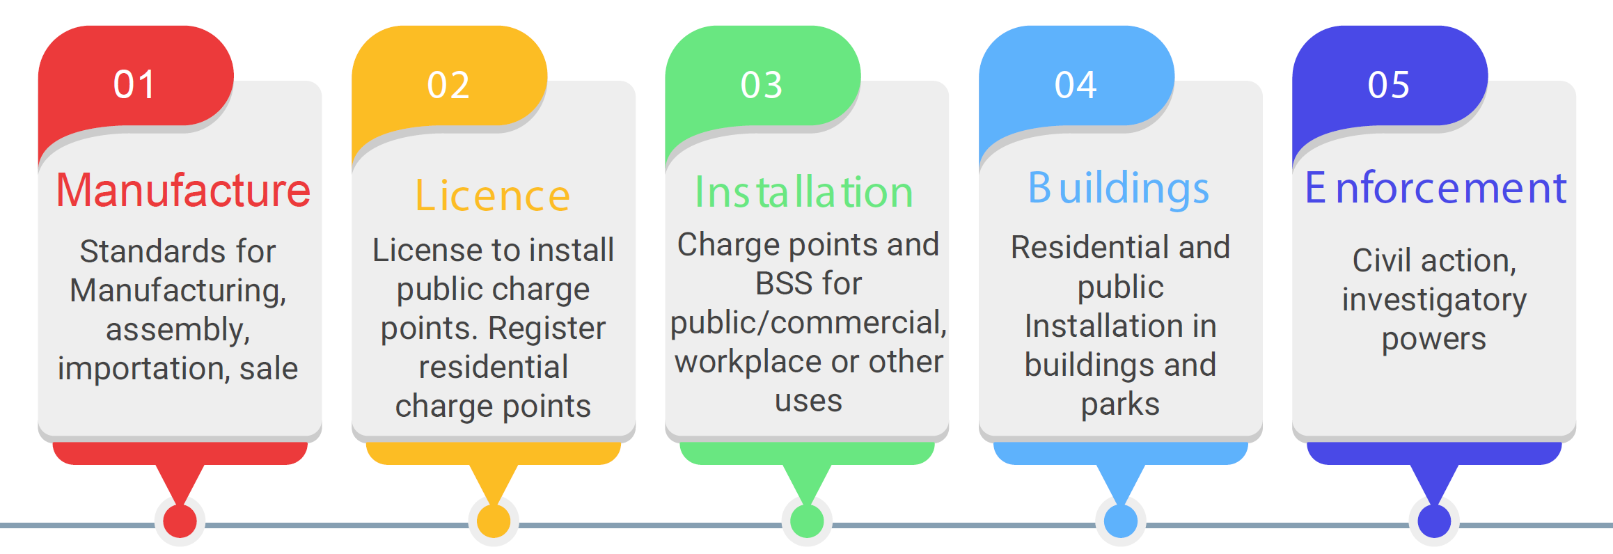
2. eV REGULATIONS
  A draft Regulation on eV Charging (Residential, Public, Charge Point Safety) have been developed, and it applies to the following:

Slide 21
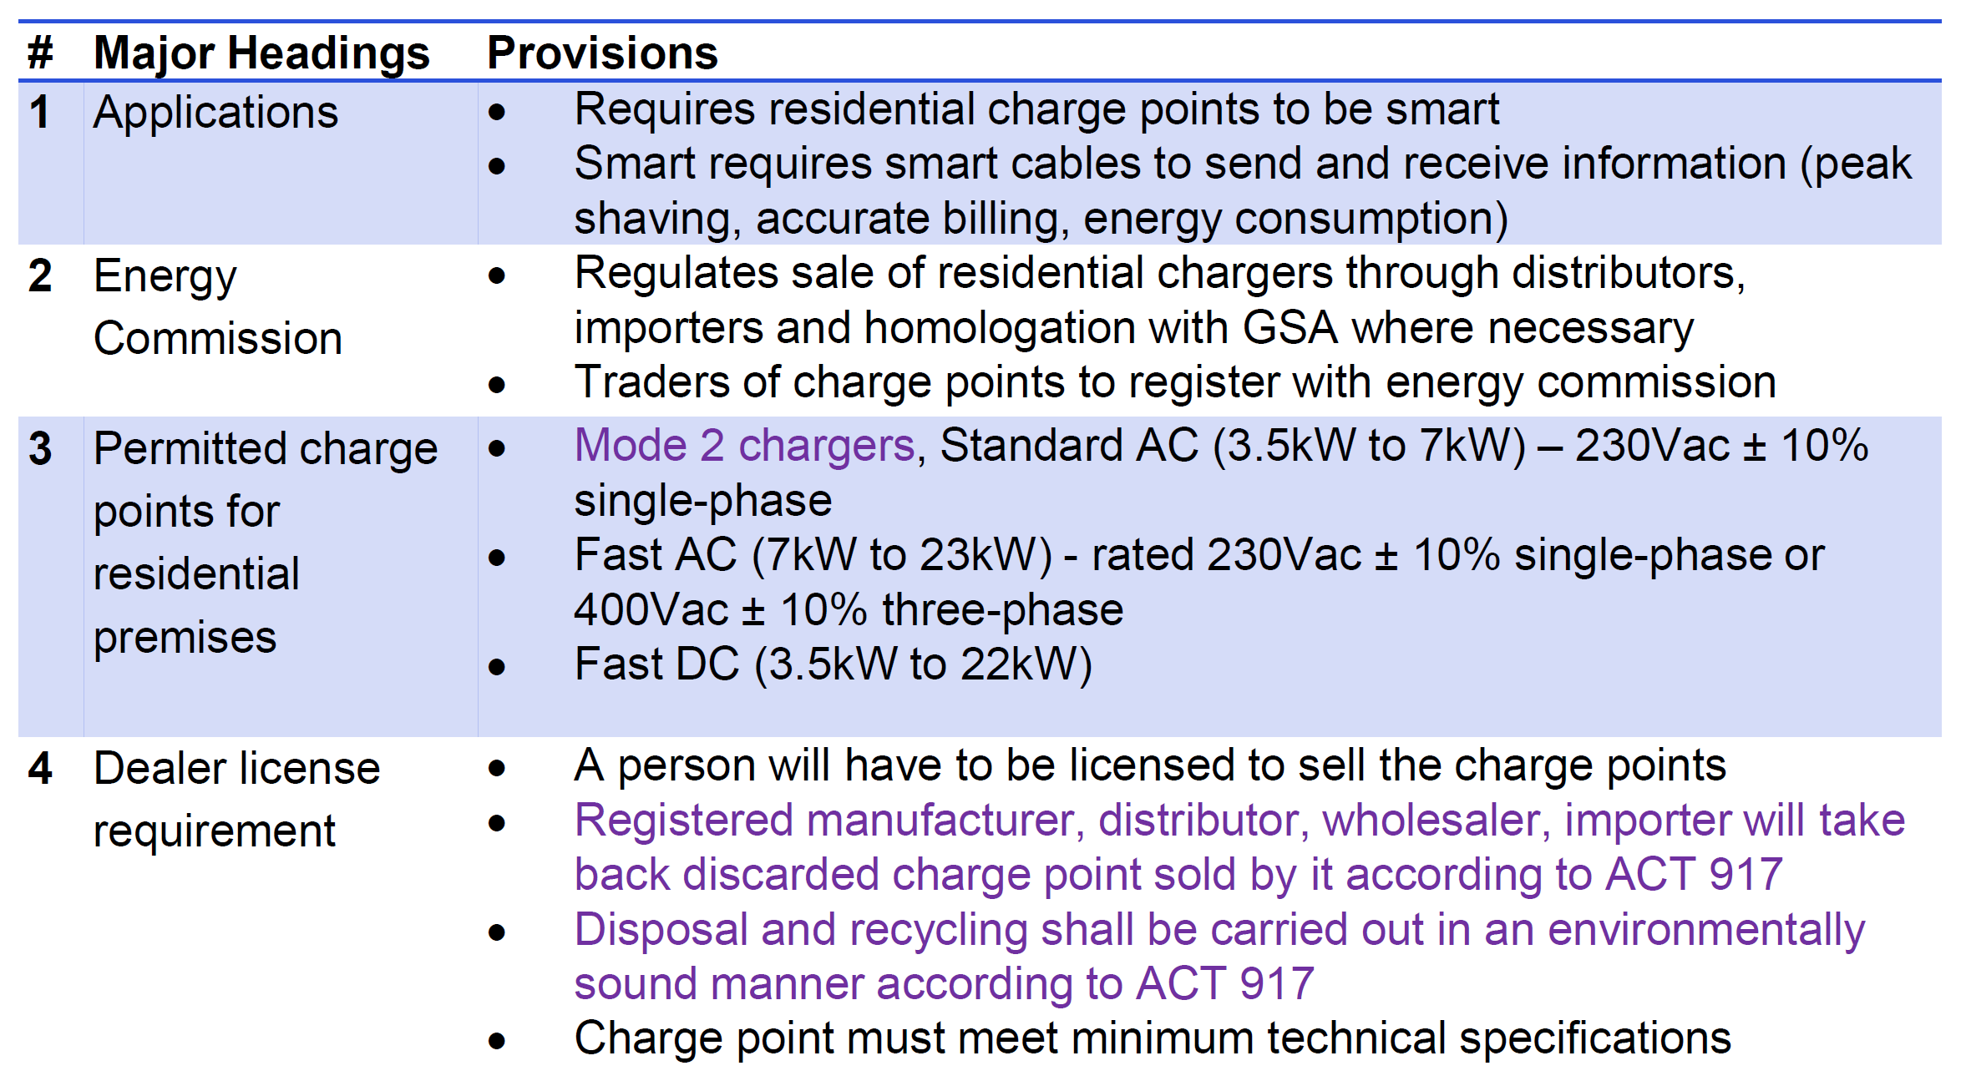
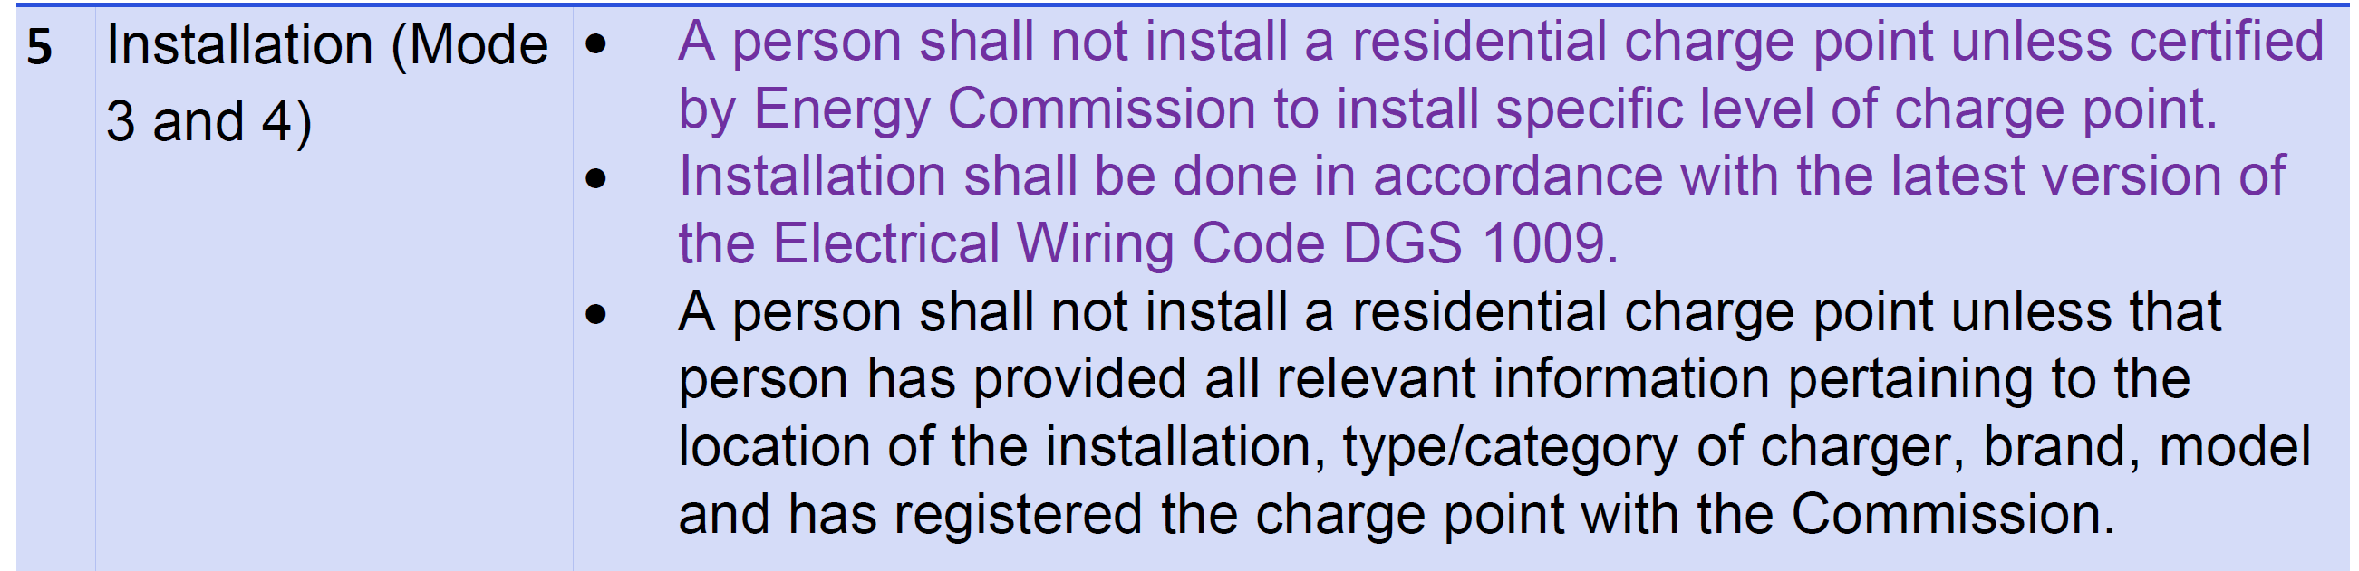
(1) Residential Charge Point

Slide 22
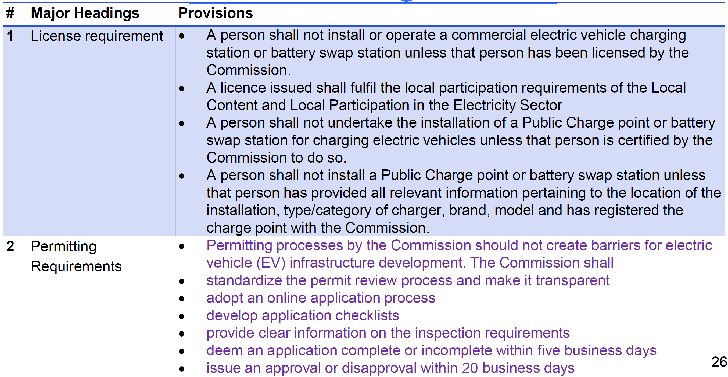
(2) Public Charge Points

Slide 23
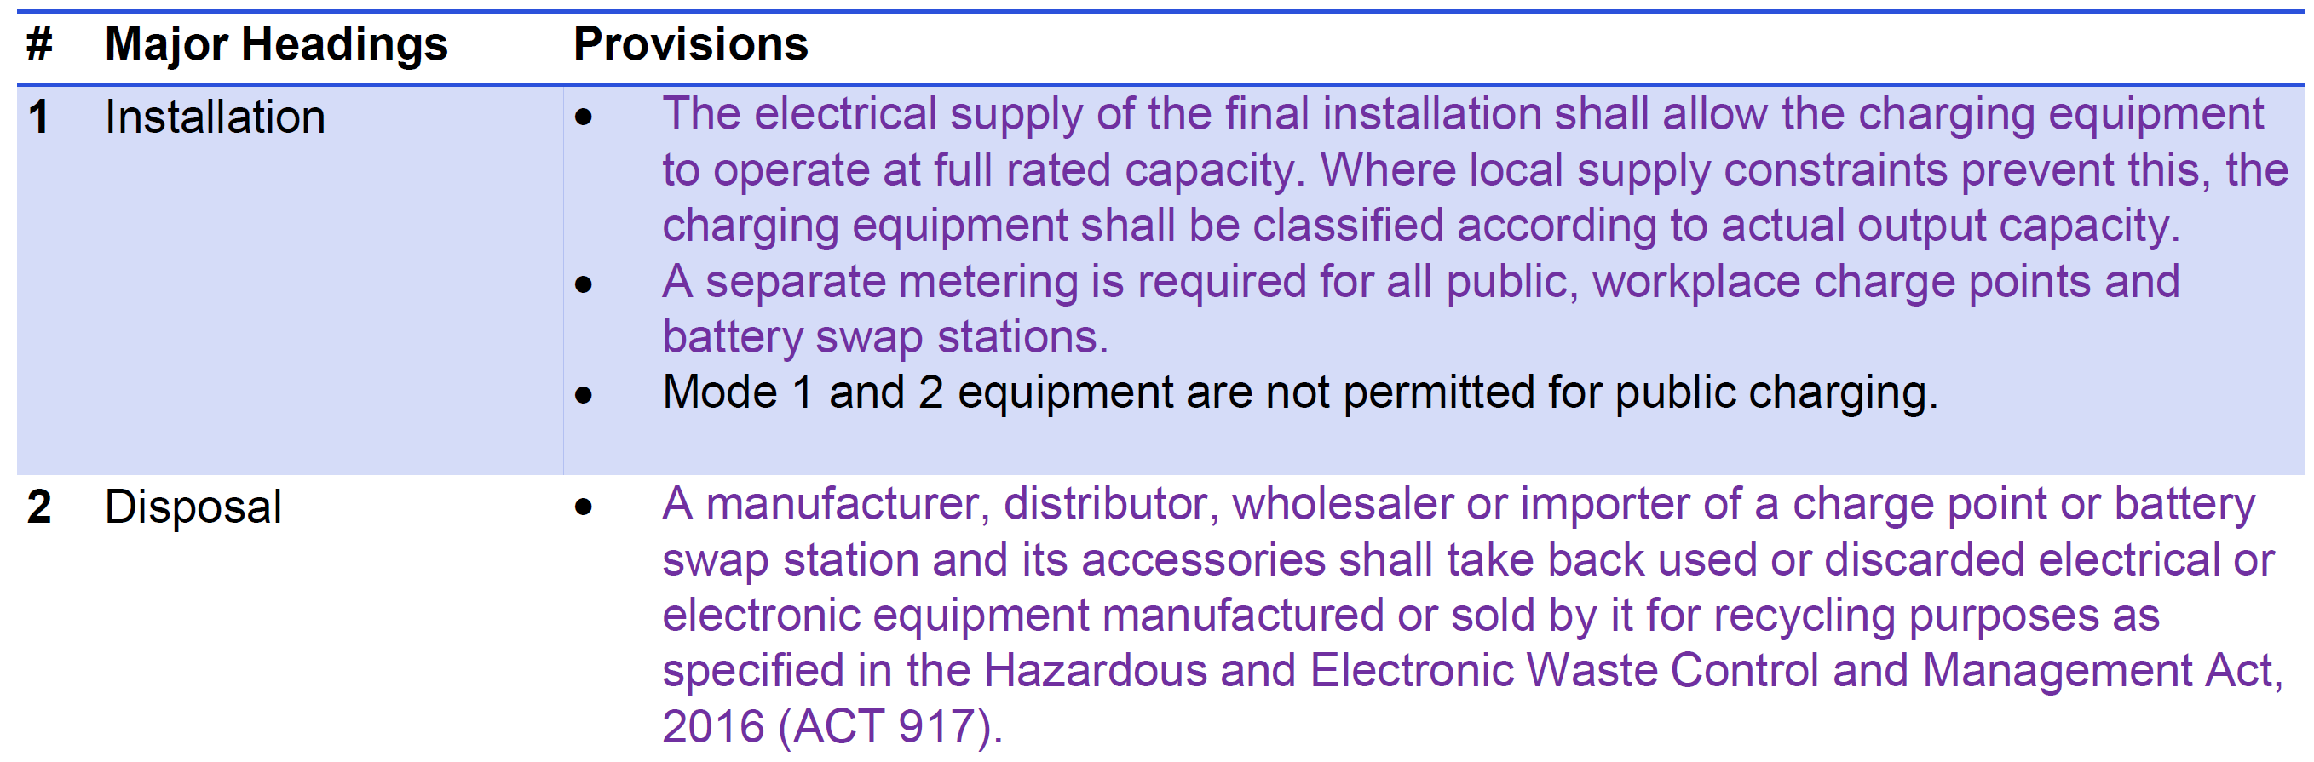
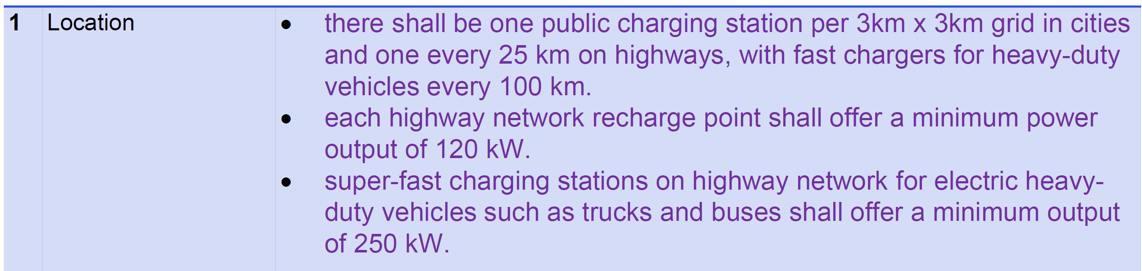
(2) Public Charge Points

Slide 24
(2) Public Charge Points
Other Requirements include;
  Fire Prevention (Charge point made of fire retardant material, and have fire detection, alarm control)
  Overload protection, lightening protection, attack protection
  Earthing protection
  Metering
  Pricing
  Payment system (provision of ticket dispensers in public places)
  Labelling and markings
  Reporting obligations
  Display/publication of charging reserve and reliability information

Slide 25
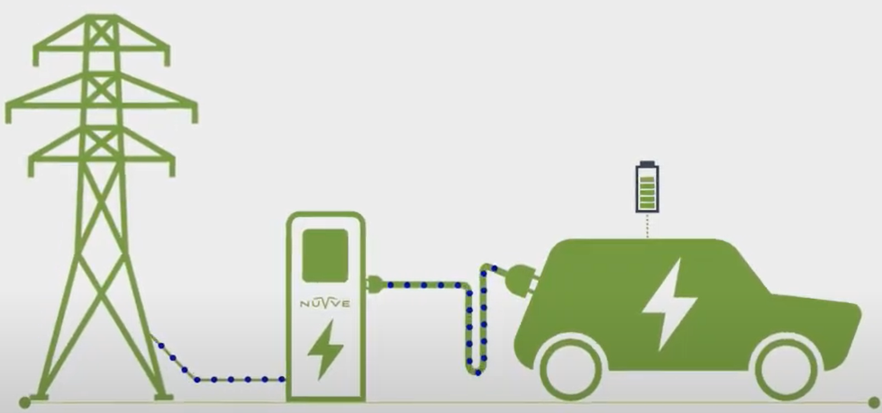
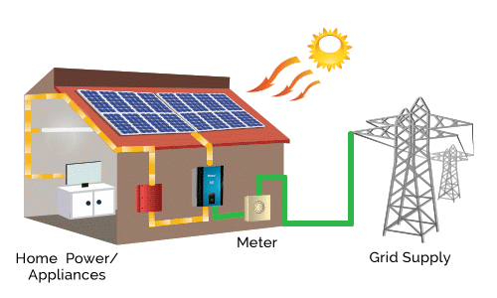
Leveraging on the Net-Metering Programme
Target is 12,000 Net-Metered Solar PV Distributed Generation Systems
Vehicle-to-Grid (V2G)
Contract already signed for the supply of 12,000 net meters

Slide 26
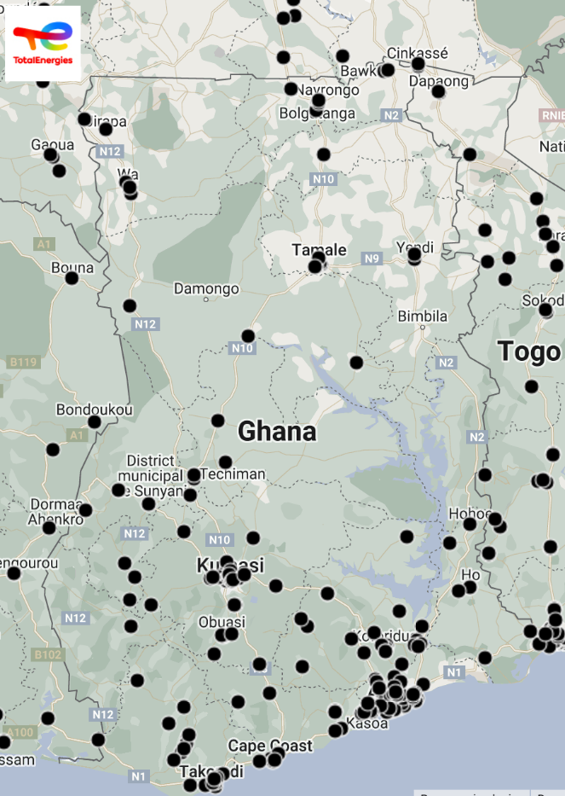

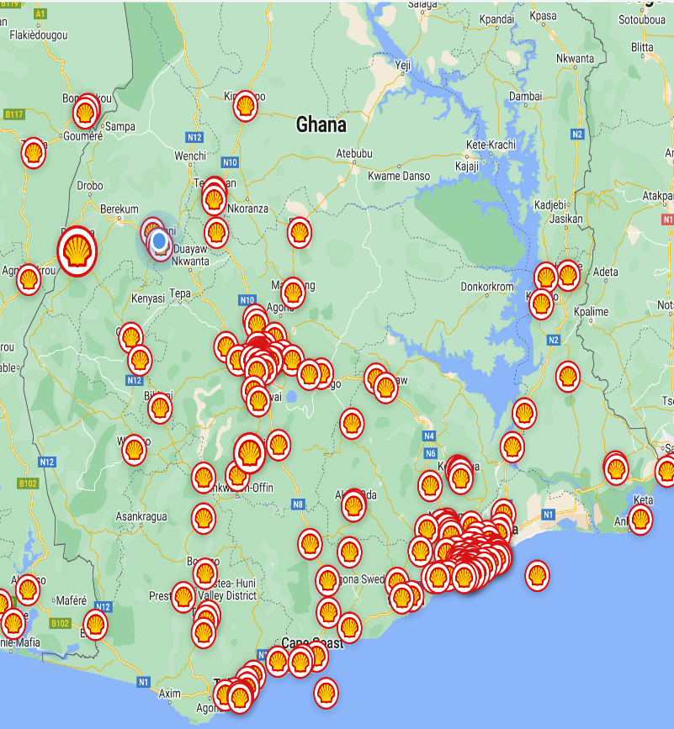
Leveraging on Fuel Stations Infrastructure

Slide 27

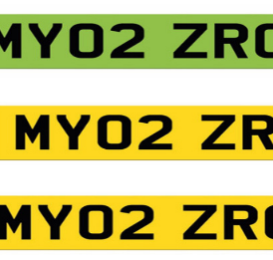
Structures to Support the eV Drive
Conducive Tariff Regime: The PURC is working to design a special tariff for eV charging.
Net-Metering: The Energy Commission will consider net meters for eV Charging Stations. The Net Metering Code will apply.
Enforce Bus Lanes Policy: eV buses should not compete with trotros/taxis.
Special Number Plates for eVs: This will promote and easily assist eVs when needed. Eg. In China, some EU countries, they issue green number plates or green highlight.

Slide 28
CHALLENGES
Charge/pricing structure is fee-for-service instead of per kWh
Re-wiring, which most times need a dedicated transformer..
Access to finance
Lack of incentives
Depreciating the Cedi against the dollar

Slide 29
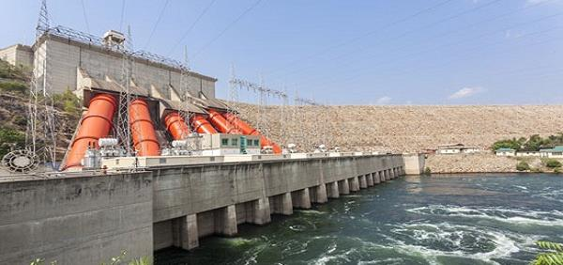




THANK YOU FOR YOUR ATTENTION
Follow us
EnergyCommissionGhana
EnergyCommissionGhana
EnergyCommissionGhana
www.energycom.gov.gh (+233) 302 813756/7

