Slide 1


THE ROLE OF TECHNOLOGIES IN ACHIEVING AFFORDABLE ENERGY IN GHANA
Ing. Prof. Samuel Gyamfi
Department of Renewable Energy Engineering
Regional Center for Energy and Environmental Sustainability (RCEES)
University of Energy and Natural Resources
Sunyani
Date: October 10, 2024

Slide 2

Presentation Outline
Introduction
World energy outlook
Ghana’s Energy Outlook
Sustainable Developmental Goals
Ghana Energy Transition Framework
Role of Technology in Addressing Energy Issues in Ghana
Technological Innovations
The way forward
2

Slide 3
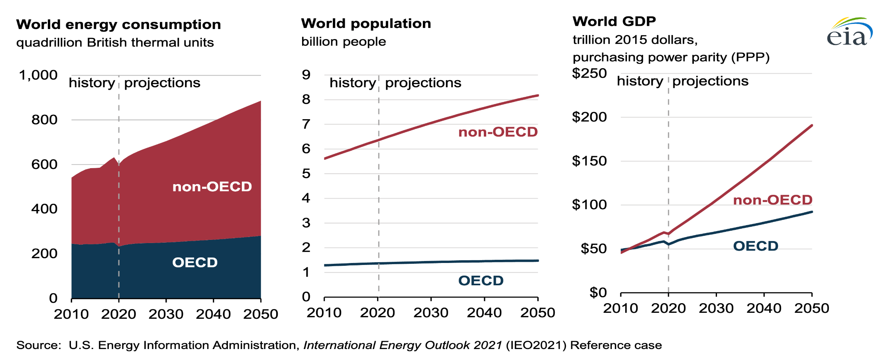
Introduction
The global energy demand is continually rising, driven by population growth, industrialization, and economic development.
3

Slide 4
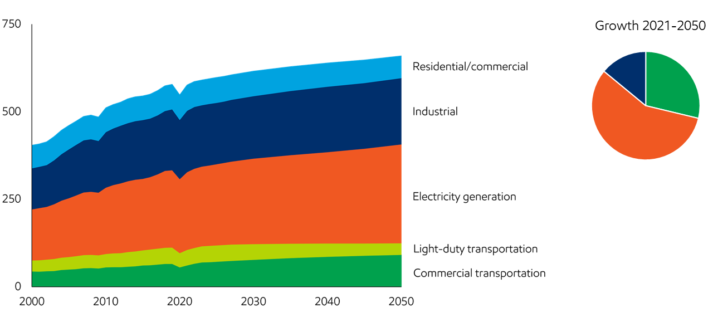
Global Energy Demand Growth
Global demand will reach about 660 quadrillion Btu in 2050, up about 15% from 2021, reflecting a growing population and rising prosperity.
Residential and commercial primary energy demand will decline by approximately 15% by 2050 as efficiency improvements offset the energy needs of a growing population.
Electricity generation is the largest sector and one of the fastest-growing, driven mainly by expanding access to reliable electricity in developing countries.
Global Outlook Report,2024
https://corporate.exxonmobil.com/what-we-do/energy-supply/global-outlook/energy-demand#Transportation
4

Slide 5
Global Energy Supply By Sector, 2023
Fossil fuels dominate current global energy supply.
Source: IEA Energy Balances of Non-OECD Countries, 2023
5

Slide 6
World Primary Energy Supply by Fuel, 1973 & 2023
Doubling time of 30 -35 years
Source: IEA, 2010, Key World Statistics
.
1973 (6115 Mtoe)
2023 (14000 Mtoe)
6

Slide 7
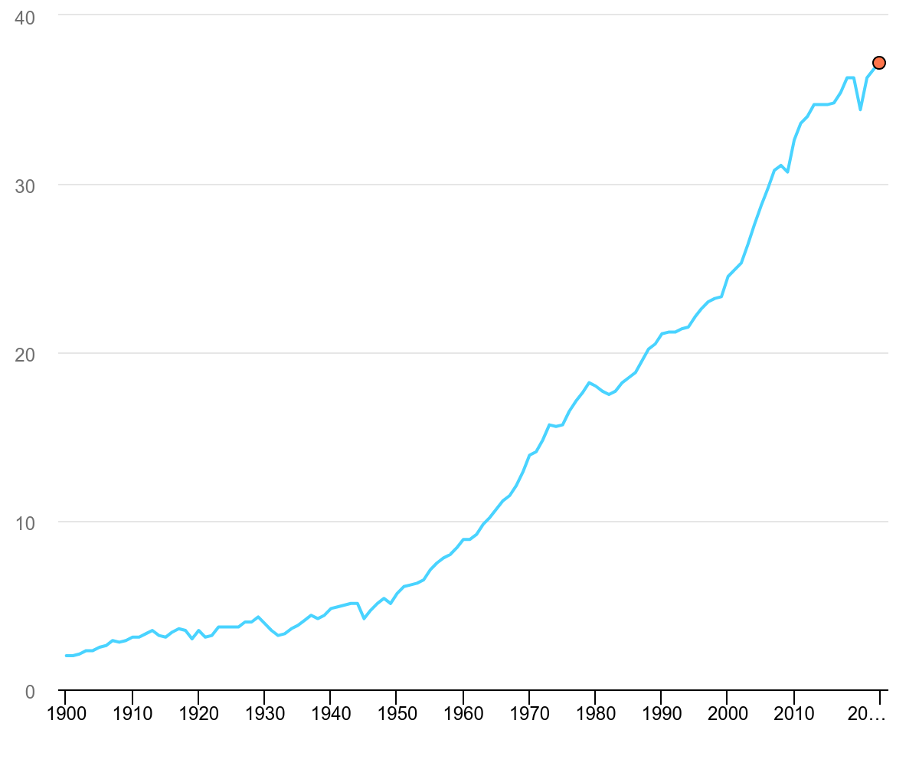
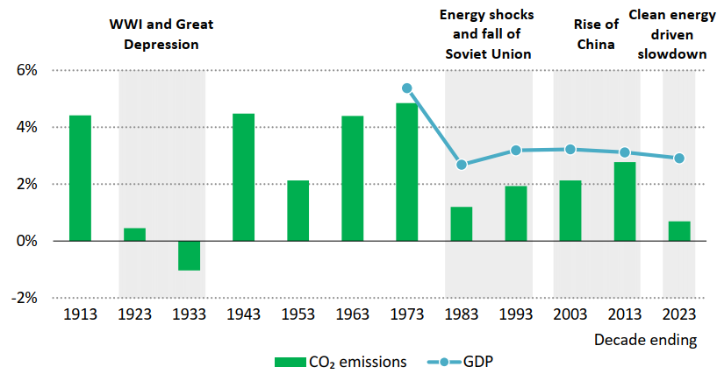
Global Energy Related CO2 Emission
Annual average rate of global CO2 emissions and GDP growth by decade, 1903-2023
Global energy-related CO2 emissions grew by 1.1% in 2023, to reach a new record high of 37.4 billion tonnes (Gt).
The decrease in emissions is due to the growing deployment of 5 key clean energy technologies since 2019 - solar PV, wind power, nuclear power, heat pumps, and electric cars
IEA, CO2 Emission, 2023
7
Notes:
Global energy-related CO2 emissions grew by 1.1% in 2023, increasing 410 million tonnes (Mt) to reach a new record high of 37.4 billion tonnes (Gt). T

Slide 8
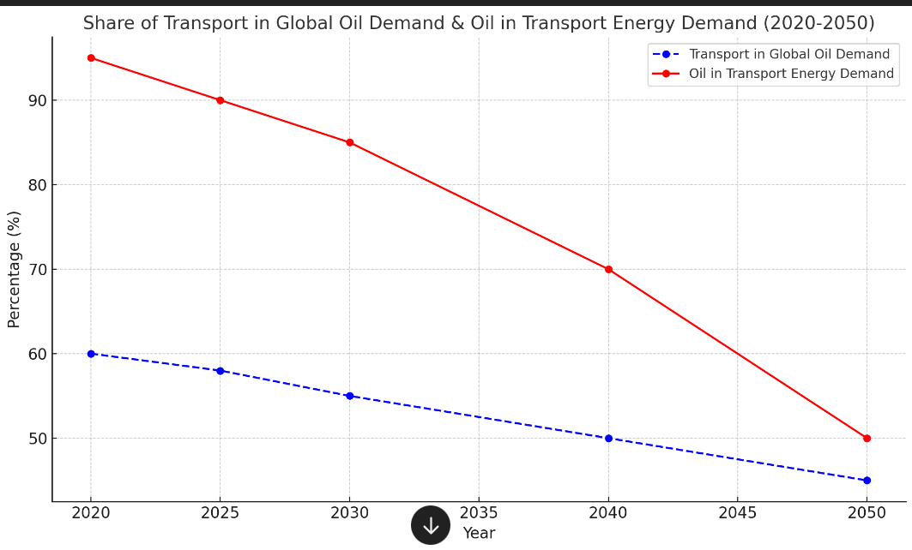
Share of Transportation in Global Oil Demand & Oil in Transport Energy Demand Projections
The blue dashed line represents the decline in the share of transport in global oil demand, gradually decreasing from 60% in 2020 to 45% by 2050.
The red solid line shows the declining share of oil in transport energy demand, dropping from 95% in 2020 to 50% by 2050 as alternative energy sources like electric vehicles and sustainable fuels take on larger roles.
World Energy Outlook Report,2024
8

Slide 9
Fossil Fuel Reserves and their Static Range Of Availability, 2024
FUEL | RESERVES (Mtoe) | ANNUAL PRODUCTION (Mtoe/year) | RANGE OF AVAILABILITY (Years)
Oil | 244,000 | 4260 | 58
Gas | 203,000 | 3980 | 51
Coal | 1,074,000 | 7700 | 139
Estimates depend on factors such as extraction technology, consumption trends, and geopolitical conditions
IEA, Global Critical Minerals Outlook
9

Slide 10
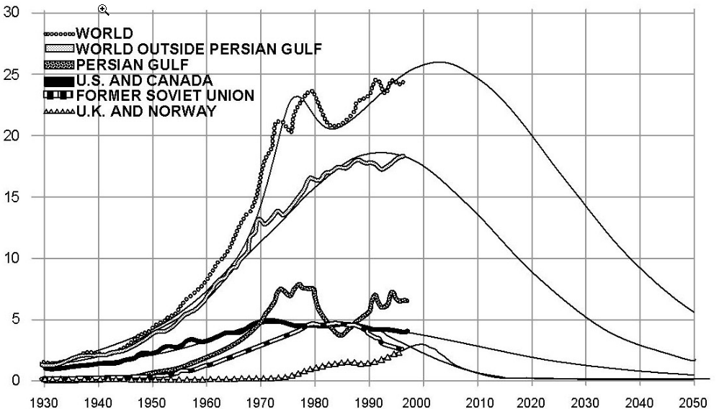
Past and Projected World Oil Production
10

Slide 11
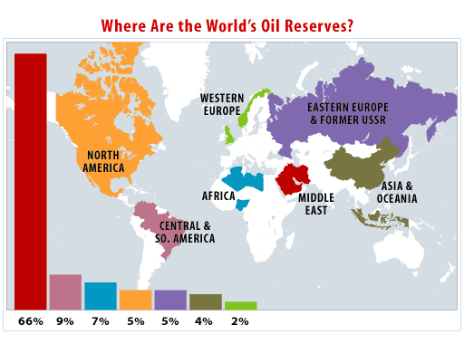
Past and Projected World Oil Production (Cont.)
Saudi Arabia
Saudi Arabia
Saudi Arabia
Saudi Arabia
Saudi Arabia
60
Saudi Arabia
Iran
Iran
Iran
50
Iraq
Kuwait
Mexico
Iran
Alaska
40
Production
Billions of Barrels per year
30
20
10
Discovery
11
1930
1940
1950
1960
1970
1980
1990
2000
2010
2020
2030

Slide 12
Past and Projected World Oil Production (Cont.)
Global Oil Production will Peak and Decline
60
Big Oil Find in the Gulf of Mexico!
50
Discovery
40
Production
Billions of Barrels per year
30
20
Projected Discoveries
10
1930
1940
1950
1960
1970
1980
1990
2000
2010
2020
2030
12

Slide 13
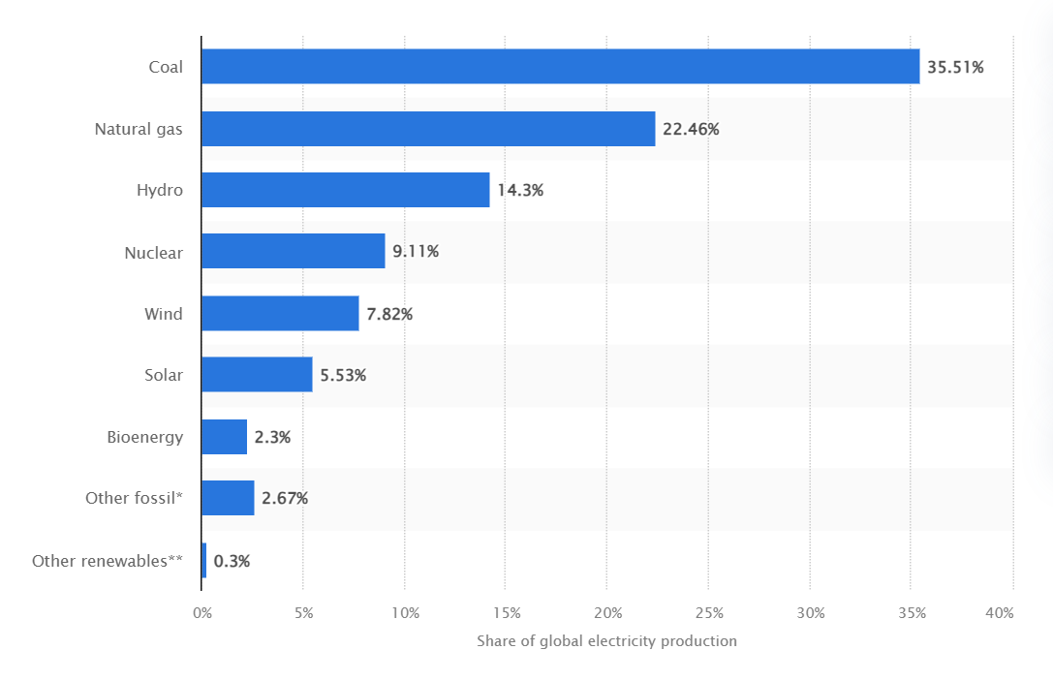
Fuel Share of Global Electricity Production
2023
2008
In 2023, fossil fuels contributed approximately 60.64% of global electricity supply. In 2008, approximately 68% was the global electricity supply. That is a 7 % decrease in the use of fossil fuels
World Energy Outlook Report,2023
13

Slide 14
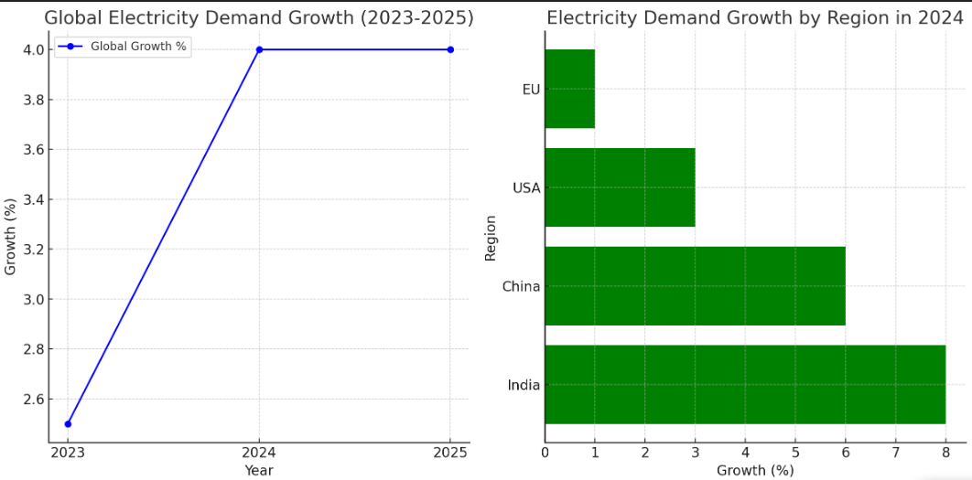
Growth in Electrical Energy Demand
Graph showing two key aspects of global electricity demand growth:
Projected rise in global electricity demand from 2.5% in 2023 to 4% in 2024 and 2025.
Bar chart showing the significant regional growth rates, with India leading at 8%, followed by China at 6%, the USA at 3%, and the EU at 1%
Source: IEA – Executive Summary – Electricity Production 2024
14

Slide 15
Electricity Statistics in Ghana
Population 2021 PHC : 30.8 million
2022 National population electricity access rate: 88.8%
2022 National household electricity access rate: 86.8%
2020 Electricity consumption per capita was 713 kWh, expected to increase to 1,282 kWh by 2030. Based
(Ghana Statistical Services, 2021)
(Energy Commission of Ghana, 2023)
15

Slide 16
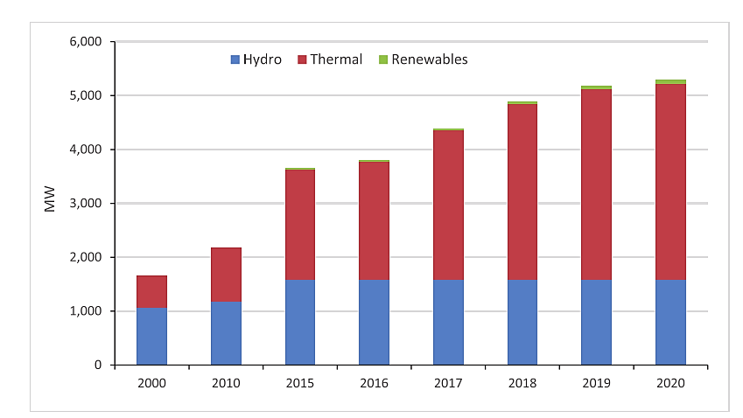
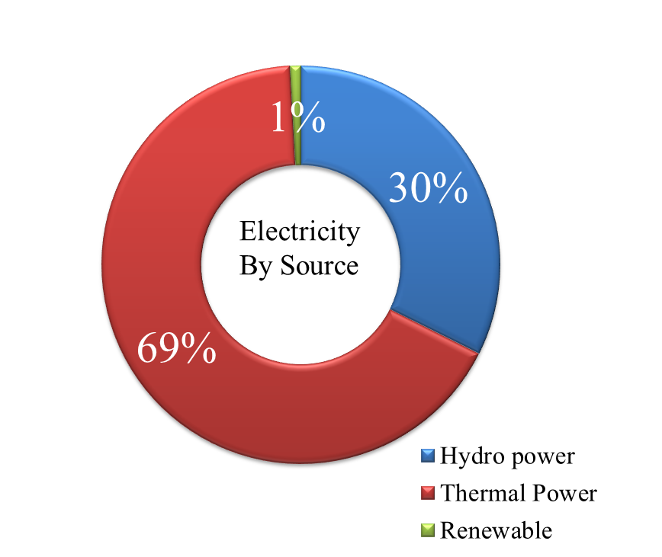
Overview of Ghana's Energy Challenges Energy Mix
Historic
Installed Capacity: 5,454 MW in 2022
Dependable Capacity: 4,843 MW in 2022
Renewable : 112.1 MW in 2022
(Energy Commission of Ghana, 2023)
16

Slide 17
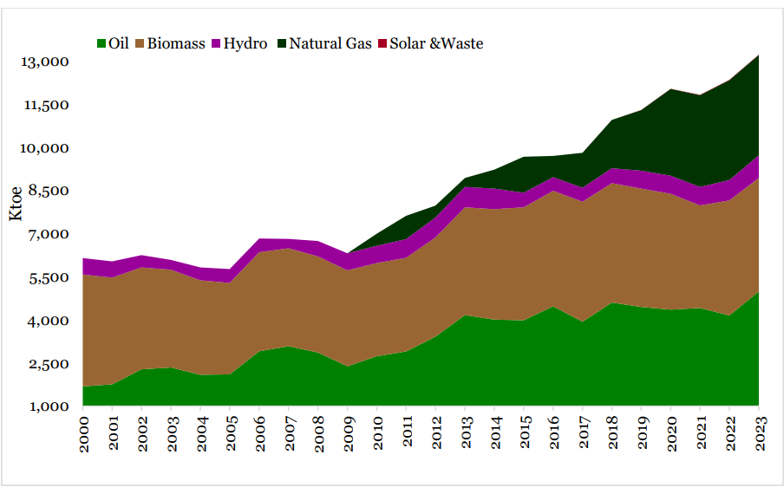
Ghana’s Total Energy Supply
17

Slide 18
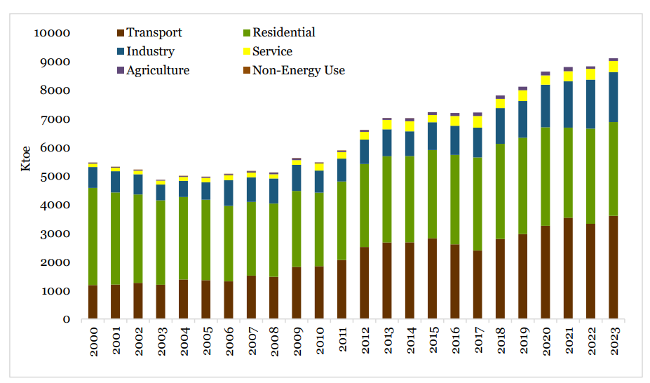
Trend in Energy Consumption by Sector
18

Slide 19
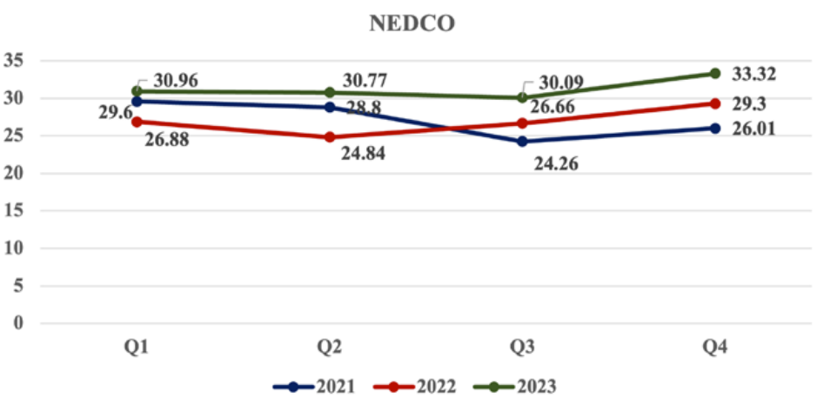
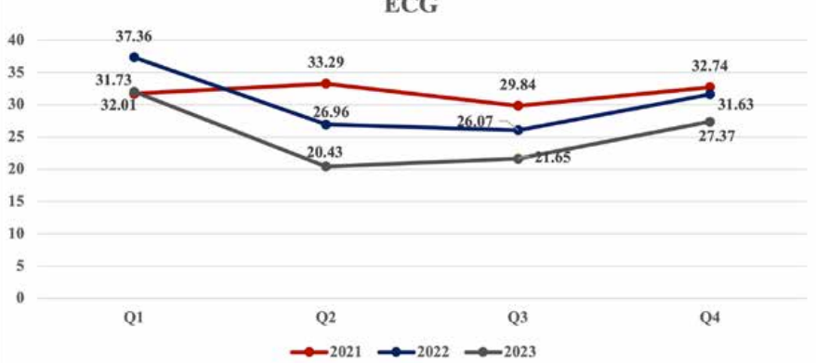
Ghana’s Electricity Distribution Losses (2021-2023)
PURC Regulatory Brief, Issue 8, March 2024
19

Slide 20
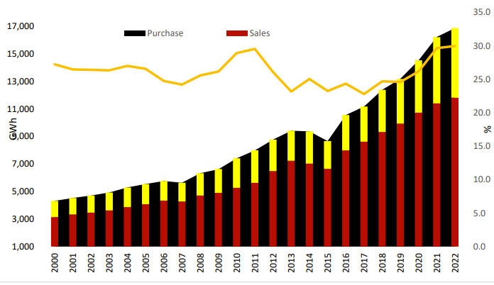
Growth in Ghana’s Electricity Distribution Losses
In 2022, the distribution utilities purchased 16,863 GWh of electricity, with sales amounting to 11,808 GWh.
20

Slide 21
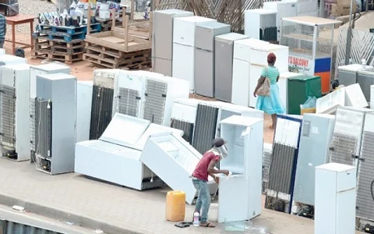
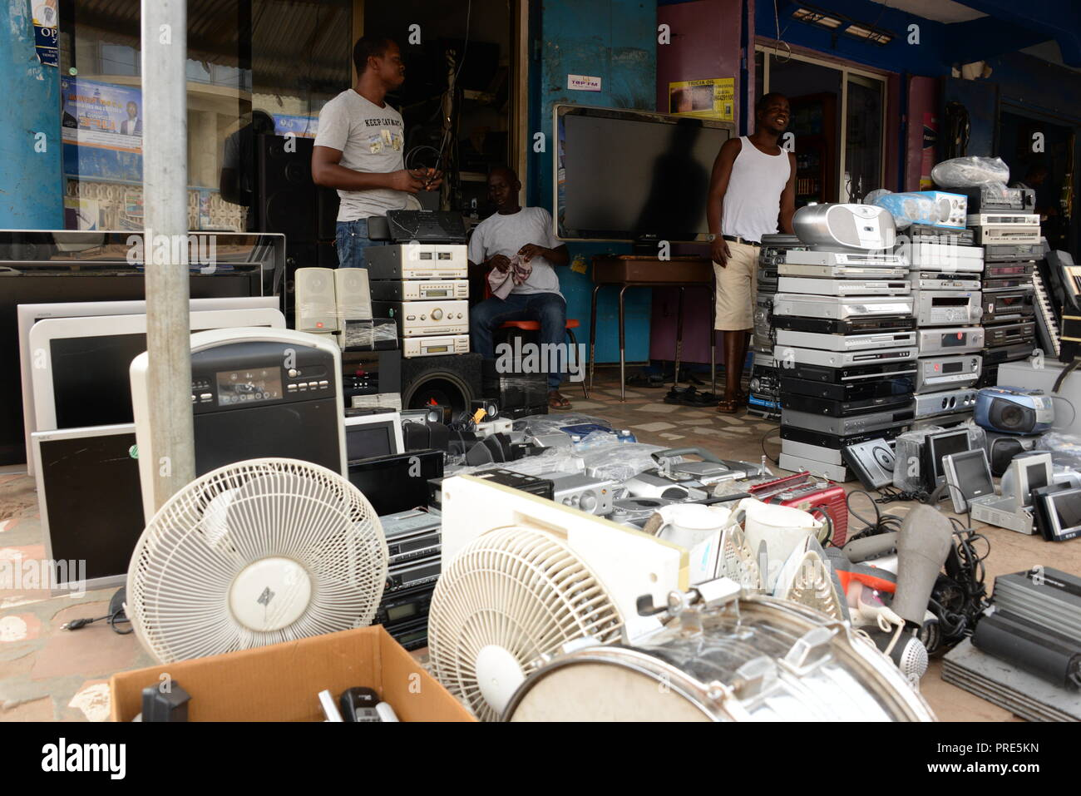
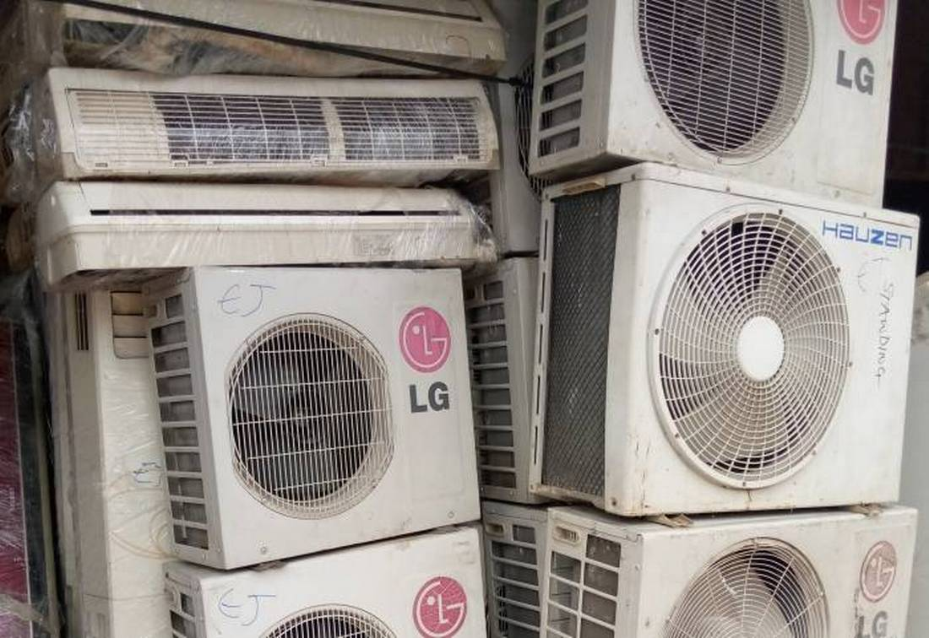
In-efficiencies at the End Use Side
21
Notes:
https://news.trust.org/item/20200624102543-fbvis/

Slide 22
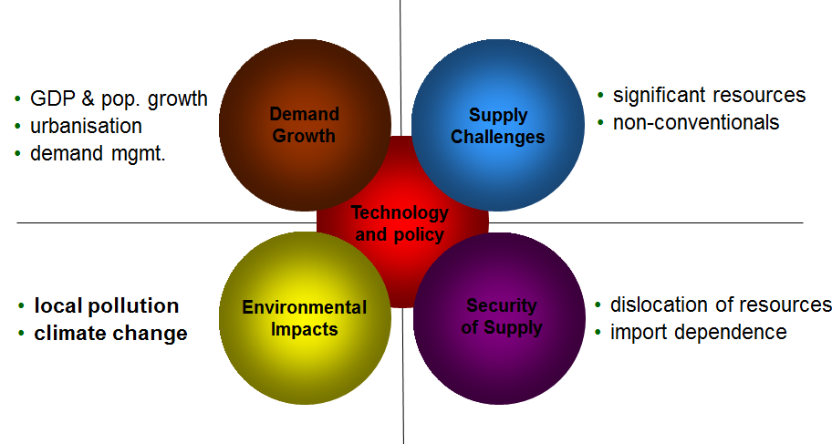
Summary of Key Global Issues
Steven E. Koonin (BP): Energy trends and technologies for the coming decades
22

Slide 23
Key issues in Ghana Electricity Sector
Increasing demand
Negative environmental impacts and climate change?
Supply chain disruptions, resulting in inflation and a surge in energy prices – leading to high food prices
High losses
In-efficiencies at the end-use
….
23

Slide 24

Sustainable Developmental Goals
24

Slide 25
SDG7: Ensure Access To Affordable, Reliable, Sustainable, And Modern Energy For All Targets
7.1 By 2030, ensure universal access to affordable, reliable, and modern energy services.
7.2 By 2030, increase substantially the share of renewable energy in the global energy mix.
7.3 By 2030, double the global rate of improvement in energy efficiency.
25

Slide 26
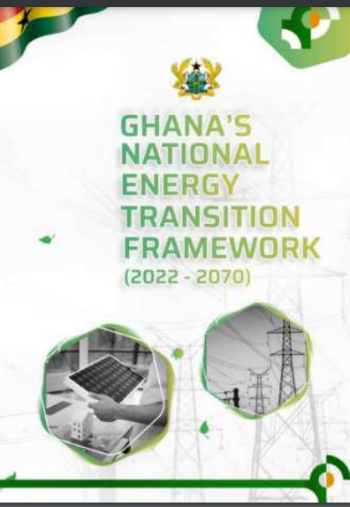
Ghana Energy Transition Framework
Ghana has developed an ambitious energy transition framework to achieve net-zero carbon emissions by 2070.
This plan includes expanding renewable energy, improving energy efficiency, promoting electric mobility, and …..
26

Slide 27
Ghana Energy Transition Framework
Key targets include;
Electrifying more than 95% of households, increasing renewable energy to 10% of electricity generation by 2030
Scaling up nuclear power, adopting sustainable aviation fuels, and phasing out fossil fuel-based electricity generation by 2040
Achieving some of these goals would facilitate decarbonization
27

Slide 28
Ghana Energy Transition Framework
However, this transition faces several challenges such as;
Implementing the $550 billion energy transition plan requires substantial investment, which is challenging given Ghana's current economic conditions.
Raising public awareness and garnering support for renewable energy projects is crucial for successful implementation.
Maintaining political will and ensuring a stable regulatory environment are essential for attracting investments and driving the transition.
Upgrades to the electricity grid are necessary to accommodate increased renewable energy capacity and improve distribution efficiency.
28

Slide 29
Ghana Energy Transition Framework - Opportunities
Despite the challenges, the energy transition framework offers opportunities such as creating over 1.4 million jobs through new technologies and boosting economic development by increasing electricity access and integrating renewable energy sources.
29

Slide 30
Role of Technology in Addressing Energy Issues in Ghana
Technology plays a crucial role in addressing these issues, driving improvements in energy efficiency, energy infrastructure, renewable energy adoption, and overall energy sector governance.
The introduction of modern grid management systems and smart meters can reduce technical and commercial losses.
These technologies enhance transparency, ensure efficient distribution, and reduce outages, which have historically plagued the country.
30

Slide 31
Six Emerging Key Technologies Driving Energy Transition
Renewable energy
Carbon capture, utilization, and sequestration;
Energy storage
Sustainable hydrogen and fuels
Upgrading of electrical grid
Improvement in energy efficiency
31

Slide 32
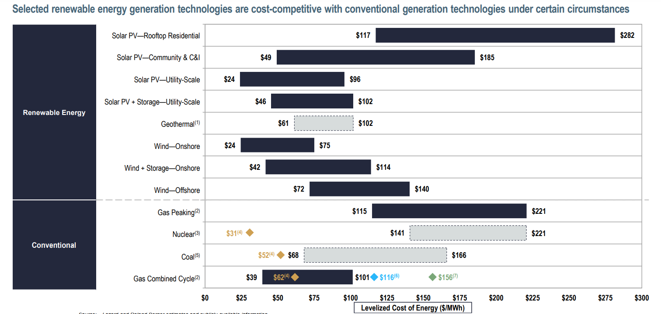
Global Levelized Cost of Energy
LCOE for Solar PV Residential= $117 - $282
LCOE for Solar PV + Storage - utility scale = $46 - $102
LCOE for Solar PV utility scale = $49 - $185
LCOE for wind onshore = $24 - $75
LCOE for wind + storage onshore = $42 - $114
LCOE for wind offshore = $72 - $140
Source: lazard’s levelized cost of energy analysis 2023
32

Slide 33

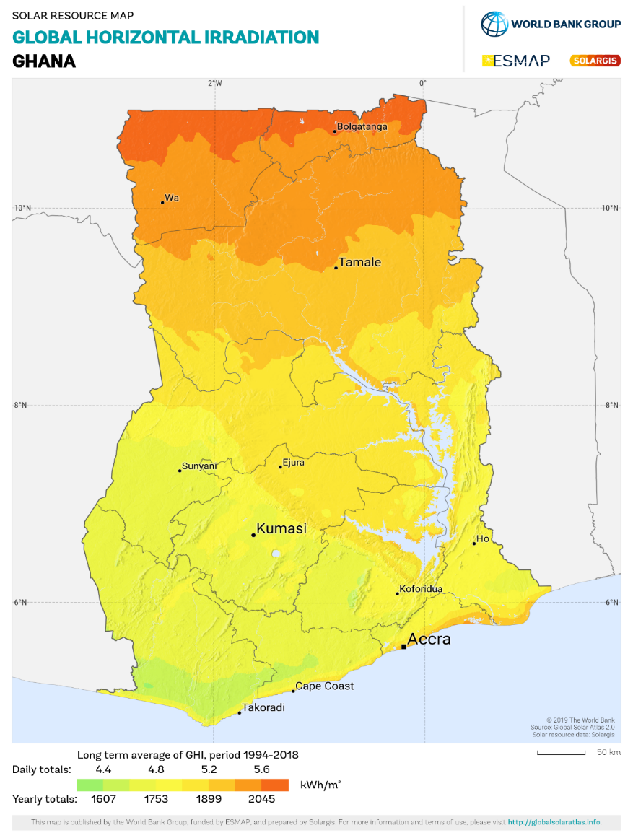
Role of Technology in Addressing Energy Issues in Ghana
Ghana has great potential for solar and wind energy, particularly along the coastal areas.
34

Slide 34
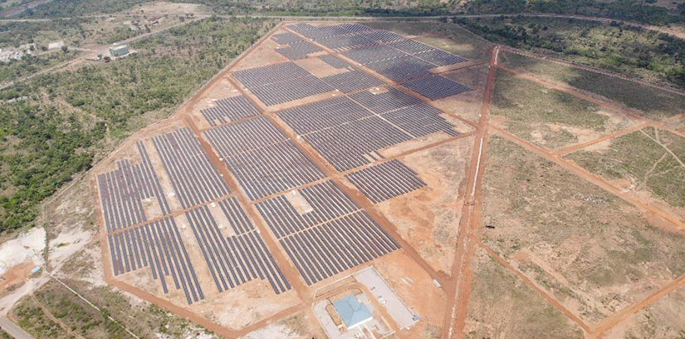
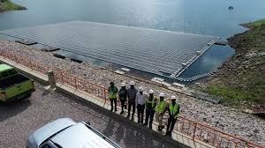

Technological Innovations in Energy Generation
Renewable Energy Technologies - Case Studies
PLANS BY Sunon Asogli
Wind Project:
Capacity: 100 MW
Location: Ada
Utility-Scale Solar Power Plants:
Total Capacity: 200 MW
Locations: Tamale, Yendi, Sawla, and Wa
Development Timeline:
First Phase: A 50 MW plant to be developed within the next 12 months
Remaining Capacity: 150 MW to be commissioned by the end of 2025
Bui 250 MWp Plant – 50 completed
Bui 4 MW Floating solar
Bui Mini Hydro Power
35

Slide 35




Technologies for Energy Efficiency
Residential Sector
Energy-Efficient Windows and Doors (Insulation): Double or triple-pane windows and insulated doors minimize heat transfer.
LED Lighting
Energy Star-rated Appliances: Refrigerators, washing machines, and air conditioners with Energy Star certification use significantly less energy
Smart Thermostats: Automatically adjust heating and cooling based on occupancy, reducing energy waste.
36

Slide 36

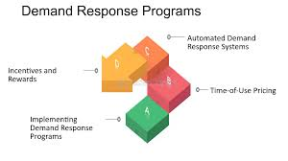

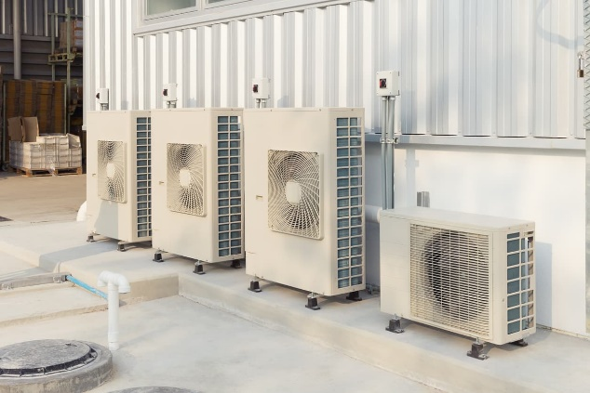
Technologies for Energy Efficiency
Commercial Sector
Building Automation Systems (BAS):
Integrate HVAC, lighting, and security systems to optimize energy use
High-Efficiency HVAC Systems: Provide precise temperature control and energy efficiency.
Green Building Certifications:
Certifications that promotes energy-efficient building practices andencourages sustainable building design and operations, leading to energy savings.
Demand Response Programs:Participating in demand response programs allows businesses to reduce or shift their energy use during peak times, lowering costs.
37

Slide 37

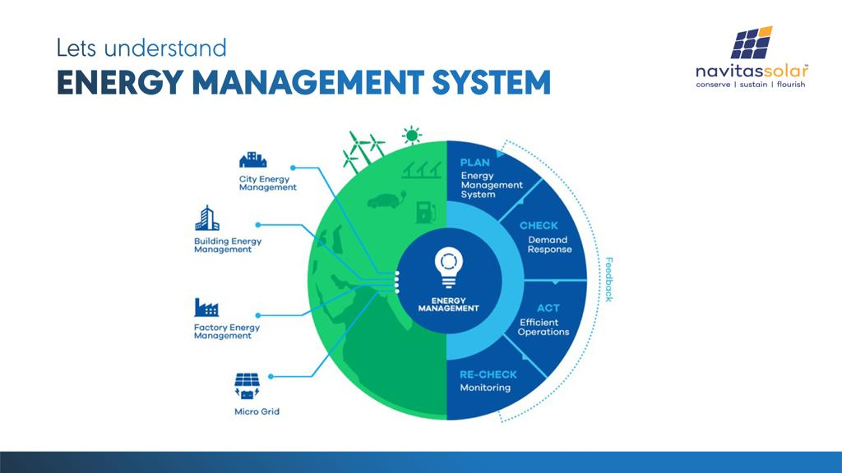

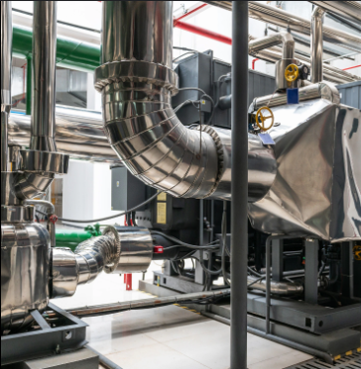
Technologies for Energy Efficiency
Industrial Sector
Process Optimization: Monitor and control energy use in real-time, optimizing processes to reduce energy waste.
Efficient Lighting and Controls: Provides better illumination with lower energy consumption compared to traditional lighting.
Waste Heat Recovery: Capture and reuse waste heat from industrial processes, reducing the need for additional energy.
High-Efficiency Motors and Drives: Uses less energy compared to standard motors, especially in continuous operation.
38

Slide 38
Policy and Regulatory Support - Role
Private Sector (Businesses And Industries)
- Invest in the research, development, and commercialization of energy-efficient technologies and solutions.
Utilities and Energy Providers
- Invest in smart grid technologies that enable real-time monitoring and management of energy use
Financial Institution
- Provide loans, grants, and other financial products to support energy efficiency projects
39

Slide 39
The way forward
To ensure the successful adoption of technologies for achieving affordable energy in Ghana, several critical steps must be prioritized:
Scaling Renewable Energy Adoption
Enhancing Energy Efficiency
Building Technological Capacity
Strengthening Policy and Regulatory Frameworks
Ghana can harness the full potential of technology to create a sustainable, affordable, and inclusive energy future for all by implementing the steps above.
40

Slide 40
Thank you

