Slide 1


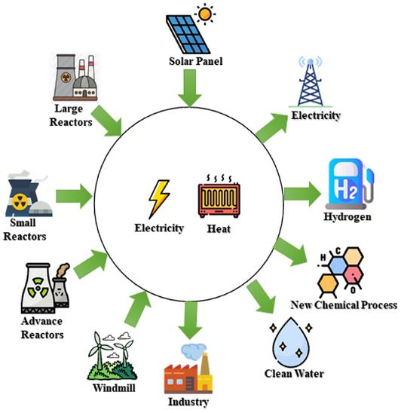

1
GHANA’S ENERGY TRANSITION PATHWAY FOR SUSTAINABLE DEV’T
Presentation By
DR. ROBERT B. M. SOGBADJI
robert.sogbadji@energymin.gov.gh ; robertmawuko@gmail.com
INNOVATIVE, AFFORDABLE AND SUSTAINABLE ENERGY IN GHANA FOR THE 4TH INDUSTRIAL REVOLUTION
GHANA SCIENCE ASSOCIATION 19TH BIENNIAL WORKSHOP, UNER, SUNYANI
10TH OCTOBERT, 2024

Slide 2
INTRODUCTION TO CLIMATE CHANGE AND ITS EFFECT

Slide 3
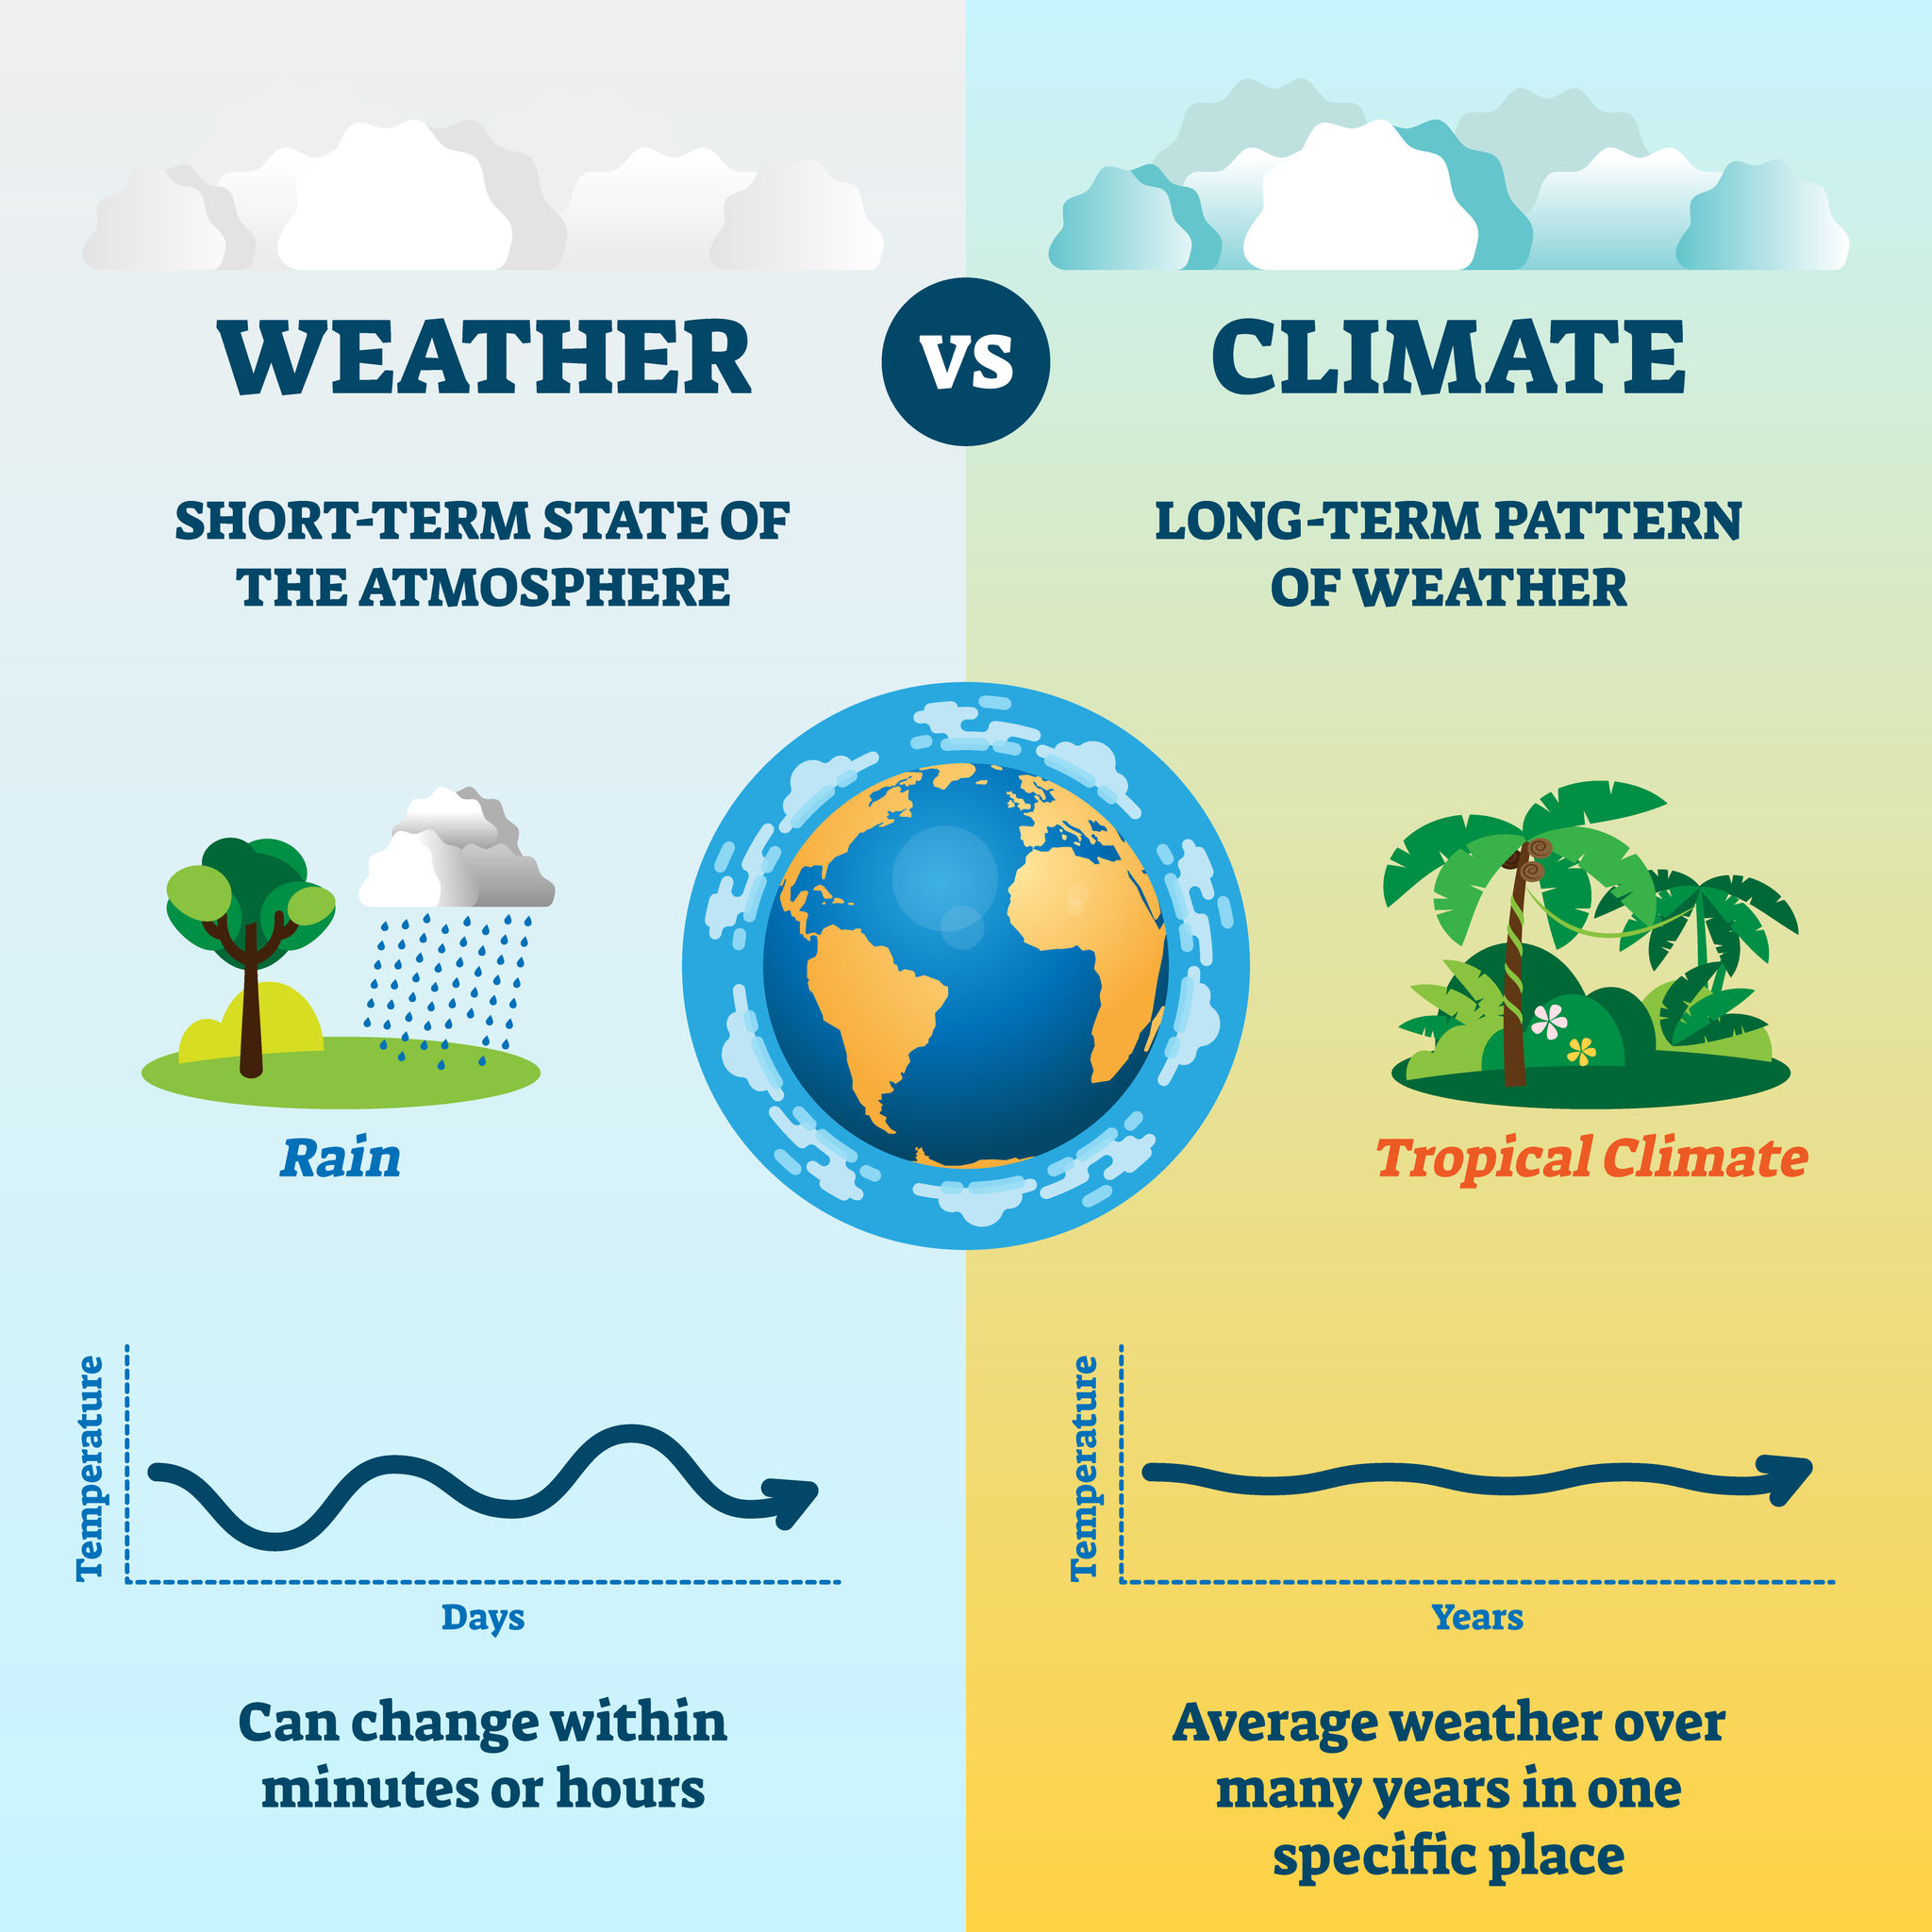

WHAT IS CLIMATE CHANGE?
Climate change is a change in the usual weather found in a place.
Such as change in temperature and rainfall — in a region over a long period of time
CAUSES OF CLIMATE CHANGE
Greenhouse gas emissions blanket the Earth, trapping
the sun’s heat leading to global warming and
climate change – CO₂, Methane, NOX, SOX, Flourinated gases
It is caused by the cumulative total of two related sources:
Natural climate change – Volcanic activities, Seasonal Solar activities etc.
Anthropogenic climate change – Human Activities such as farming,
industrilisation, transportation, Electricity generation etc.

Slide 4




SOURCES OF GREENHOUSE GASES
Generating electricity and heat by burning fossil fuels such as coal, oil and natural gas causes a large chunk of global emissions. Most electricity is still produced from fossil fuels.
Manufacturing and industry produce emissions, mostly from burning fossil fuels to produce energy for making things like cement, iron, steel, electronics, plastics, clothes and other goods. Mining and other industrial processes also release gases
Most vehicles, vessels and air planes run on fossil fuels. That makes transportation a major contributor of greenhouse gases, especially carbon-dioxide emissions. Road vehicles account for the largest part, but emissions from ships and planes continue to grow.
Deforestation to create farms or pastures, or for other reasons, causes emissions, since trees, when they are cut, release the stored carbon. Forest absorb carbon dioxide, destroying them also limits nature’s ability to keep emissions out of the atmosphere.

Slide 5



SOURCES OF GREENHOUSE GASES
Producing food requires energy to run farm equipment or fishing boats, usually with fossil fuels. Growing crops can also cause emissions, like when using fertilisers and manure.
Cattle produce methane, a powerful greenhouse gas. Emissions also come from packaging and distributing food.
Globally, residential and commercial buildings consume over half of all electricity generated. As they continue to draw on coal, oil and natural gas for heating and cooling, they emit significant quantities of greenhouse gas emissions.
Methane emissions in waste management. The use of power in your homes, how you move around, what you eat and how much you throw away all contribute to greenhouse gas emissions. So does the consumption of goods such as clothing, electronics and plastics.

Slide 6
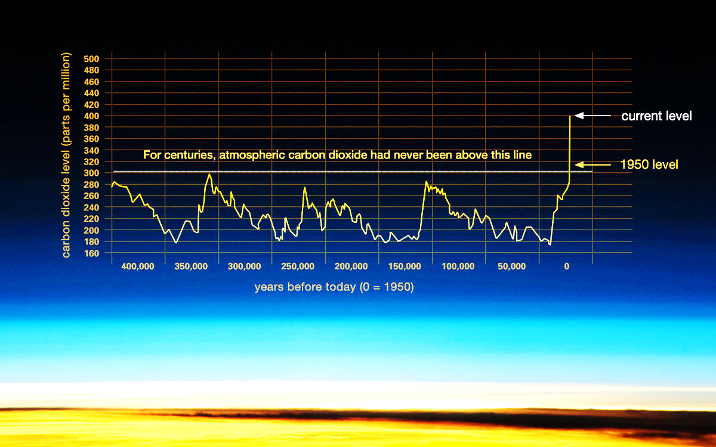
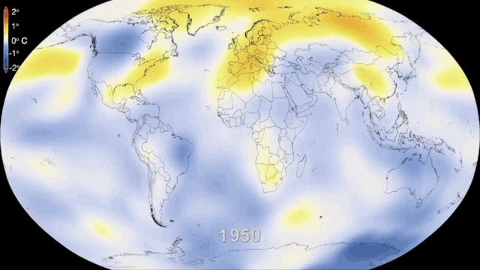
GLOBAL WARMING AND CLIMATE CHANGE
Global warming is the long-term heating of Earth's surface observed since the pre-industrial period (between 1850 and 1900) due to increased heat-trapping greenhouse gas levels in Earth's atmosphere.

Slide 7
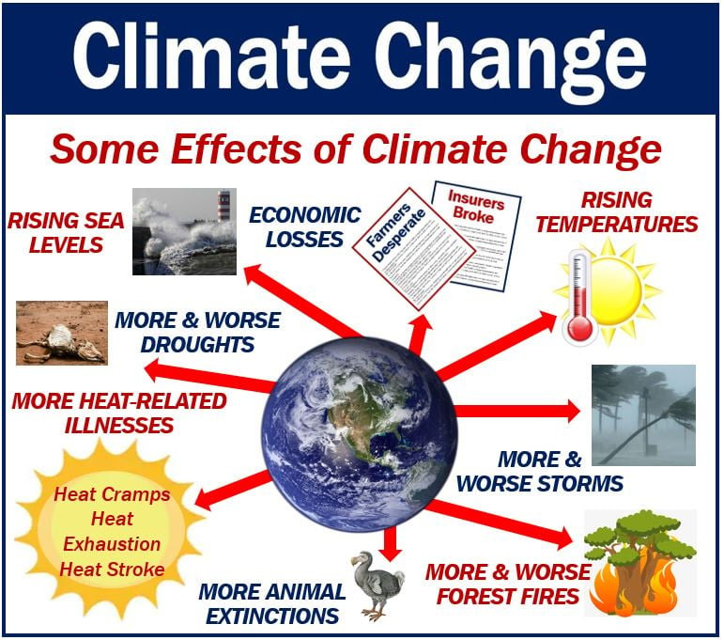
SOME EFFECTS OF CLIMATE CHANGE

Slide 8
GHANA’S GREEN HOUSE GAS EMISSION SOURCES

Slide 9
CHANGE IN GREENHOUSE GAS EMISSION BY SECTOR

Slide 10
TOTAL ENERGY SECTOR EMISSIONS MTCO₂e

Slide 11
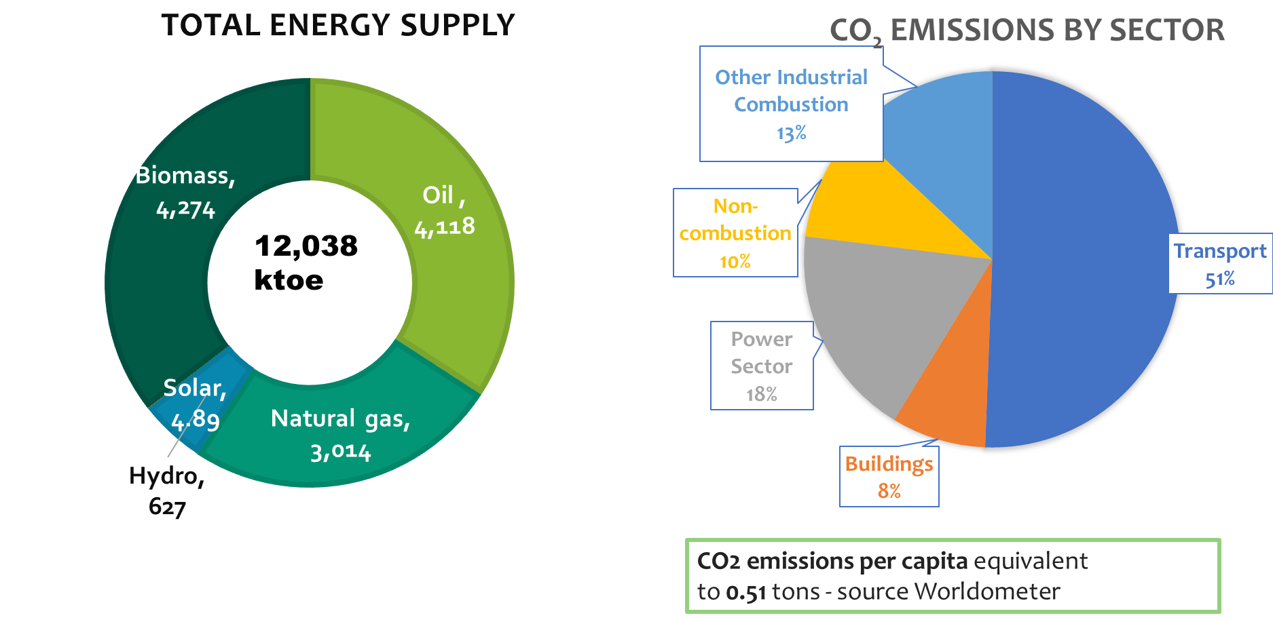
WORLD EMISSION LEVELS
World Average – 4.79tons/capita
USA – 15.52 tons/capita
China - 7.38tons/capita
Germany – 9.44tons/capita
South Korea – 11.85ton/capita
Angola – 1.06tons/capita
Kenya – 0.33tons/capita
Africa’s emission are ~3.8% of world CO₂ emissions

Slide 12
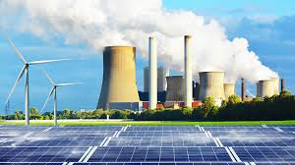
GHANA’S JUST ENERGY TRANSITION PATHWAY

Slide 13
BENEFITS & ADVERSE IMPACT
DIVERSITY IN THE ENERGY SUPPLY MIX
POTENTIAL THREAT TO ENERGY SECURITY
OPPORTUNITY TO COMMERCIALIZE THE RENEWABLE ENERGY CARBON CREDIT
REDUCED FUNDING FOR FOSSIL RELATED PROJECTS
IMPROVEMENT IN AIR QUALITY AND HEALTH
ADVERSE
IMPACTS
POTENTIAL OF STRANDED ASSETS
BENEFITS
CONTRIBUTE TO THE REDUCTION OF COST OF ENERGY IN THE LONG TERM
JOB LOSSES IN THE FOSSIL FUEL INDUSTRY
CREATION OF NEW JOB OPPORTUNITIES
POTENTIAL REVENUE LOSS

Slide 14
CHALLENGES OF ENERGY TRANSITION
Geopolitical challenges:
Financial challenges:
There is a spur for fossil fuel producing nations to resist this change as Energy transition is likely to shift control from these fossil fuel producing nations to nations with an abundance of rare earth minerals.
Effect on Russian-Ukraine Conflict on Global energy pricing
Huge capital investment needed
Difficulty in accessing cheap and ready funding by developing countries to build essential clean energy infrastructure.
Technology challenges:
Low availability factor of modern renewable energy technology.
Battery storage technology is still inefficient and less economical – performance still being improved.
Electrification of transport (heavy) industry – ships and airplane
Advancement in Nuclear Reactors, though promising are still on the drawing board. Small and Modular and Gen IV reactors

Slide 15
NEW OPPORTUNITIES
CRITICAL MINIERALS
Ghana has discovered some critical (green) minerals, including lithium and graphite which will replace hydrocarbons in the future. The key minerals and metals used in the production of the Lithium-Ion Batteries (LIB) growing demand for electricity storage facilities for power generation, electric vehicles and electronics. Government must therefore establish investor friendly mechanisms for commercial exploitation of the critical minerals and the management of revenue accruing from these minerals.
GREEN TRADING
Ghana has the opportunity to install clean energy technology to have access to the green bond market, trade carbon credits as well have access to the green commodities market
JOB CREATION
New jobs sectors will be created due to due the introduction of new technologies such hydrogen production, Nuclear power, CCUS, Renewable and electric mobilities.

Slide 16
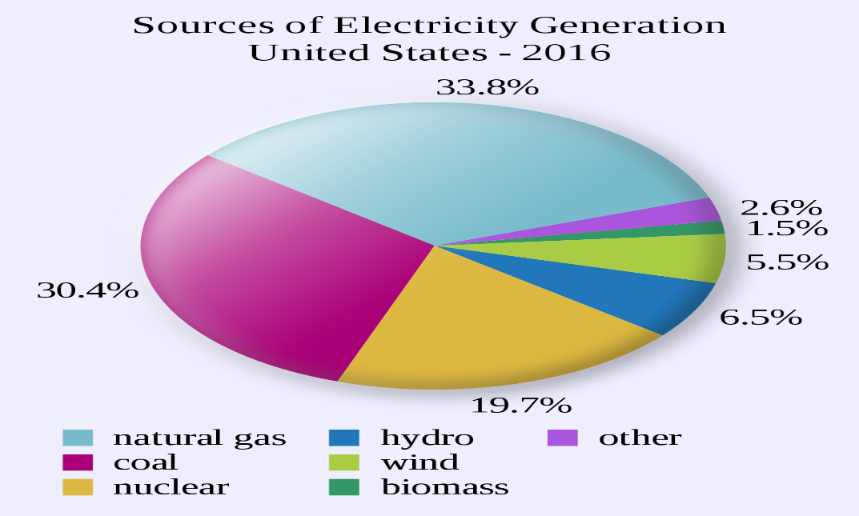
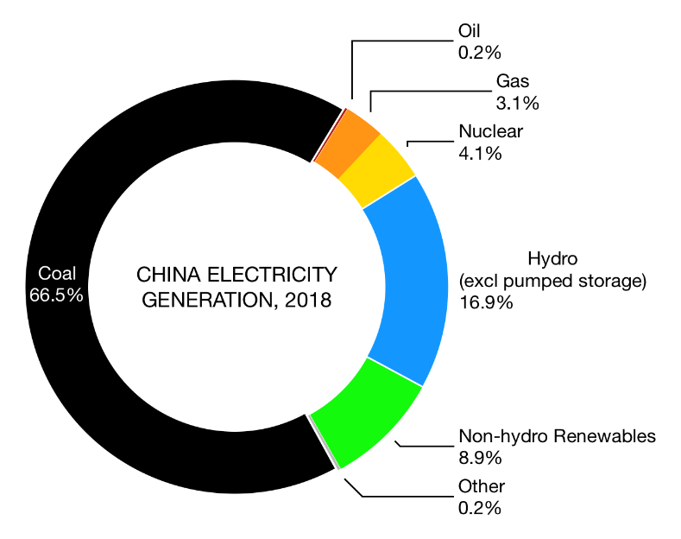
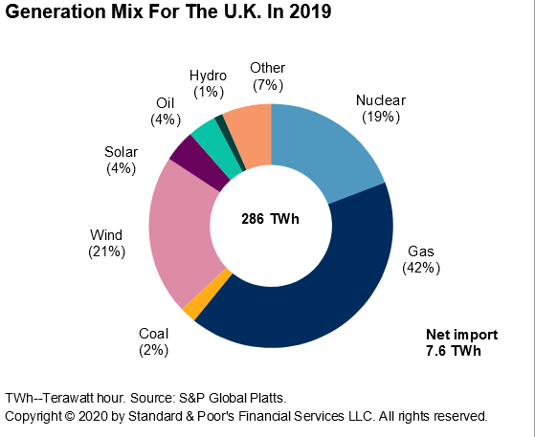
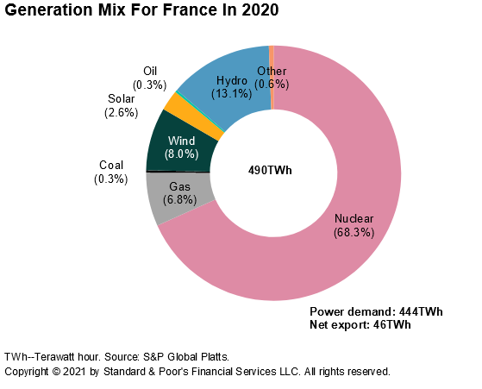
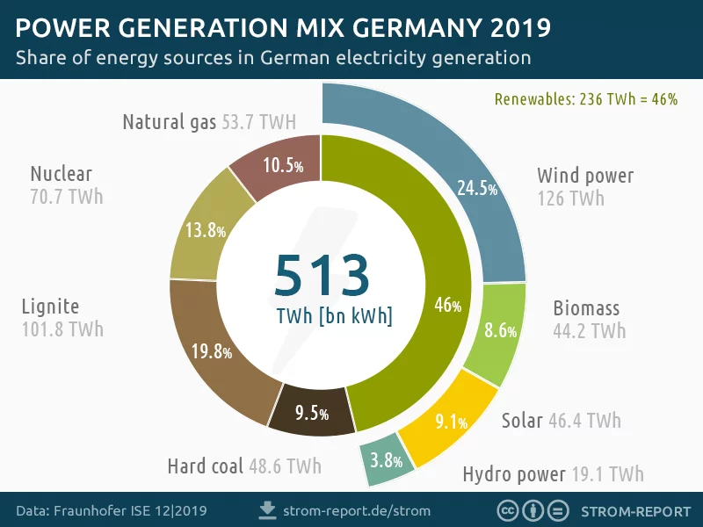
ENERGY MIX OF INDUTRALISED CONUTRIES
Ghana’s energy policy is geared towards our commitment to the Paris Agreement on Climate change and the Nationally Determined Contributions
We need to plan for future clean base-load energy for industrial growth

Slide 17
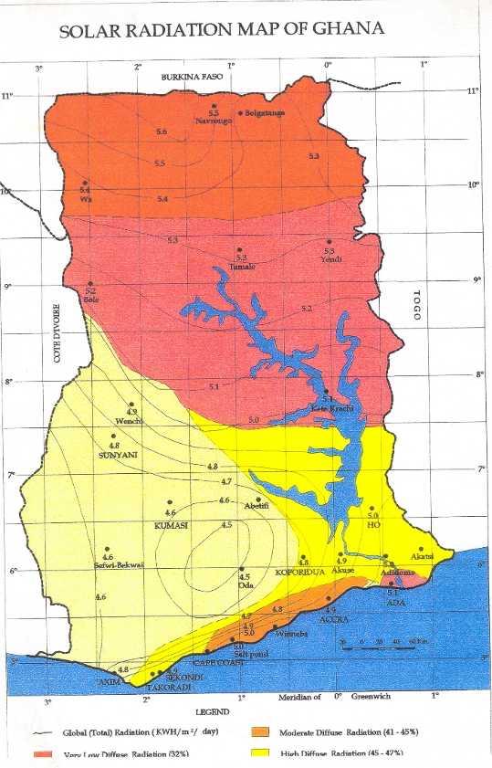
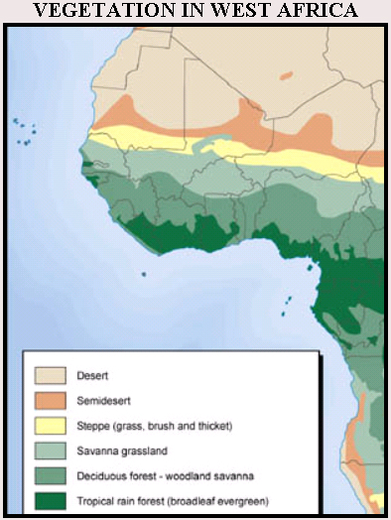
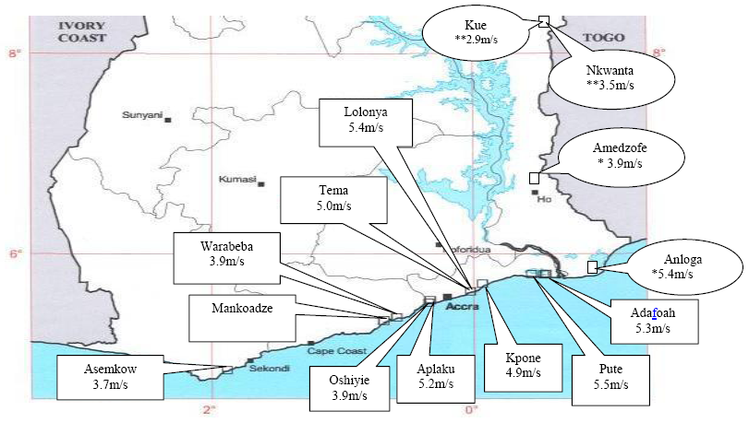
Energy Resource Potential in Ghana
Ghana has high potential for energy crops, forest and crop reside for electricity generation
Until the late 1980s, renewable energy in the form of hydro power accounted for more than 90% of Ghana’s total electricity generation
As at December 2020, the contribution of hydro and other renewable energies in the energy mix had declined to about 39% of total installed electricity generation capacity.
It is our Energy Policy to increase clean energy penetration in the energy mix
High solar irradiation 4-6 kWh/m²/day to support grid and off-grid electrification
Ghana has over 14 potential hydro sites with total capacity of 740MW yet to be exploited.
High Wind power potential along coast. Data collection at 60m & 80m height underway in 13 sites.

Slide 18
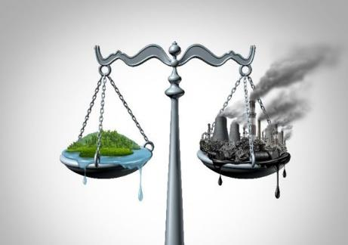
NET-ZERO ENERGY TRANSITION
Energy Transition is the pathway toward transformation of the global energy sector from fossil-based fuel to zero carbon by the second half of this century (IRENA)
Paris Agreement on Climate Change
Reduction in global emissions
The Call for Action (COP 26)
Increase investments in green energy initiatives
The UN SDG 7
Ensure access to affordable, reliable, sustainable and modern energy for all
Local Context: We want to transition to a low carbon Economy
To achieve NET-ZERO:
Emission – Mitigation = Zero

Slide 19
METHODOLOGY OF GHANA’S ENERGY TRANTIONS POLICY FRAMEWORK

Slide 20

PRELIMINARY ASSUMPTIONS
Main assumptions |  | 2021 | 2070 | Avg. Annual Growth Rate
GDP($billion) |  | 79.1 | 863.7 | 5%
Population(million) |  | 30.8 | 72.2 | 2%
Urban share (%) |  | 56.0 | 85.0 | 1%
Electricity access | National |  | 99.8% (by 2030)
 | Rural Savannah* | 57.3 | 99.8% (by 2030) | 12%
 | Rural Forest** | 60.1 | 99.8% (by 2028) | 14%
 | Rural Coastal*** | 76.9 | 99.8% (by 2030) | 4%

Slide 21
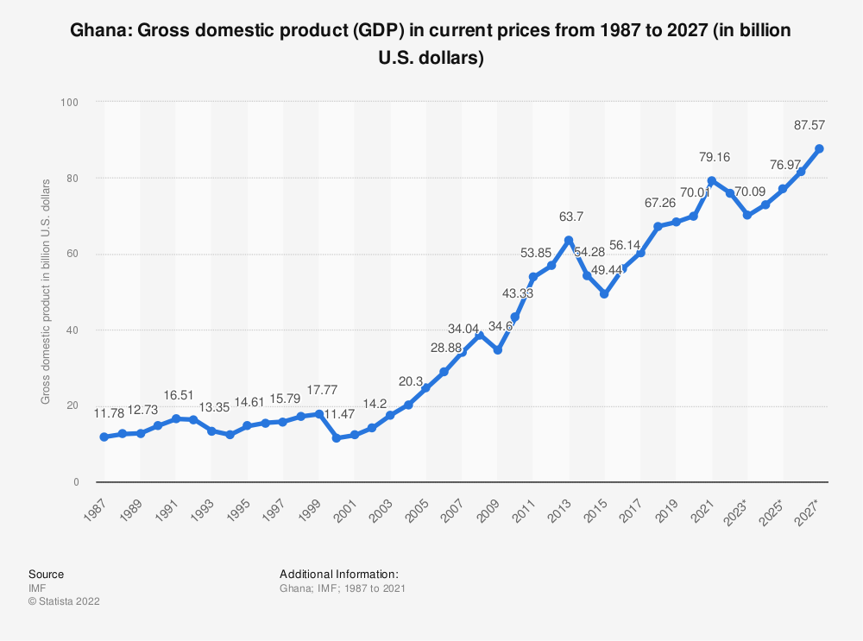

Slide 22
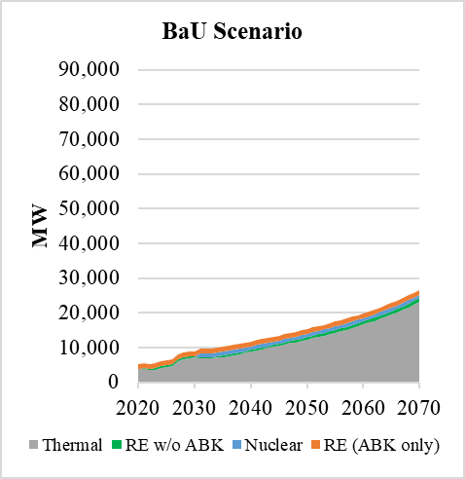
MODELLING SCENARIOS –
No Policy Intervention (NPI) SCENARIO
This is the base scenario upon which all other scenarios are assessed. It explores the effect of current policies and programmes on energy demand and supply, and its resultant emissions.
NPI Scenario
Advantage
  Low investment cost
Associated Risk
  Low energy security due to non-diversified fuel mix
  No guarantee of constant availability and supply of domestic natural gas
  Price volatility of imported gas (LNG)
  Electricity demand for e-mobility will not be met
  No carbon mitigation measures beyond 2030
  No access to green trade market

Slide 23
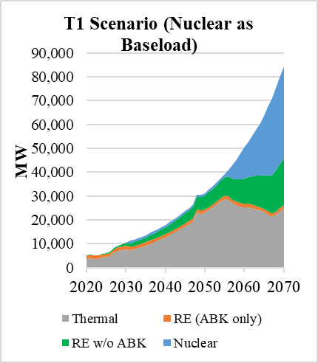
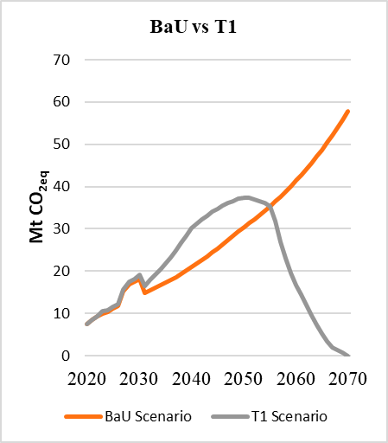
DEMAND MODELLING AND ASSOCIATED EMISSION SCENARIOS
- TRANSITION SCENARIO 1 (T1)
This scenario includes the use of nuclear for power generation; use of Carbon Capture, Utilization and Storage (CCUS) technology; use of compressed natural gas, electric, hydrogen fuel cell vehicles; sustainable aviation fuel; efficient energy transformation processes; and efficient end-use appliances.
T1 Scenario (Nuclear as baseload
NPI Vs TI Emissions
Advantages
  High energy security due to a diversified based load fuel mix
  Access to future green trade market
  Lower cost of electricity generation
  Meet future electricity demand due to fuel switch
Associated Risk
  High investment cost – introduction of CCUS and Nuclear
  Human resource and industrial capacity of new technologies

Slide 24
CUMMULATIVE ELECTRICITY COSTS
NPI
NPI

Slide 25

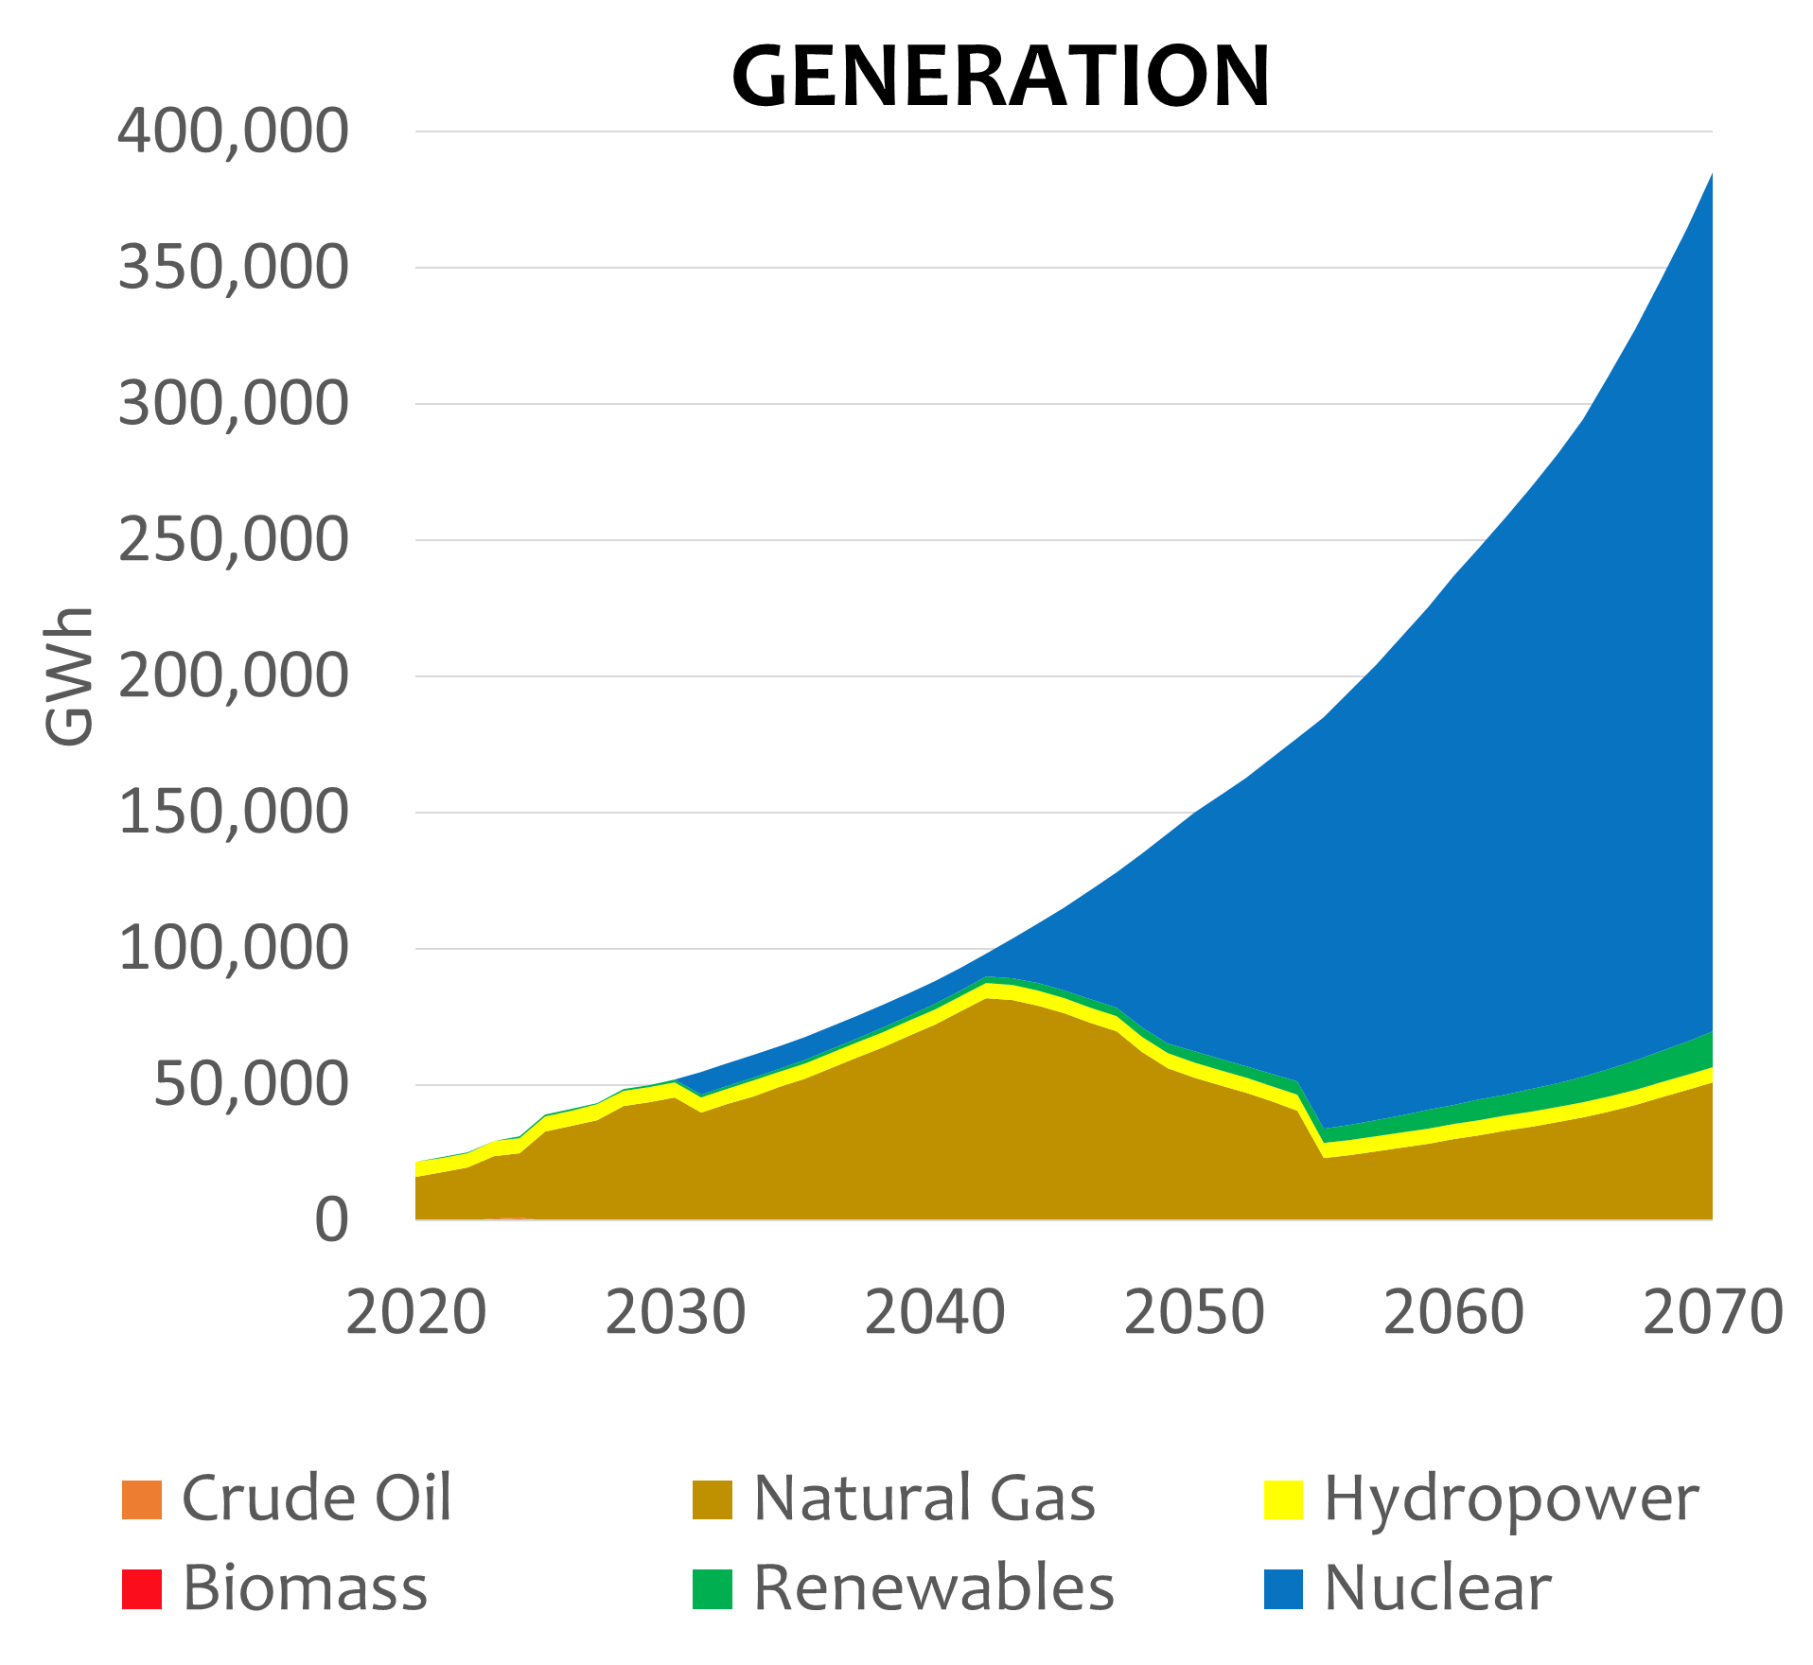
ENERGY TRANSITION ENERGY MIX
Nuclear and Gas as baseload

Slide 26

SOCIAL IMPACTS
GENDER
The extensive use of biomass especially for cooking disproportionately affect women and children who are the gatherers of these solid fuels. An improvement in access to energy both for cooking and for lighting would lead to a total avoided time loss of 30.05 million hours for firewood collection.
HEALTH
01
Minimising energy-related indoor air pollution could avoid 48,218 number of premature deaths. The reduction in fine particulate matter will prolong the lives of people in communities.
02

Slide 27

POLICIES TO ACHIEVE GHANA ENERGY TRANSITION

Slide 28
POLICIES TOWARDS ACHIEVING NET ZERO
Phase-out fossil-fuelled ICE vehicles
Introduce Carbon Capture, Utilisation and Storage (CCUS) technology in applicable thermal power plants and industries
Increase the share of renewable in the energy generation mix
Introduce and increase the share of nuclear in the energy generation mix
Introduce and promote biofuel as a transition fuel
Reduce the use of bulk road vehicles for transportation of goods
Promote the use of hydrogen fuel
DECARBONIZATION
GHG emitting industries shall be required to establish tree plantations to offset emissions.
Natural Gas shall be a transition fuel for electricity production, industrial heating and transport
Aggressively promote afforestation as carbon sinks.
Establish a regulatory framework to minimise GHG emissions from industries.
Legislate and develop rules for carbon finance and trade
Promote and encourage non-motorized transportation
Promote and encourage the use of electric vehicles

Slide 29
POLICIES TOWARDS ACHIEVING NET ZERO
ENERGY ACCESS AND SECURITY
Encourage innovation in renewable technologies.
Expedite Oil and Gas Exploration and Production to Fund development of Clean Energy Technologies
Expand Gas Infrastructure to ensure reliable and adequate supply of gas for Power and Non-Power Uses.
Facilitate the creation of industries for local manufacture of clean energy components.
Promote and encourage the use of LPG to reduce dependency on wood fuel
Encourage fossil fuel companies to invest in renewable energy projects
Prioritise green energy to attract more investment
Resource the National Oil Company to exploit national hydrocarbon resources.
Accelerate the implementation of the Petroleum Hub
Strengthen and expand power transmission and distribution systems to accommodate intermittent RE technologies
Exploit lithium and other critical mineral resources to develop the clean energy industry
Promote sustainable woodlot as biomass fuel.

Slide 30
POLICIES TOWARDS ACHIEVING NET ZERO
ENERGY EFFICIENCY
Intensify the promotion of energy efficiency programmes
Ensure the use of most efficient lamps suitable for various lighting needs
Encourage and promote the use of best-in-class energy appliances.
Promote energy efficiency in Small and Medium Scale enterprises.
Encourage the construction of energy efficient buildings.
Encourage the use of clean cookstoves.

Slide 31
POLICIES TOWARDS ACHIEVING NET ZERO
CROSS CUTTING
Decentralize the energy transition implementation process
Establish an energy transition fund
Incorporate energy transition into the curricula of academic institutions.
Create public awareness on the effects of continuous use of fossil-based energy and its impact on climate
Encourage regional cooperation among African countries for the development of clean energy initiatives.
Mainstream gender in the implementation of energy transition plan
Resource key technical educational institutions to undertake research and development in clean energy systems
Promote alternative livelihood programmes for persons affected by energy transition
Promote local content and local participation in the implementation of Energy Transition programmes
Encourage private sector participation in energy transition programmes
Promote low-carbon systems technologies to stimulate new business ventures

Slide 32


PROJECTS AND PLANS

Slide 33
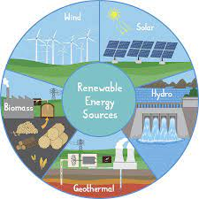
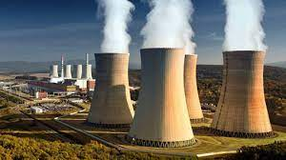
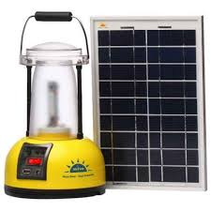
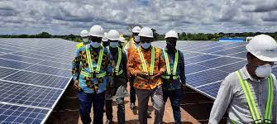
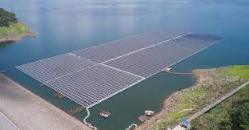
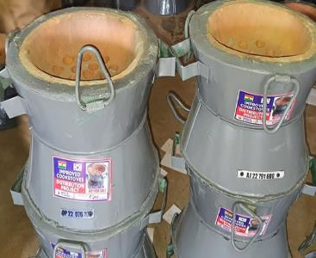
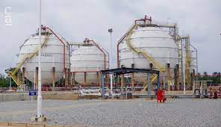

CURRENT ENERGY TRANSITION RELATED ACTIVITIES
02
07
03
Replacement of kerosene lanterns with solar lanterns.
Developed a Renewable Energy Master Plan
Development of Nuclear Power Programme
01
Achieved 3.1% Solar PV (Renewable Energy 36%) penetration
06
Improved Charcoal Stove distribution
04
05
Mienergy (20 MW)
BXC (20 MW)
BPA Solar (51MW)
VRA Solar (17MW)
Minigrids(250kw)
Achieved 95% Conversion of thermal plants from Liquid fuels to Natural Gas
LPG promotion

Slide 34
CURRENT ENERGY TRANSITION RELATED ACTIVITIES CONT’D
08
09
10
11
Conversion of Single cycle thermal plants to combine cycle thermal plants
Zero Gas Flaring Policy
Establishment of Ghana Petroleum Hub Corporation
Shifting to e-mobility

Slide 35
SHORT TO MEDIUM TERM PLANS & ACHIEVEMENTS
Collaborating with the Development Partners and ECOWAS to produce Green Hydrogen as clean fuel
Regulation on road transportation of CNG completed to commence the implementation of CNG as substitute fuel for public transportation
Waived off taxes on the importation of Electric Vehicles
National electric vehicle policy developed
Aggressively increasing Renewable Energy Penetration through SREP and NET-METERING programme.
Dialogue on Bioethanol fuel blending has commenced with the NPA and its stakeholders
Carbon capture technology also aggressively being perused
Ghana supports other African countries to develop their own Energy Transition Plan

Slide 36
MEDIUM TO LONG TERM PROJECTS IMPLEMENTATION AND PLANS

Slide 37
2030
2040
2050
2070
New sales of household electrical appliances are best in class
Commencement of net-zero emission in electricity generation
More than 50% of water heating systems are solar heaters
More than 70% of rural households use LPG for cooking
More than 50% of metro urban households use electric stove
More than 60% of cooling appliances and systems are best in class
Introduction of sustainable aviation fuel
More than 98% of all appliances and cooling systems are best in class
Phasing out of off-road fossil-fueled ICEs
More than 90% of household electrical appliances are best in class
More than 95% of households are electrified
All road and rail mobility are electricity and H₂ fueled
Phase out fossil liquid-fuel for electricity initiated
More than 70% road vehicles are EVs and H₂
Introduction of CNG-fueled ICEs and trains
Net-zero emission in electricity generation in mid-60s
10% of electricity generation capacity is RE
20% of electricity generation capacity is RE
85 Mt CO₂-eq Avoided
180 Mt CO₂-eq Avoided
Minimum of 30% Renewable Energy (10% - Solar and Wind) in the electricity generation mix
Carbon capture technology introduced in Gas thermal plants
Renewable, Nuclear and Carbon-Capture Gas-to-Power technology in the electricity generation mix
Nuclear Energy introduced in Generation Mix

Slide 38
CONCLUSION

Slide 39
GHANA’S ENERGY TRANSITION PROJECTED ENERGY MIX
20% Renewable (21GW)
34% Gas Thermal
46% Nuclear Energy
27% Renewable
40% Gas Thermal
33% Nuclear Energy
26% Renewable
70% Gas Thermal (Intro. of Carbon Capture)
5% Nuclear Energy (First nuclear plant in energy mix)
30% Renewable (10% Modern Renewable)
70% Gas Thermal

Slide 40
HIGHLIGHTS OF GHANA’S ENERGY TRANSITION FRAMEWORK
It is a long-term framework (2022 – 2070);
Guarantees the best fuel supply security due to a diversified fuel mix including natural gas and nuclear energy;
Estimated 200MtCO₂-eq emission avoided (T1 emission - 14.5MtCO₂-eq);
Access to and commercialization of the green trade market (21GW of installed capacity);
Achieves universal access to electricity – 99.8% by 2030;
Lower long-term cost of electricity generation - below 4.5cents/kWh;
Meets future electricity demand of 380,000 GWh (83GW install capacity) due to fuel switch;
Minimises energy-related indoor air pollution and its related illnesses - 48,218 premature deaths avoided due to improvement in air quality and health;
30.05 million productive hours gained due to the upscaled adoption of clean cooking fuels. This would have a significant impact on women and children who are the main gatherers of firewood;
New job opportunities to be created is estimated at 1,404,702 due to the introduction of new technologies such as CCUS, Nuclear, Hydrogen, EV charging stations, etc.;
Achieves just and equitable transition both in universal access to electricity and the exploitation of our natural resources to support economic development; and
Requires estimated financing to the tune of US$562 billion.

Slide 41





Conclusion 16
NATIONAL ENERGY TRANSITION COMMITTEE
..Moving
Towards
Net-Zero
THANK
YOU

Slide 42


